Slide 1
Infection Prevention & Control
Practical, Evidence-Based Approach
Prof. T. Ramdin
Every missed clean = a preventable infection

Slide 2
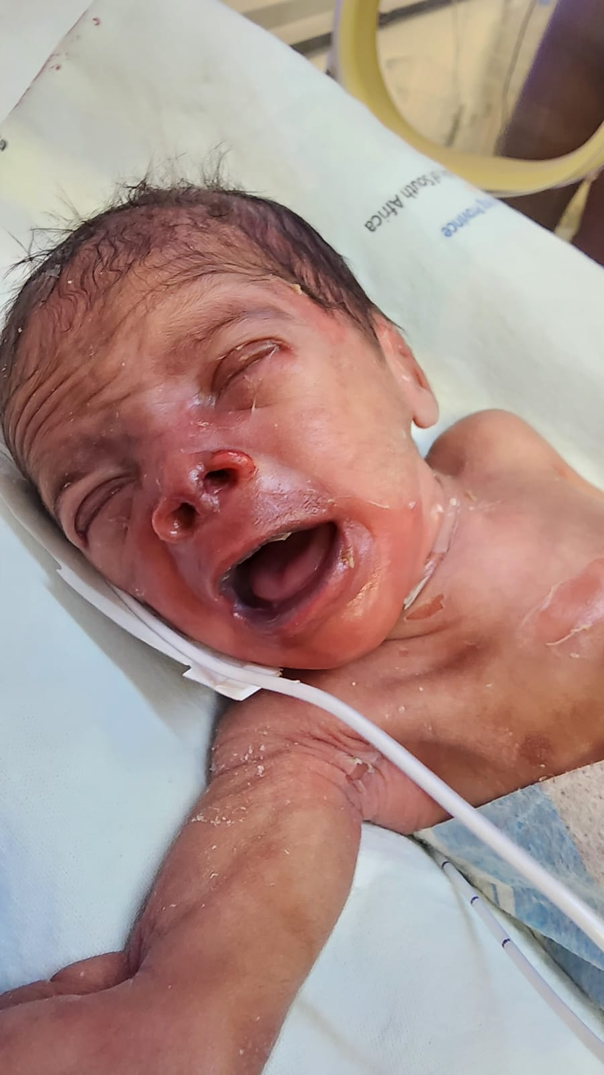
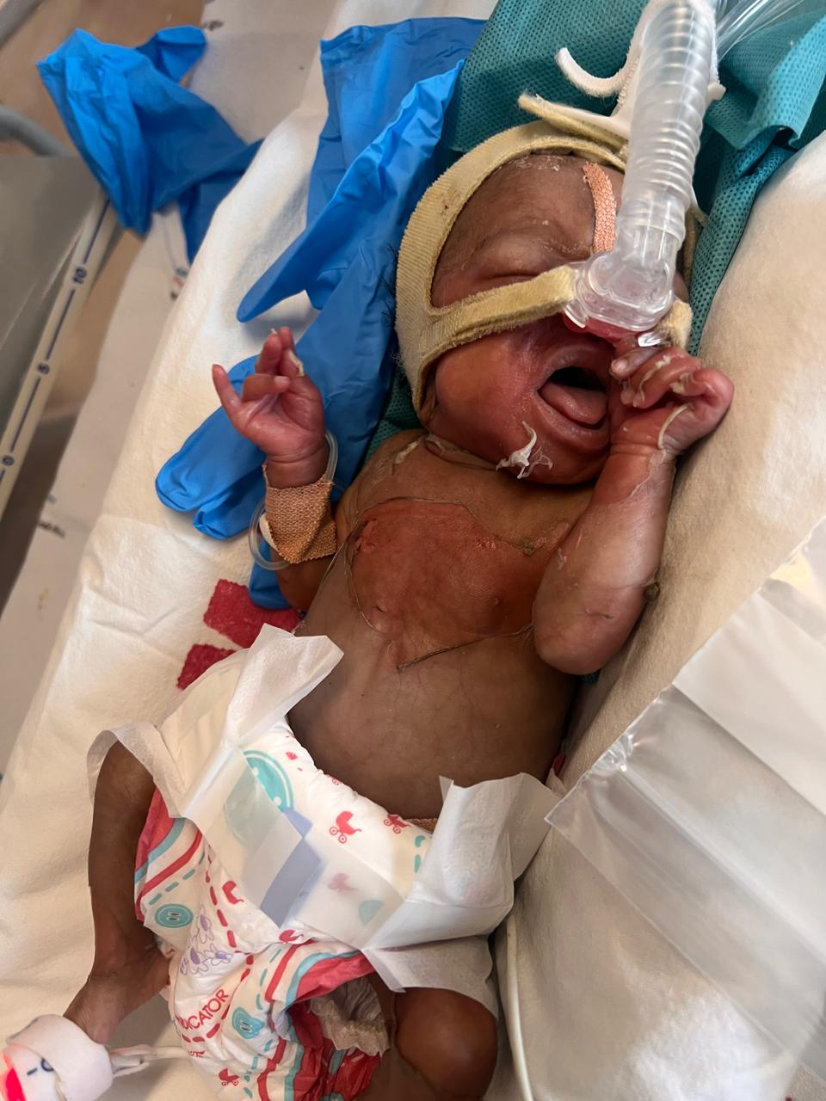
Case presentation Neonatal outbreak with severe skin involvement

Slide 3
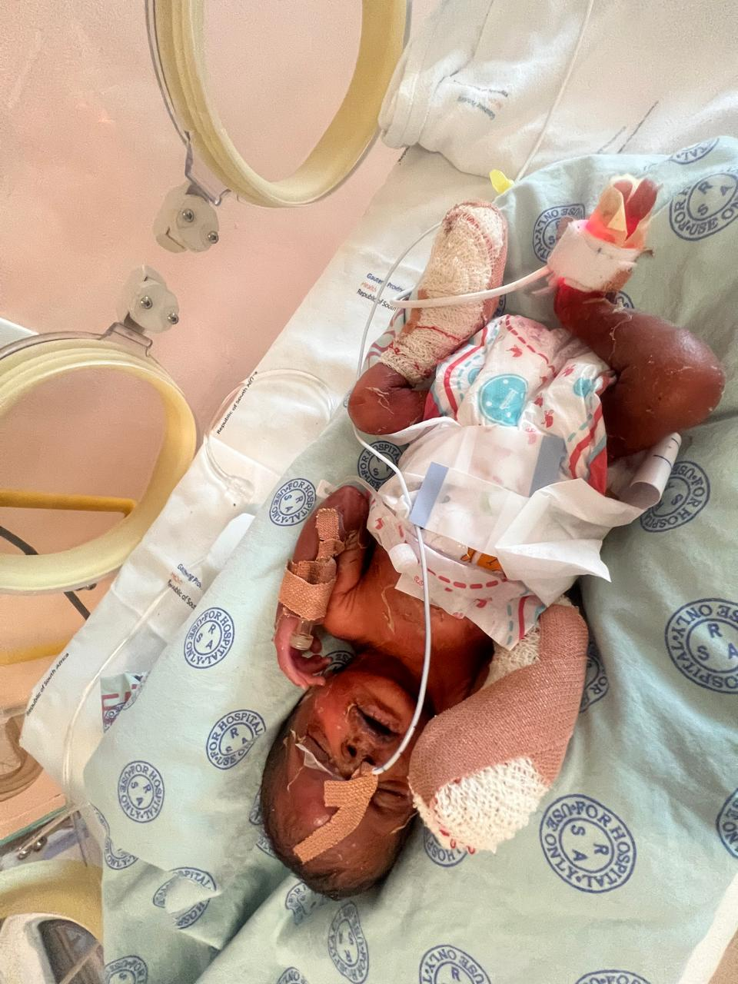
Notes:
Multiple patients deteriorating rapidly
High morbidity and mortality risk

Slide 4
Differential diagnosis
Staphylococcal scaled skin syndrome
Drug reaction
Contaminated feeds or infusions
Epidermolysis bullosa

Slide 5
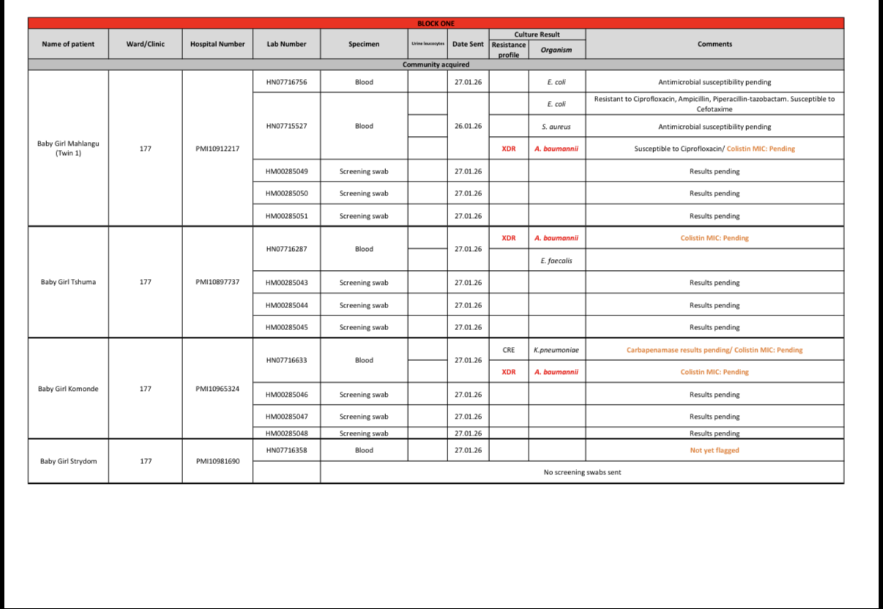
Blood culture results

Slide 6
Core Message
Most healthcare-associated infections are preventable
Failure is due to systems, not knowledge
IPC requires implementation, not just guidelines

Slide 7
IPC Audit and Checklist
Hand hygiene compliance
Correct disinfectant & labelling
Bleach dilution correct
Clean → dirty, top → bottom
High-touch surfaces cleaned
No double-dipping
Correct PPE
Equipment clean & dedicated
Waste segregation
Monitoring & feedback

Slide 8
Neonatal IPC bundle
Strict hand hygiene
Dedicated equipment
Daily incubator cleaning
Terminal cleaning
Safe breastmilk handling
Minimal handling
Antibiotic stewardship
Skin protection
Visitor control
Weekly audits

Slide 9
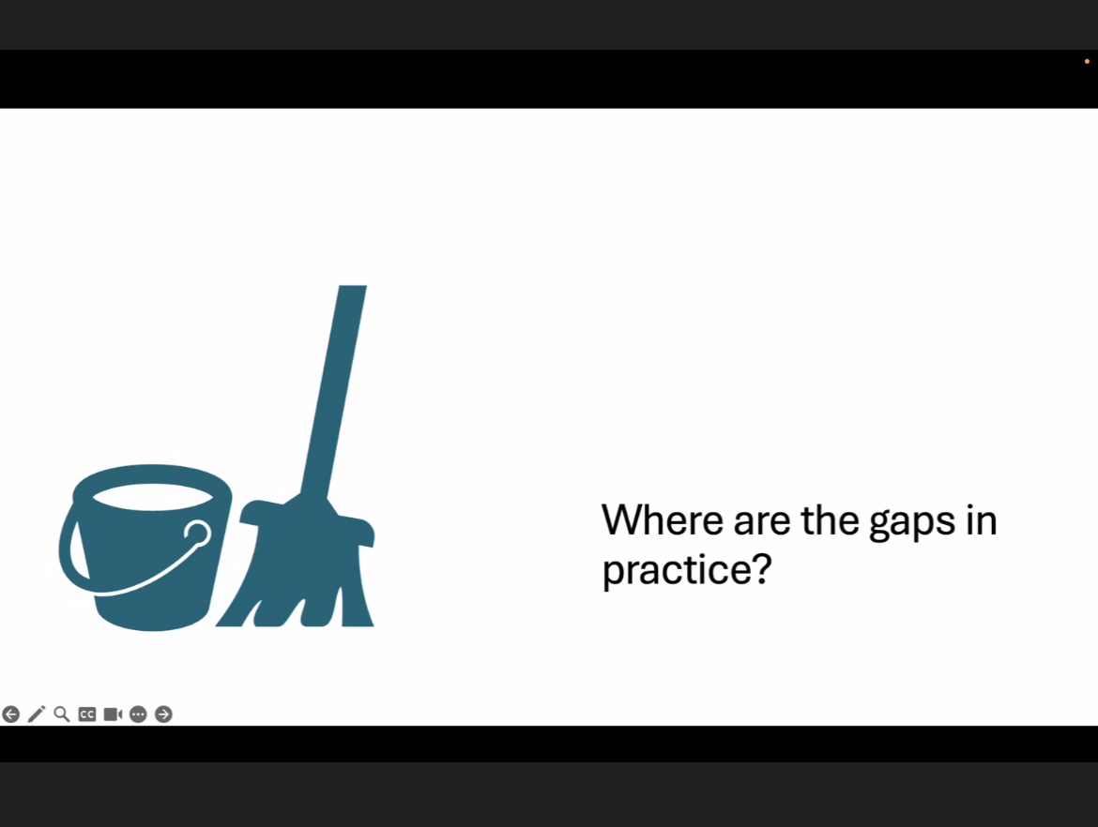
Where are the gaps in practice?
Identifying system-level failures

Slide 10
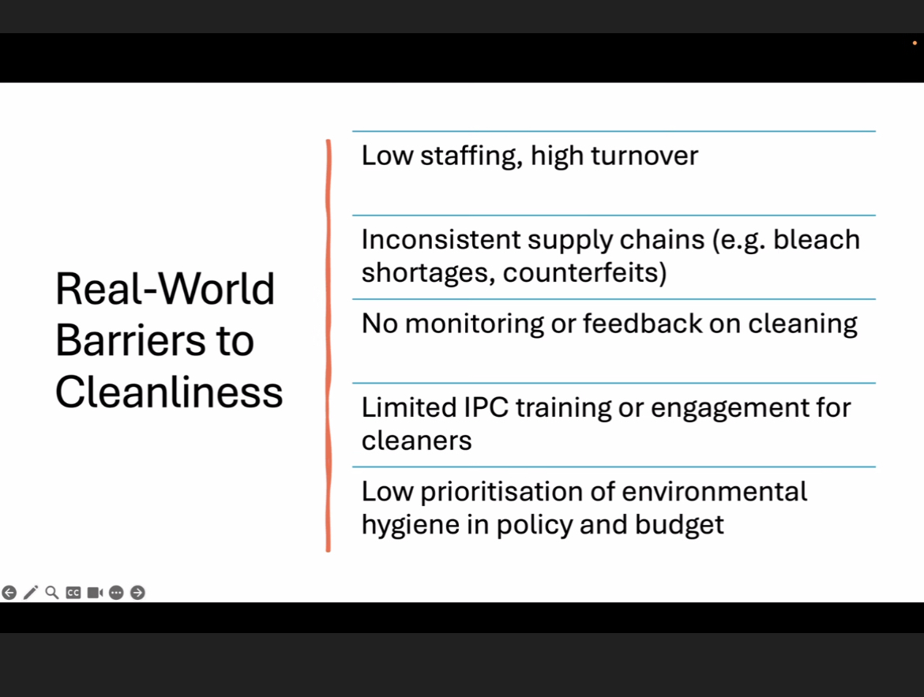
Real-world barriers
Staffing, supply chains, training gaps

Slide 11
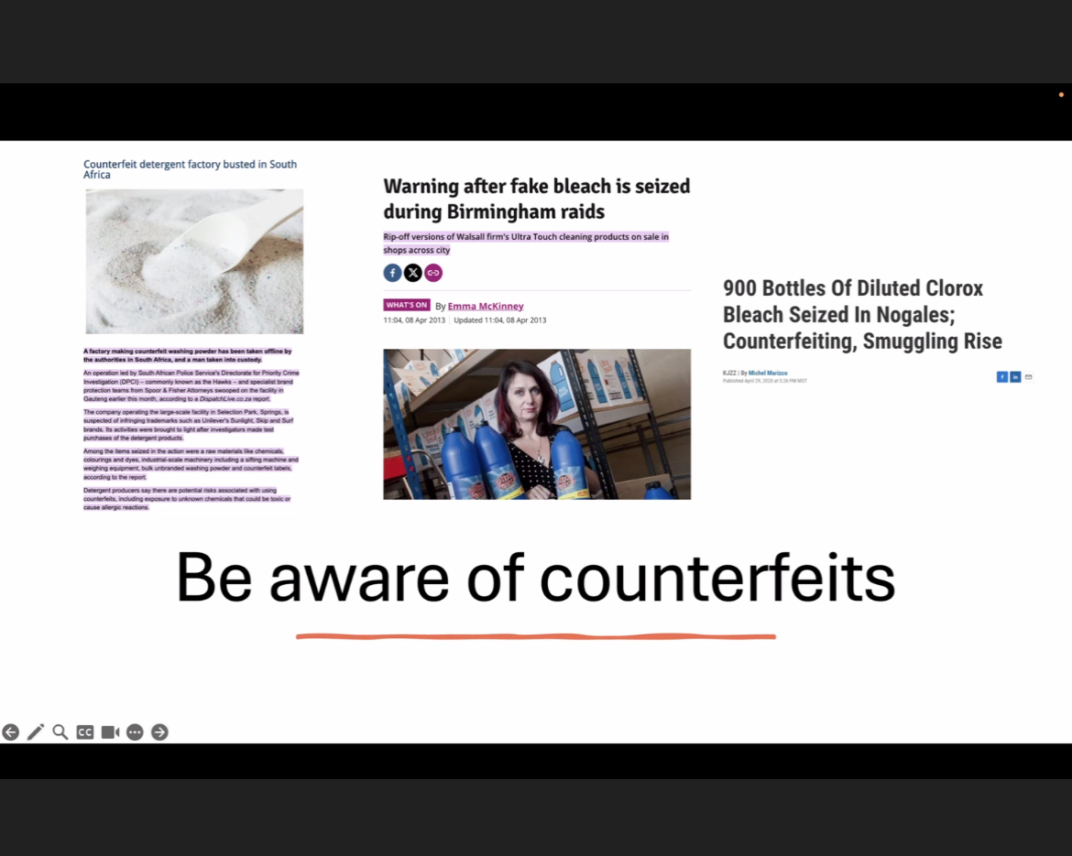
Beware of counterfeits
Substandard disinfectants undermine IPC

Slide 12
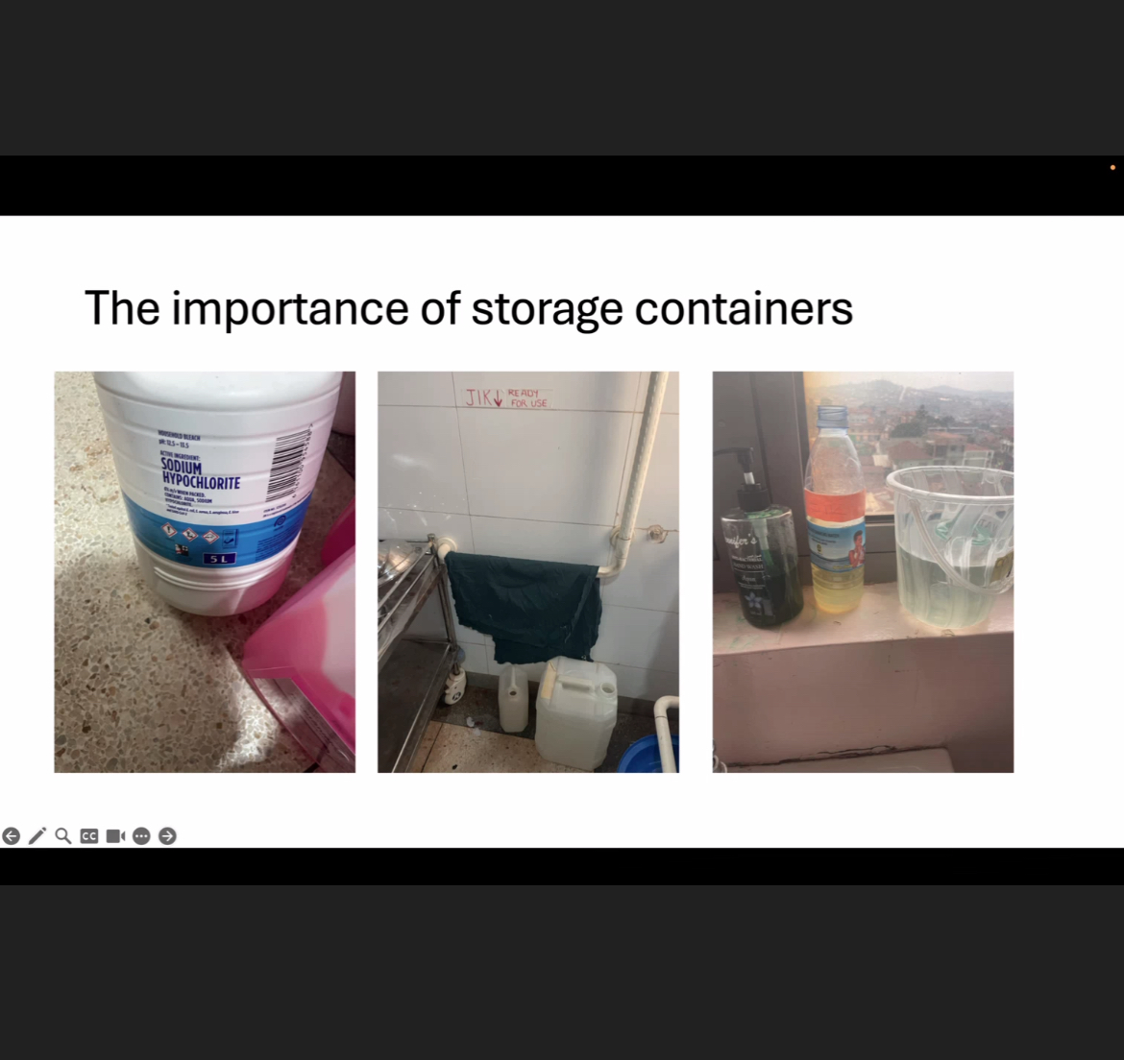
Storage matters
Safe, labeled, and dedicated containers

Slide 13
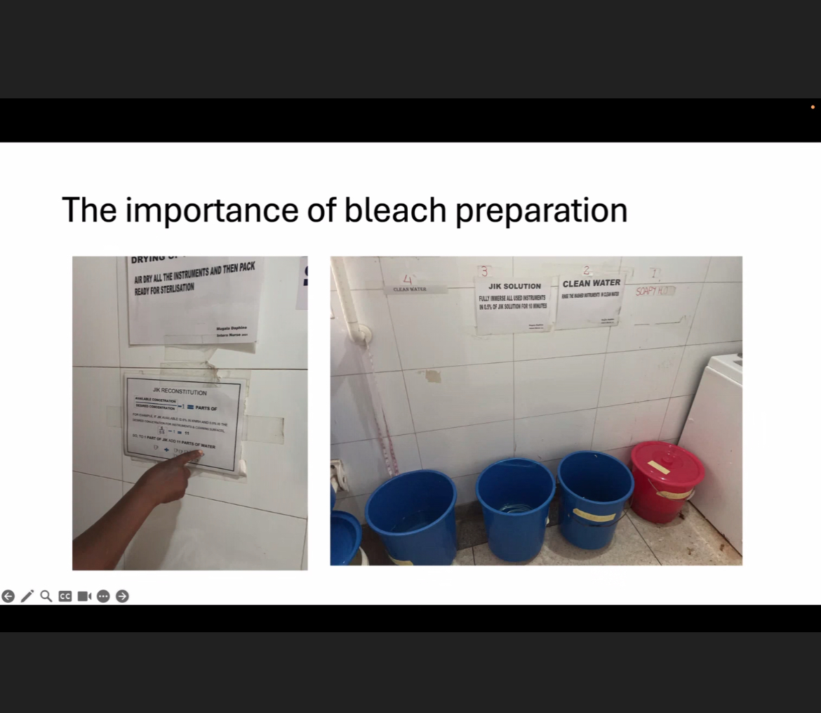
Bleach preparation
Correct dilution and workflow is critical

Slide 14
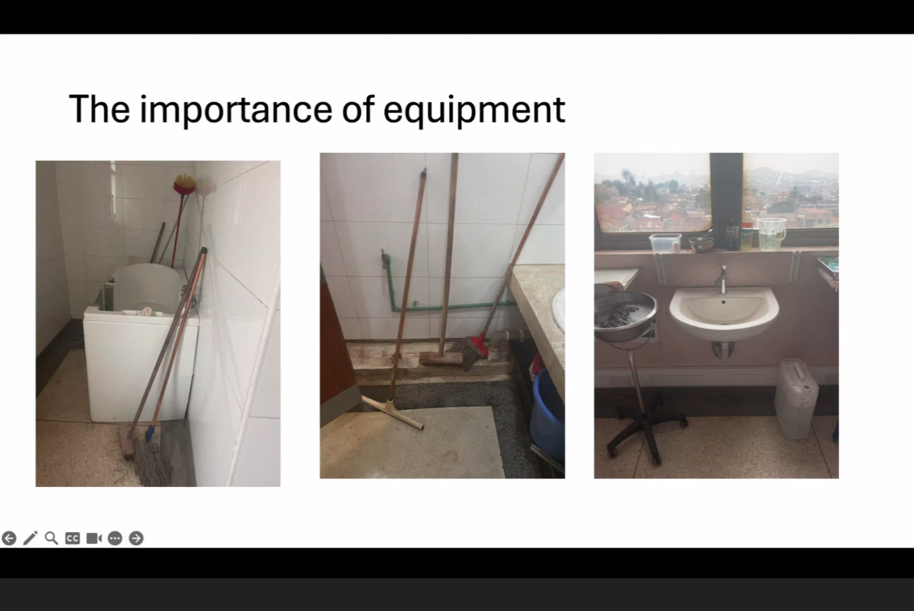
Equipment hygiene
Dedicated, clean, and well-maintained tools

Slide 15
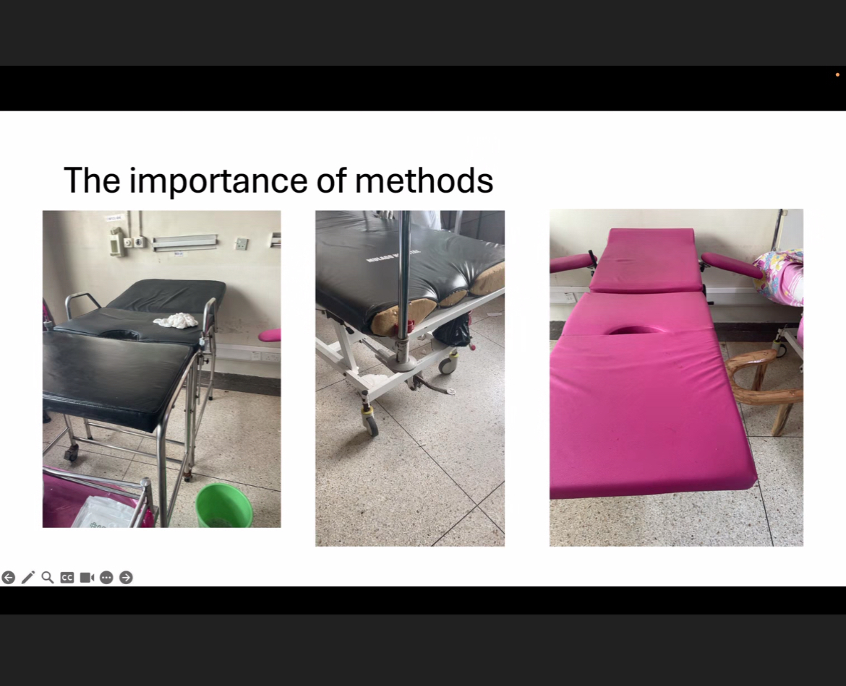
Methods matter
Standardised cleaning techniques improve outcomes

Slide 16
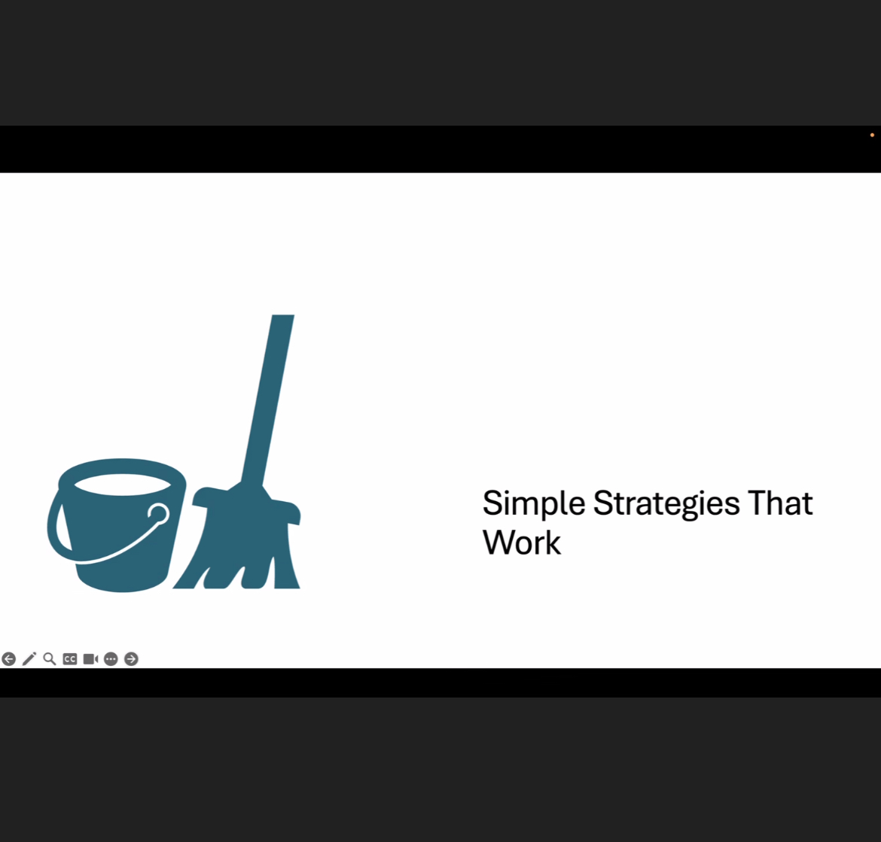
Simple strategies that work
Low-cost, high-impact interventions

Slide 17
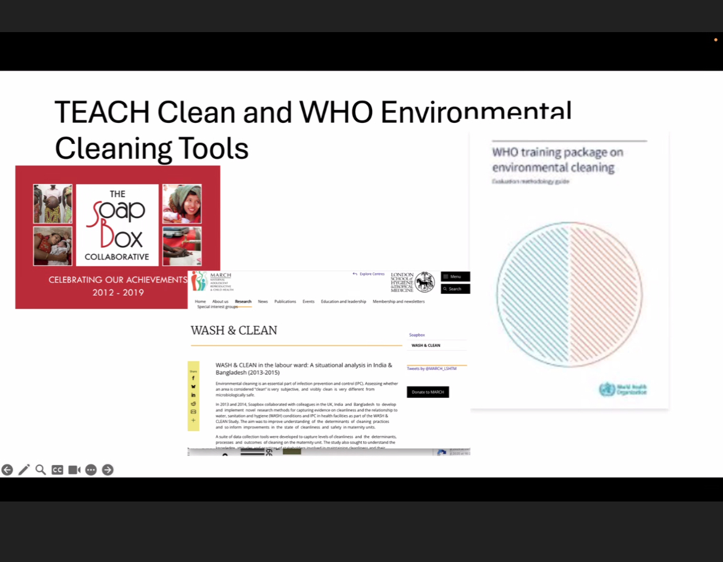
Teach & standardise
WHO tools and structured training

Slide 18

THE EVIDENCE and Statistics ‘Problem to be solved’

Slide 19
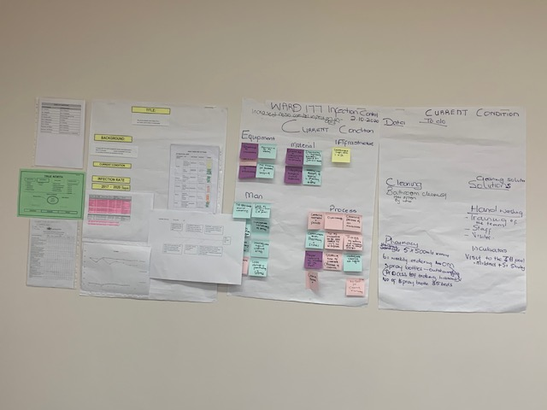
Implementation of LEAN MANAGEMENT ‘problem solving’
Background: Lean was adopted from the Japanese car manufacturer Toyota to streamline processes and improve quality and efficiency.
Flow Charts: a series of activities that translate data inputs to outputs
Visual Management: colour and picture to monitor the process and send feedback where there are problems
Standardisation -5S method
Equipment
Man
Material
Process
Infrastructure
Incorporating lean principles in a cultural change and teamworkk

Slide 20
Lean Team
Members | Coach/SUPPORT ERS
Dr T Ramdin | CEO- ???
Dr Y Mavunda | IPC: Tina Thomas
Sr M Dolo | Director Nursing: M Pule
Sr S Mobai (IPC) | Prof Mulaudzi
W/C P Mkhonjana | CM: Dr Afriiva
G/A T. Malumane | AM: G Galetlole
G/A C Sithole | OM: N Selekane
Operator: M Mgoqi | D/D: O Khumalo
Operator M Makua | Cleaning Supervisor: Mrs E Madiope
Security : Junior

Slide 21
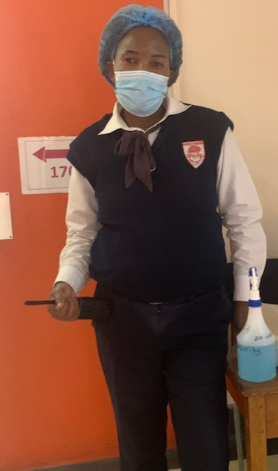
THE POLICE OFFICER OF WARD 177

Slide 22
Protocols and Guidelines
ISOLATE/COHORT
HAND HYGIENE: 5 MOMENTS+ DO NOT MOVE THE DEGERM
CONTACT PRECAUTION: GLOVES AND APRONS
TRANSMISSION PRECAUTIONS: EQUIPMENT AND CHLOROHEXIDINE BATHS
ENVIRONMENTAL CLEANING
SURVEILANCE: All close contacts and transfers rectal swabs
EDUCATION: ALL STAFF

Slide 23
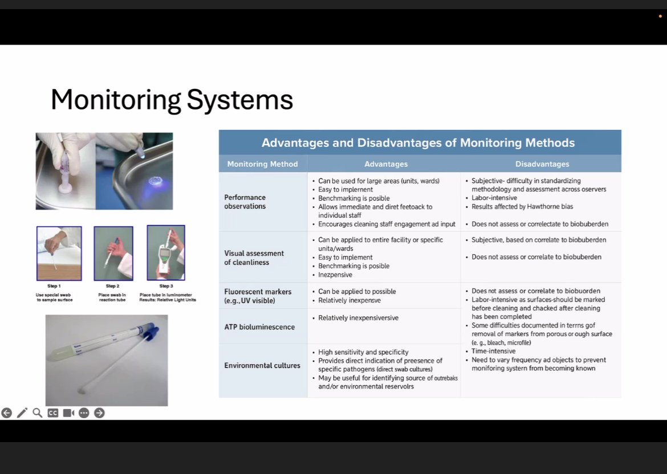
Monitoring systems
Audit, feedback, and continuous improvement

Slide 24
Top 10 IPC Pearls
Cleaning saves lives
Technique > product
Contact time matters
High-touch surfaces critical
Do not mix chemicals
Label everything
Avoid double-dipping
Train cleaners
Audit & feedback
Standardise practice

Slide 25
Final message
Cleaning is high-impact
Systems drive outcomes
Empower staff
Measure & improve
IPC is everyone's responsibility

