Slide 1
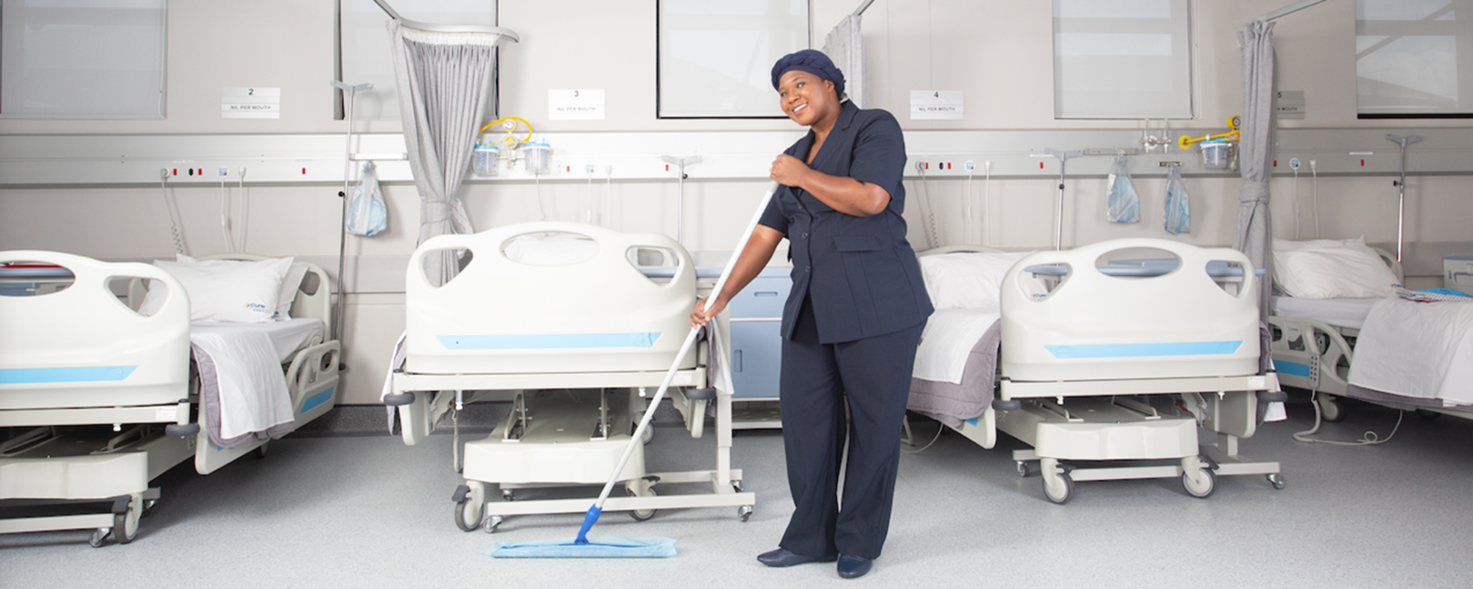
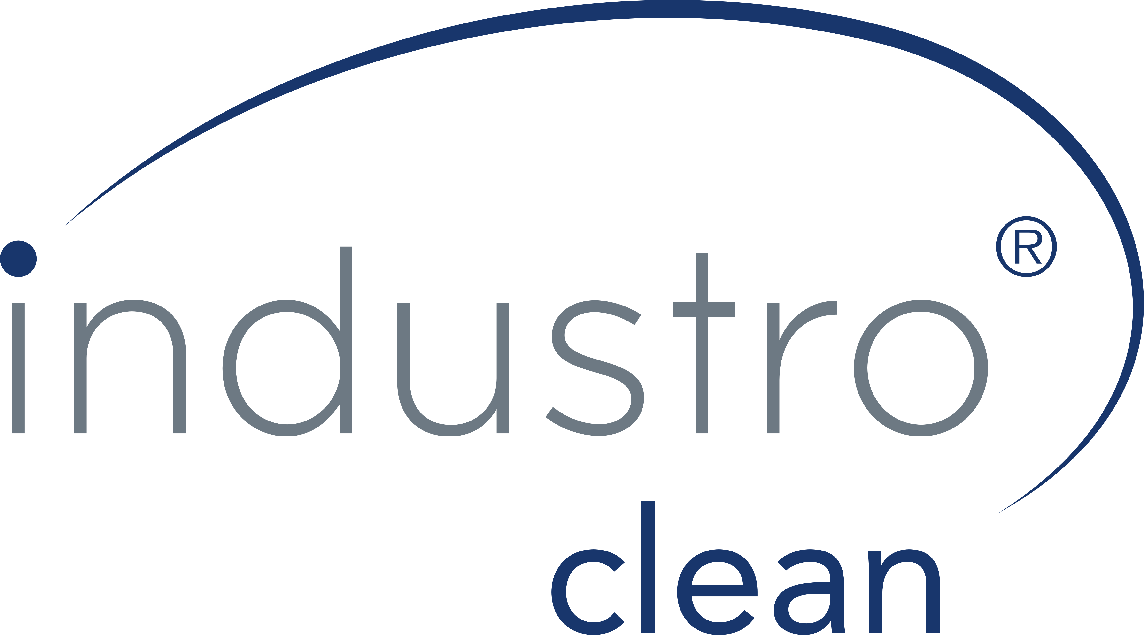
Industroclean Gics
The good and bad practices

Slide 2
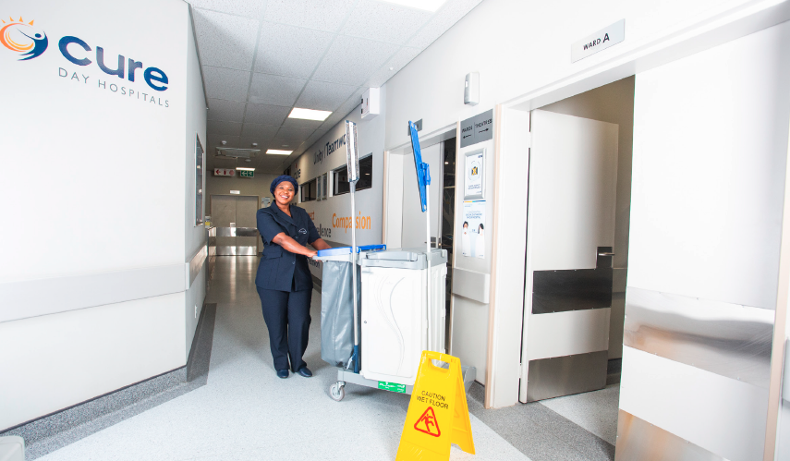
THE IMPORTANCE OF CLEANING IN A HOSPITAL
A large number of patients, many with infections are present within the hospital environment [Immune compromised]
Micro-organisms present in this environment will include a proportion of virulent anti-biotic resistant strains.
Patient care involves hand contact by nursing staff.

Slide 3
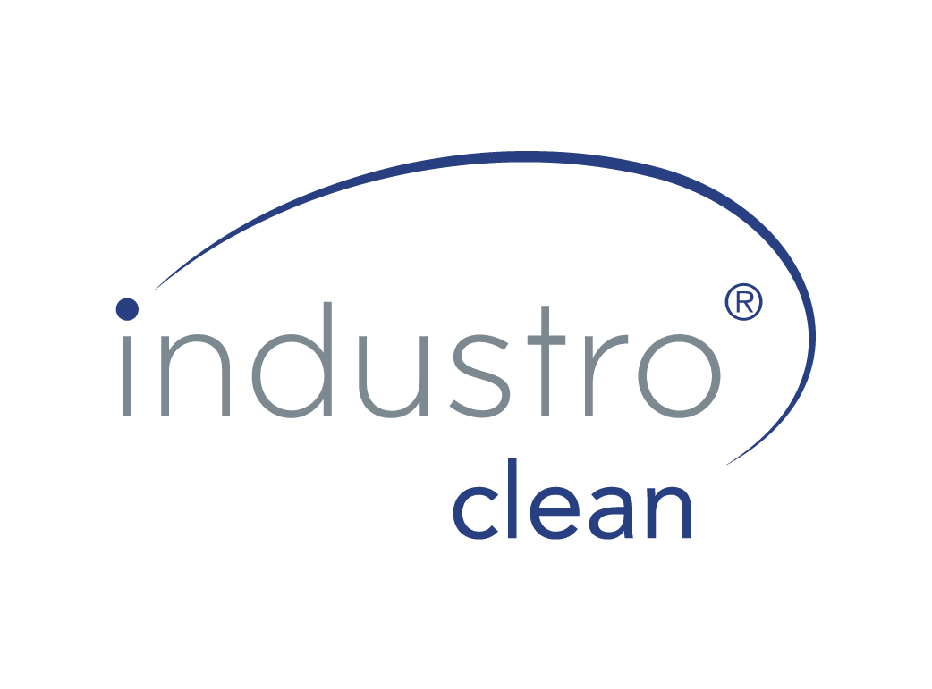
THE RISK FACTOR IS BASED ON:
The environment and the probability of contamination
The patient immune system and their vulnerability to infection
Treatment and the potential for exposure
The determination of environmental cleaning procedures for individual patient care areas, including frequency, method, and procedure, should be based on the risk of pathogen transmission.
In general, the higher the RISK factor of an area the more frequently cleaning needs to occur.

Slide 4

OBJECTIVES OF CLEANING IN A HOSPITAL ENVIRONMENT
To achieve the required standards of hygiene and cleanliness.
To achieve the required visual appearance level.
To prevent cleaning personnel from unwittingly acting as vehicles for pathogenic micro-organisms (cross infection).
To carry out cleaning without undue hindrance to patients at the lowest cost.

Slide 5
LOW RISK AREAS:
Are areas in which the transmission of infection is relatively limited. Such areas include the recreational areas outside the wards and departmental utility rooms:
Reception areas
Recreational areas outside ward room Departmental utility rooms
Departmental utility rooms
Clean every 24 hrs

Slide 6
MEDIUM RISK AREAS
Are areas with a medium risk of transmitting infections.
These areas therefore require more careful cleaning and disinfection.
Medium risk areas include: in-patient areas, out-patient areas, wards, treatment (X-Rays), sanitary facilities and laundry.
In these areas regular cleaning
In-patient areas
Out-patient areas
Wards
Treatment (X-Ray)
Sanitary facilities
Clean every 24 hours
Touch points more often

Slide 7
HIGH RISK AREAS
Are areas with a high risk of transmitting infections. They therefore require frequent, careful, and methodical cleaning and disinfection.
All areas with special characteristics are classed as high risk and need specific treatment to satisfy their various cleaning and disinfection requirements.
Use only dedicated cleaning equipment
Use disposable cloths and mop sleeves
Clean every 24 hours
Clean touch points every 8 hours or as per IPP

Slide 8
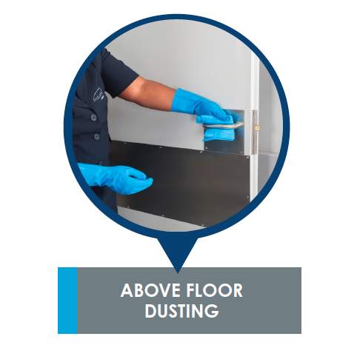
ABOVE FLOOR DUSTING - GENERAL AREAS

Slide 9
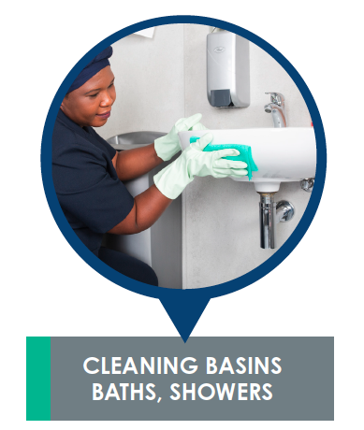
CLEANING BASINS BATHS SHOWERS

Slide 10
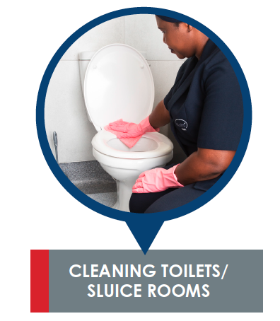
CLEANING TOILETS AND SLUICES

Slide 11
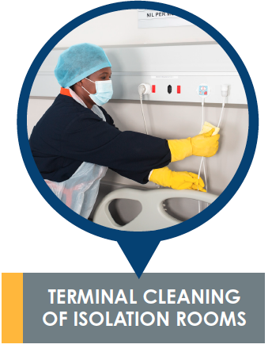
CLEANING OF ISOLATION ROOMS

Slide 12
CHAIN OF CONTAMINATION
Objectives of Cleaning in a Hospital Environment
SOURCE – Existing site of infection
RESERVOIR – Floors, furniture, equipment & touch points
VEHICLE – Dust, staff & equipment
Critical Control Points in cross contamination
Hand wash
Touch points
Dust control
Frequencies

Slide 13
CLEANING PRODUCT SELECTION CRITERIA
Cleaning Products chosen should have proven hygienic benefits:
Disposables for both floor & above the floor cleaning
Microfiber technology
“One room” cloth/mop usage concept
Automatic scrubber driers
Colour coding
Dedicated equipment in high risk areas
Clean from clean to dirty. From top to bottom
Am I cleaning or contaminating?

Slide 14
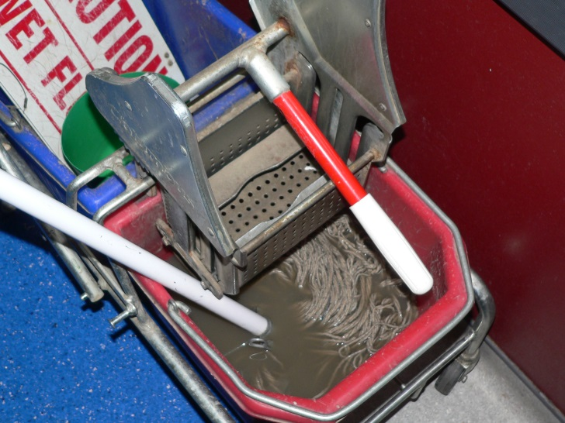
CLEANING [COLLECT AND CONTAIN SOIL]
To remove dirt & organic material
AIM> aesthetic effect & lowering bio burden
Removing favorable environment for micro organisms
Emphasis on effective cleaning methods to reduce cross contamination
Daily
DON’TS

Slide 15
CO-OPERATION – INFECTION CONTROL/CLEANING DEPARTMENT
Disinfectant Policy
Approved Cleaning Policy
Precautions in high risk areas
Training

Slide 16
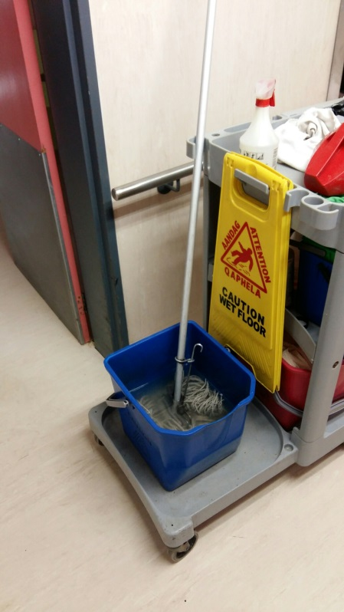
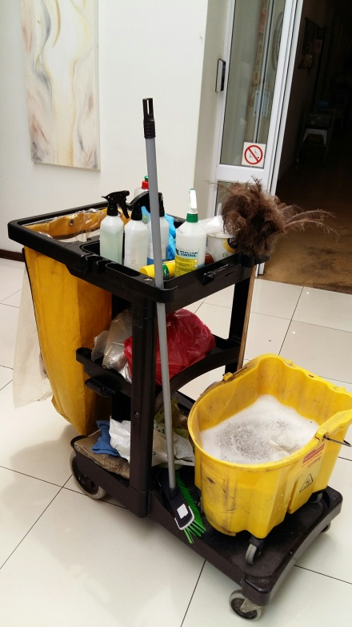
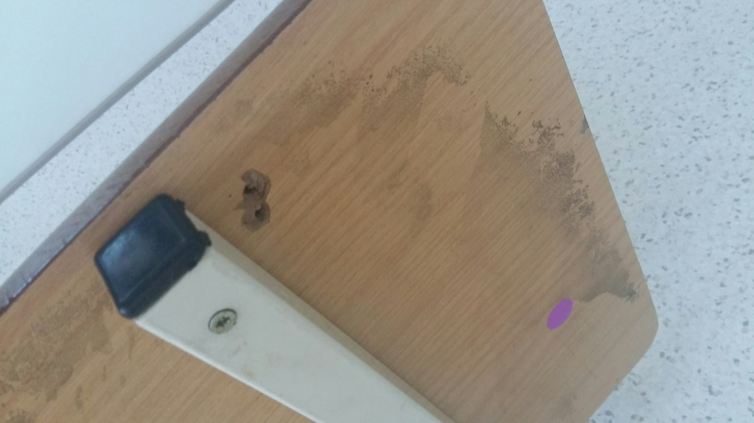
DON’TS!

Slide 17
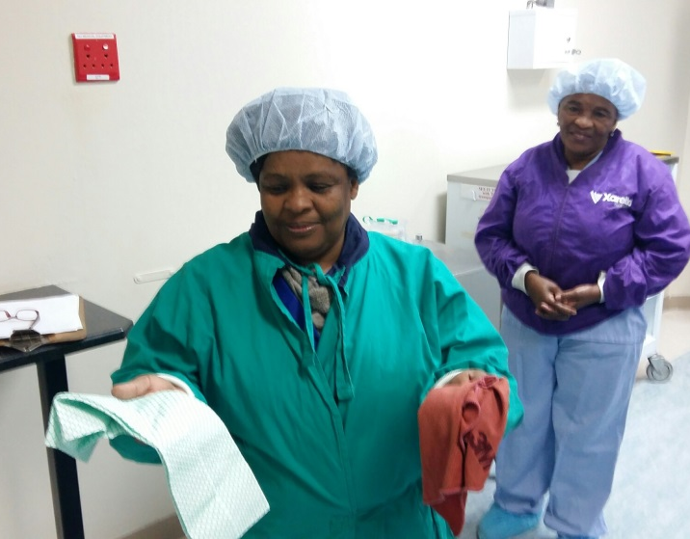
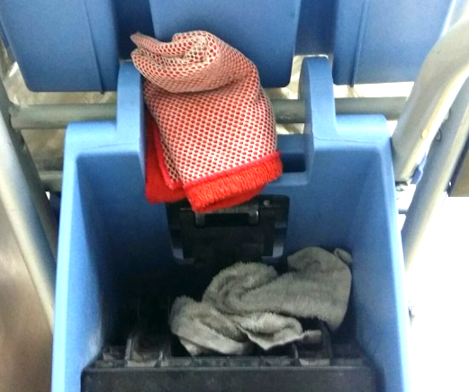
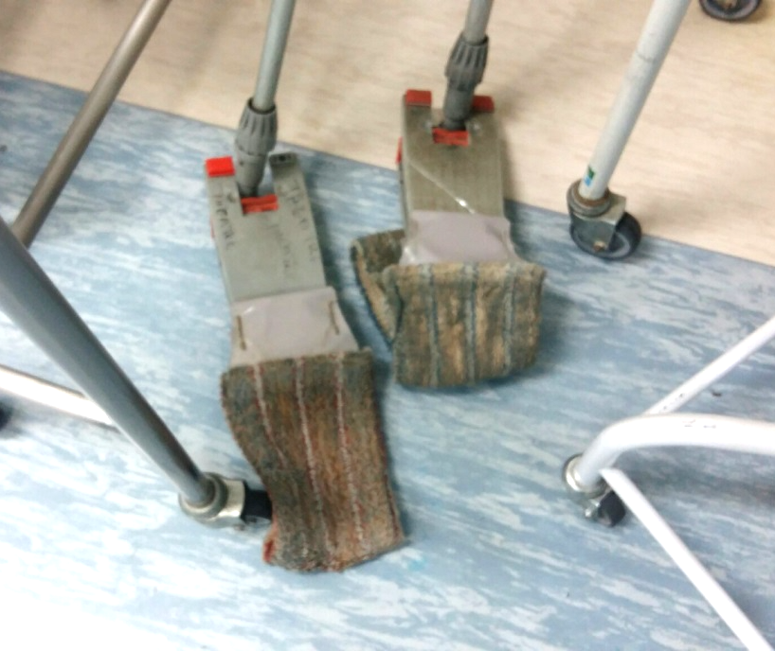
DON’TS!

Slide 18
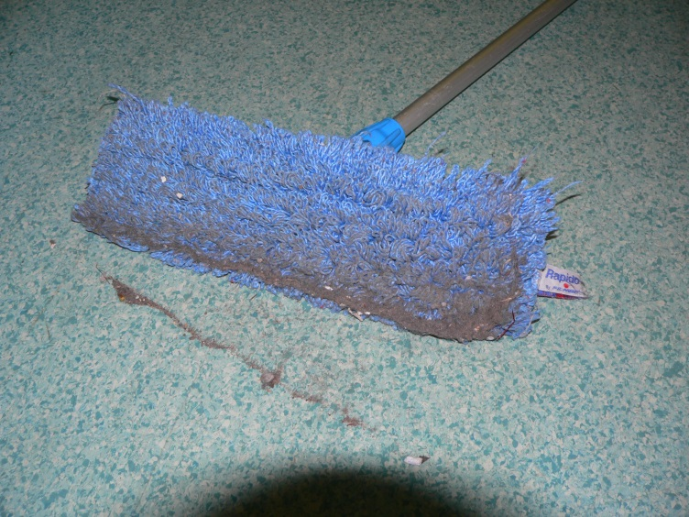
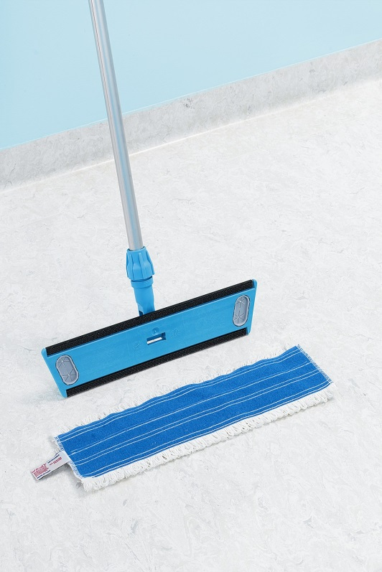
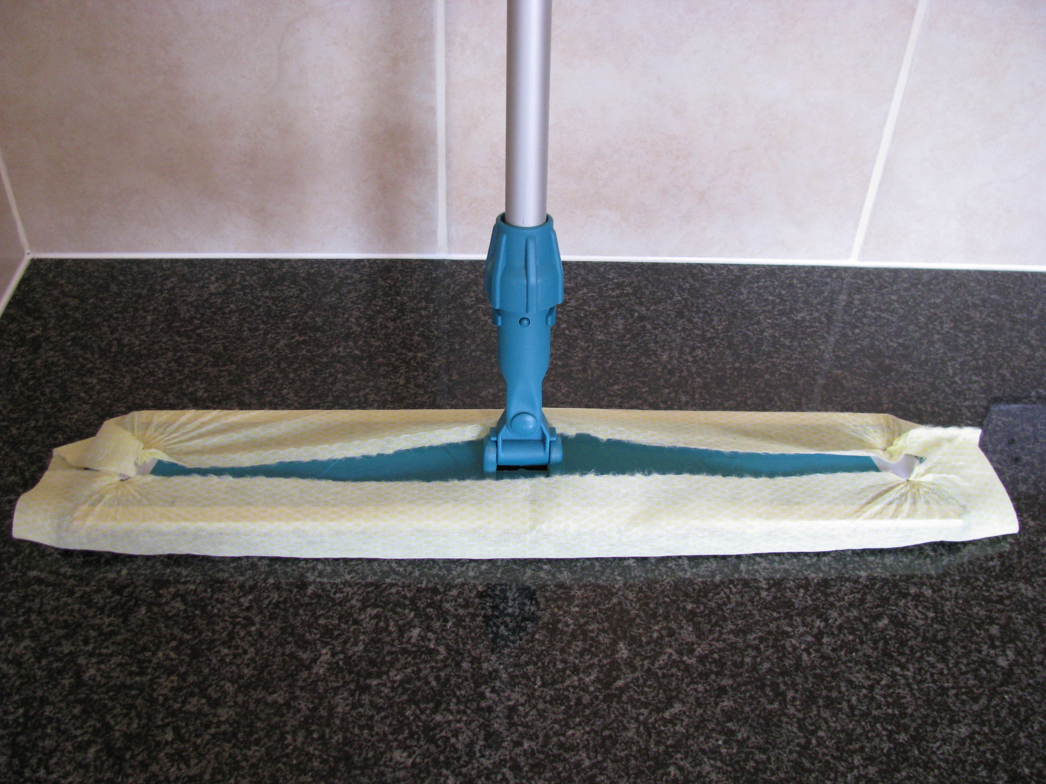
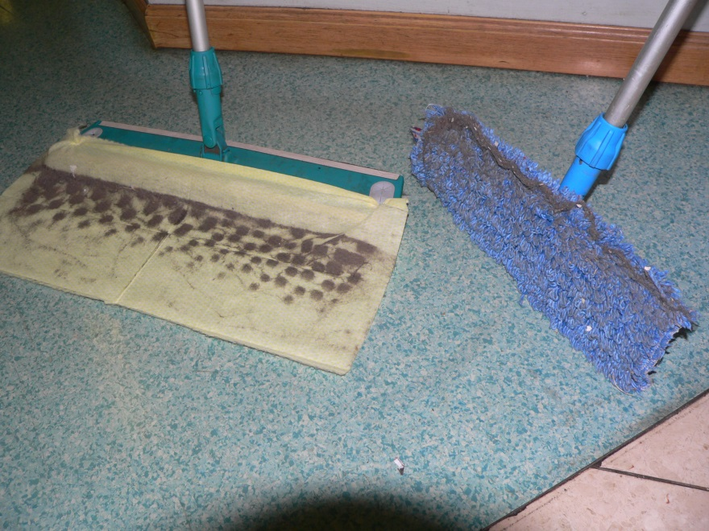
DO’S!
DON’TS!

Slide 19
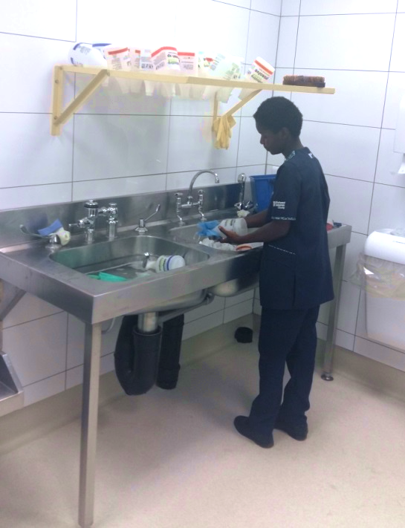
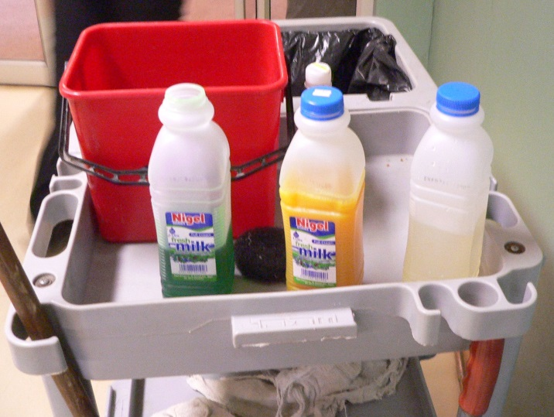
Chemical Dilution
No Topping up
Clean and disinfect bottles
Drain and dry
Correct Dilution
Labelling
SDS Sheets
Disinfectants
DON’TS!

Slide 20
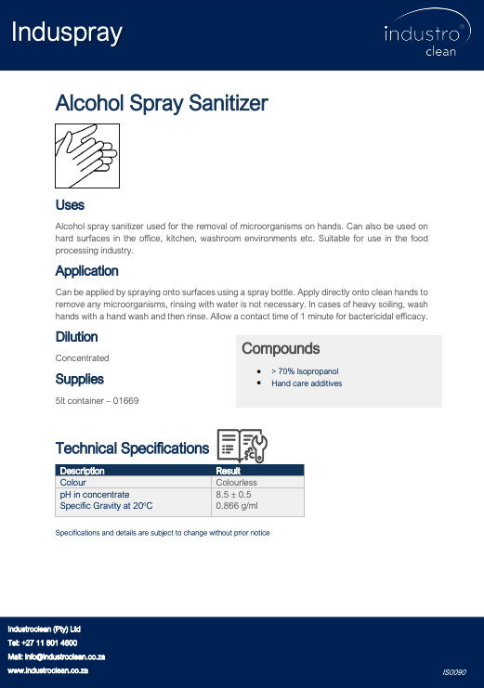
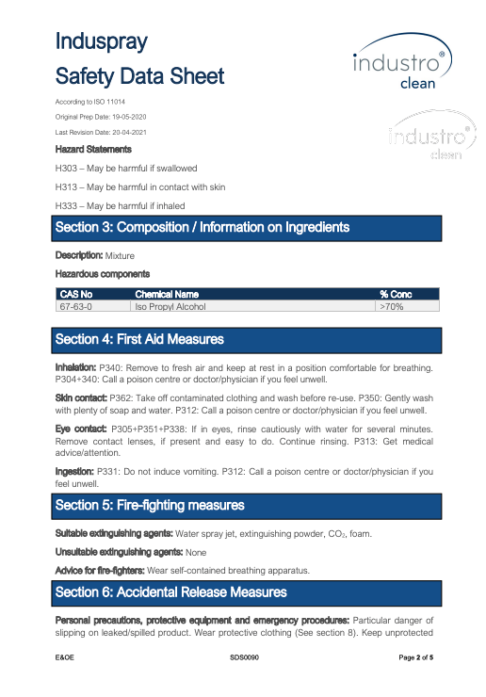
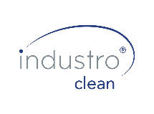
BENEFITS OF INDUSTROCLEAN CHEMICALS - INFO & SDS SHEETS
We ensure that you can access the information and SDS sheets for each chemical which provides all the necessary data on the chemical including the dilution, usage instructions and safety information.
Notes:
George

Slide 21
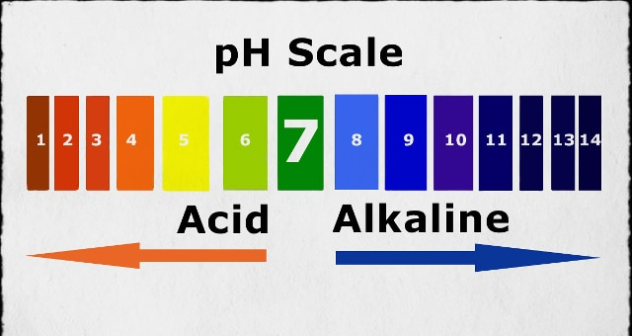
PH of Dirt and Chemicals

Slide 22
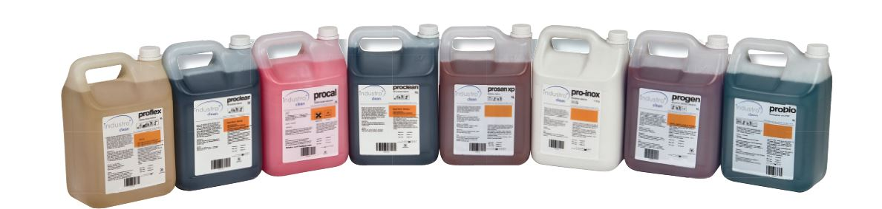
Detergents
How soap works
Residues

Slide 23
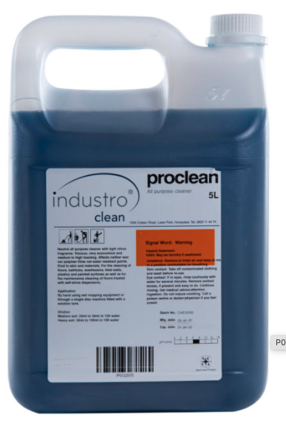
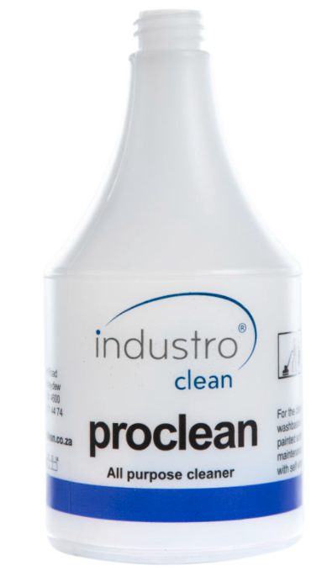
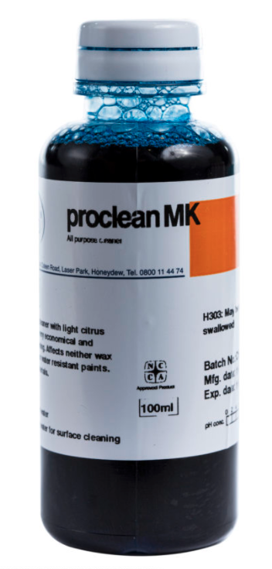
P03205 | Proclean 5L | Neutral all-purpose cleaner with light citrus fragrance | Viscous, very economical and medium to high foaming Affects neither wax nor polymer films nor water resistant paints Kind to skin and materials For the cleaning of floors, bathtubs, washbasins, tiled walls, plastic and painted surfaces as well as for the maintenance cleaning of floors treated with self-shine dispersions 5L
P03207 | Proclean MK 100ml (pack of 10) | Neutral all-purpose cleaner with light citrus fragrance | Viscous, very economical and medium to high foaming Affects neither wax nor polymer films nor water resistant paints Kind to skin and materials For the cleaning of floors, bathtubs, washbasins, tiled walls, plastic and painted surfaces as well as for the maintenance cleaning of floors treated with self-shine dispersions 100ml x (10 units) = 1L
Notes:
George

Slide 24
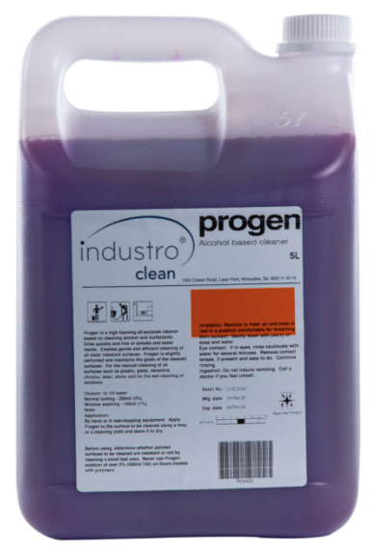
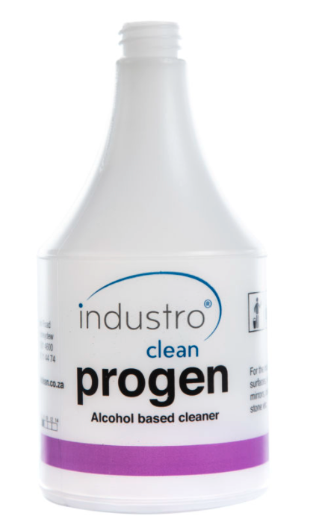
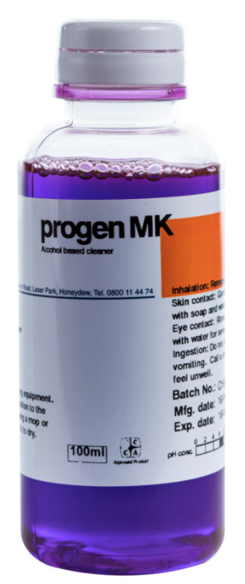
INDUSTROCLEAN PRO RANGE CHEMICALS
P03430 | Progen 5L | Progen is a high foaming all-purpose cleaner based on cleaning alcohol and surfactants | Dries quickly and free of streaks and water marks. Enables gentle and efficient cleaning of all water-resistant surfaces Progen is slightly perfumed and maintains the floss of the cleaned surfaces For the manual cleaning of all surfaces such as plastic, glass, ceramics, chrome, steel, stone and for the wet cleaning of windows 5L
P03437 | Progen MK 100ml (pack of 10) | high foaming all-purpose cleaner based on cleaning alcohol and surfactants | Dries quickly and free of streaks and water marks. Enables gentle and efficient cleaning of all water-resistant surfaces Progen is slightly perfumed and maintains the floss of the cleaned surfaces For the manual cleaning of all surfaces such as plastic, glass, ceramics, chrome, steel, stone and for the wet cleaning of windows 100ml x (10 units) = 1L
Notes:
George

Slide 25
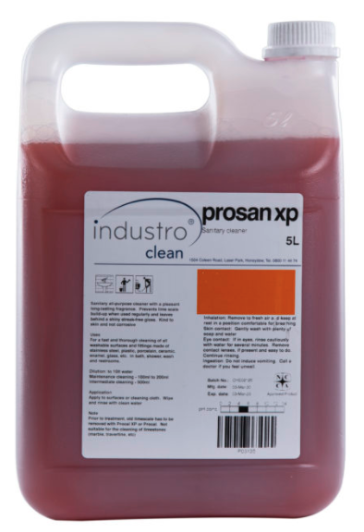
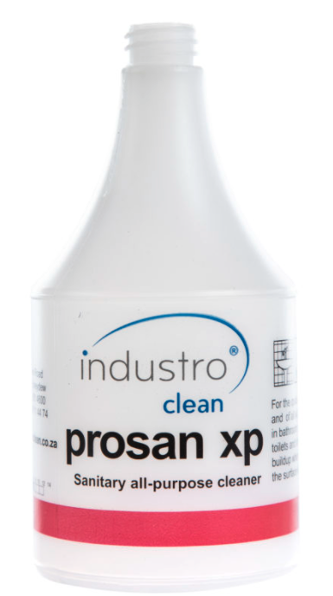
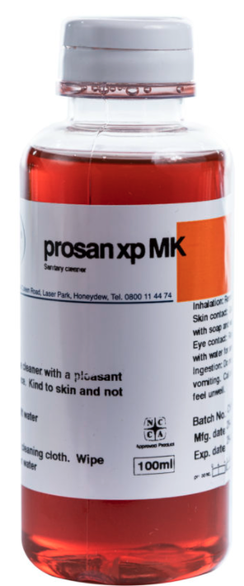
INDUSTROCLEAN PRO RANGE CHEMICALS
P03135 | Prosan XP 5L | Sanitary all purpose cleaner with a pleasant long-lasting fragrance | Kind to skin and not corrosive For a fast and thorough cleaning of all washable surfaces and fittings made of stainless steel, plastic, porcelain, ceramic, enamel, glass etc in bath, shower, wash and restrooms 5L
P03137 | Prosan XP MK 100ml (pack of 10) | Sanitary all purpose cleaner concentrate with a pleasant long-lasting fragrance | Kind to skin and not corrosive For a fast and thorough cleaning of all washable surfaces and fittings made of stainless steel, plastic, porcelain, ceramic, enamel, glass etc in bath, shower, wash and restrooms 100ml x (10 units) = 1L
Notes:
George

Slide 26
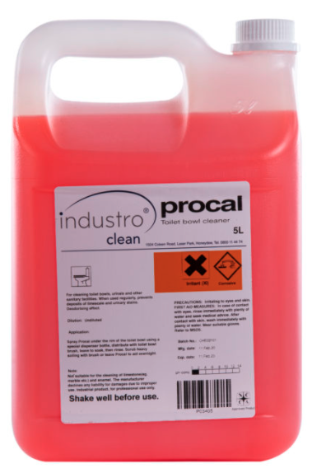
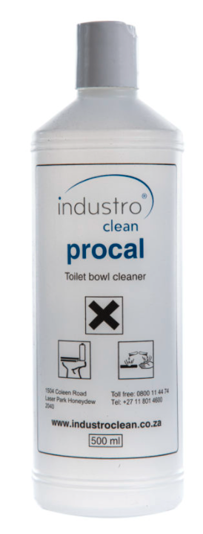
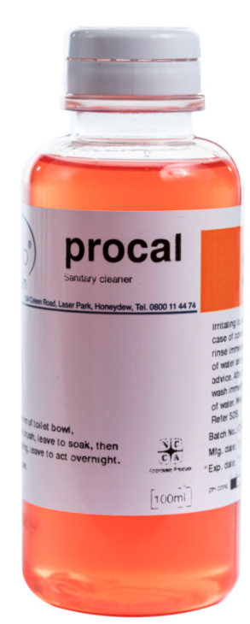
INDUSTROCLEAN PRO RANGE CHEMICALS
P03405 | Procal 5l | Viscous acidic toilet bowl cleaner for the removal of lime scale and urinary stains | Deodorizing and bactericidal For cleaning toilet bowls and other sanitary facilities When used regularly, prevents the building of lime scale and urinary stains 5L
P03408 | Procal 100ml (pack of 10) | Viscous acidic toilet bowl cleaner for the removal of lime scale and urinary stains | Deodorizing and bactericidal For cleaning toilet bowls and other sanitary facilities When used regularly, prevents the building of lime scale and urinary stains 100ml x (10 units) = 1L
Notes:
George

Slide 27
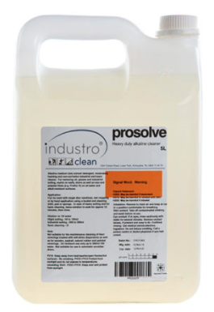
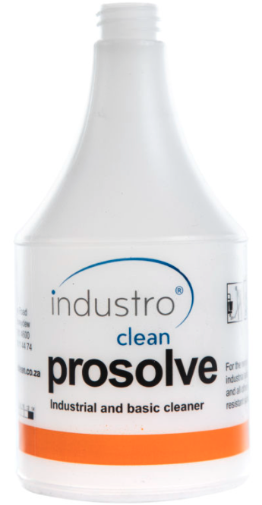
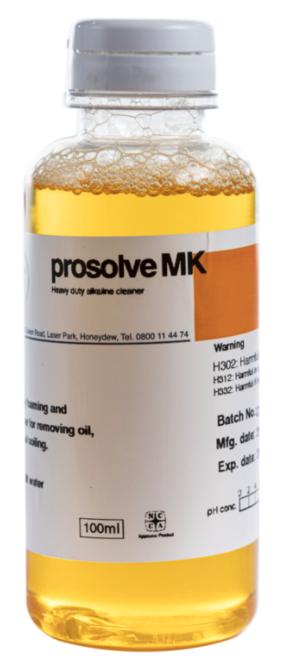
INDUSTROCLEAN PRO RANGE CHEMICALS
P02225 | Prosolve 5L | Heavy duty alkaline cleaner | Alkaline, moderately foaming and non-corrosive industrial and basic cleaner For removing oil, grease and industrial soiling, marks on walls, doors as well as wax and polymer films (e.g. Proflor H) on all water and alkali-resistant surfaces 5L
P02227 | Prosolve MK 100ml (pack of 10) | Heavy duty cleaner concentrate | Alkaline, moderately foaming and non-corrosive industrial and basic cleaner For removing oil, grease and industrial soiling, marks on walls, doors as well as wax and polymer films (e.g. Proflor H) on all water and alkali-resistant surfaces 100ml x (10 units) = 1L
Notes:
George

Slide 28
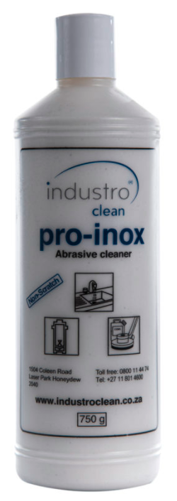
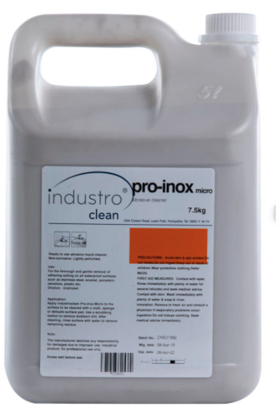
INDUSTROCLEAN PRO RANGE CHEMICALS
P03825 | Pro inox 750g | Ready to use abrasive liquid cleaner | Ready to use, non-perfumed abrasive liquid cleaner with vigorous cleaning power for gentle removal of adhering dirt Non-scratch and non-corrosive For all waterproof surfaces such as chrome, steel, enamel, ceramics, porcelain, plastics etc in the food processing industry 750g
P03830 | Pro inox micro 7.5kg | Non-scratch liquid abrasive cleaner | Ready to use, abrasive liquid cleaner with vigorous cleaning power for gentle removal of adhering dirt Non-scratch and neutral For all waterproof surfaces such as chrome, steel, enamel, ceramics, porcelain, plastics etc 7.5kg
Notes:
George

Slide 29
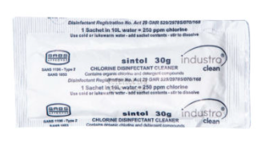
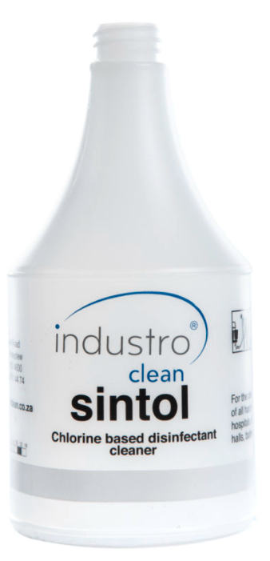
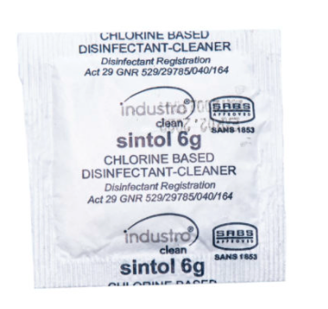
INDUSTROCLEAN PRO RANGE CHEMICALS
06600 | Sintol sachet 30g (pack of 50 sachets) | Combined disinfectant cleaner and deodoriser | Combined disinfectant Cleaner and deodoriser Based on Sodium Dichloro-s-triazinetrione (DCCNa) For the cleaning, disinfection of all hard non-porous surfaces in hospitals, schools, institutes, gymnastic halls, bathrooms, change rooms, kitchens etc SANS1853: Disinfectants, detergent-disinfectants and antiseptics for use in the food industry 30g x (50 units) = 1.5kg
06610 | Sintol sachet 6g (pack of 100 sachets) | Combined disinfectant cleaner and deodoriser | Combined disinfectant Cleaner and deodoriser Based on Sodium Dichloro-s-triazinetrione (DCCNa) For the cleaning, disinfection of all hard non-porous surfaces in hospitals, schools, institutes, gymnastic halls, bathrooms, change rooms, kitchens etc SANS1853: Disinfectants, detergent-disinfectants and antiseptics for use in the food industry 6g x (100 units) = 600g
Notes:
George

Slide 30
POINTS ON DISINFECTANT
Dilution rates for the application
Contact time
Dilution age
Clean before disinfection
When Needed

Slide 31
Disinfectants
All disinfectants should be NRCS registered by law. Log 5 level for Healthcare and food environments
Disinfection cannot take place unless proper cleaning has been carried out ie. you cannot disinfect dirt
It is critical that the correct PPM is used. This should be clear on the manufacturer’s instructions.
Chlorine is sensitive to elements such as light and temperature and must be discarded within 24hours of being mixed. Containers should be marked with date and time of mixing.
In general, disinfection is often used as a “substitute” for good cleaning practices. The first step in the cleaning process is critical.

Slide 32
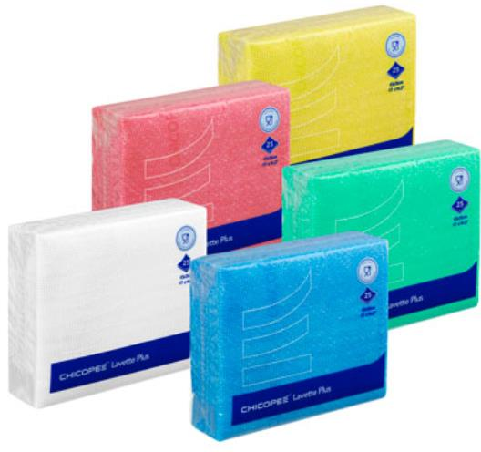
CHICOPEE LAVETTE
Strong and durable multipurpose cloths that can be washed and re-used
Easy to rinse, so that the cloth stays clean and fresh
Unique open weave of the cloth, ensure perfect absorption of dirt
The cloths dry quickly, giving bacteria less opportunity to accumulate
The rough structure of the cloth ensures optimal cleaning of all surfaces
Ideal for applications in varying industries such as healthcare, hospitality etc.

Slide 33
WET CLEANING VERSES DRY CLEANING
DO NOT UNDER ESTIMATE DUST:
80% of all dirt in buildings is dust
Nearly all known micro organisms can be found in dust and find it nutritious
Dust is whirled up by air movement and spread bacteria around
Dust can seriously harm peoples health [Asthma ,Bronchitis ,Allergies] or can cause dangerous infections [MRSA]
Clear facts about clean floors:
Micro organisms are not visible to naked eye
Micro organisms need warmth ,moisture and nutrition
Moist floors favourably stimulate growth of micro organisms

Slide 34
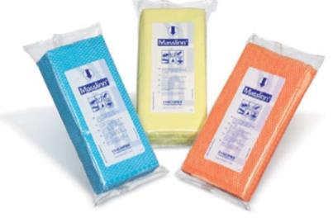
CLOTHS
What is Masslinn:
Masslinn is the sweeping with a disposable impregnated cloth.
Dust control is the main objective when cleaning various environments – floors are the largest horizontal surface and collect considerable amounts of dust
Dust sweeping with the impregnated disposable cloths is most effective and rational method for removing dust from all smooth floor surfaces.
Dirt is bound without any whirling up and kept in the cloth thanks to the dust binding properties of the chemical impregnation of the cloths.

Slide 35
CLOTHS
Advantages of using Masslinn:
30% - 40% time saving compared to traditional cleaning methods
Optimal cleanliness through efficient dust removal
Danger of cross-contamination greatly reduces (one-room disposable cloths)
No airborne dust
Dry method” ensures that ideal conditions for bacterial growth are not created

Slide 36
FLOORS STEPS – 3 TYPES OF DIRT TO COLLECT AND CONTAIN
Dry – Dust sweep – Masslinn
Sticky or Wet Dirt – Spot Mop
Scuffs & Scratches – Buff or Burnish[ Most visual yet least health impact. [Emotional dirt]

Slide 37
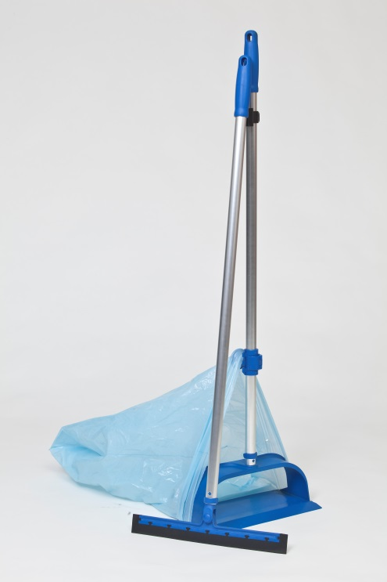
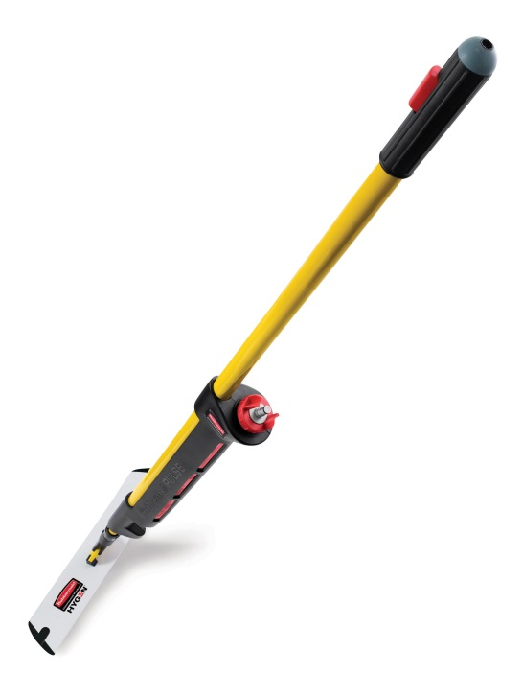

MOPPING
Damp
Maintenance cleaning
Spotting
Does not disturb traffic
Microfibre/disposable
Wet
Full floor – deep cleaning
No traffic – safety
Double bucket

Slide 38



VIPER DS350 DUAL SPEED SINGLE DISC MACHINE
50000301 | VIPER DS350-EU 17IN DUAL SPEED SD 175/350RPM (Includes Brush, Pad Drive & Solution Tank) | Motor Power Source: Electric Brush/Pad Speed (RPM): 175/350 Cable length (M): 10 Cleaning Width (mm): 432mm | Ideal dual-speed single disc for a variety of professional cleaning tasks Simple to use and efficient dual speed single disc machine. DS350 is the perfect solution for hard floor scrubbing and for heavy duty cleaning Ideally suited for daily indoor cleaning of hotels, restaurants, schools, shopping malls, exhibition centres, as well as schools and government institutions. Viper DS350 is a versatile dual-speed single disc machine designed for or different kinds of professional cleaning tasks. For scrubbing, spray cleaning and buffering tasks. Operation is simple and easy to use controls. The Viper DS350 single disc is robust, reliable and service friendly, with the ergonomic design, you can easily scrub, clean and buffer floors. The machine is ready to use, water tank, brush and pad holder come with the machine. You can also choose the optional foam generator and carpet brush. Simple and user-friendly. The machine is automatically locked off when the handle is in 90 degree vertical position. Soft start system and automatic brush installation. The aluminium base and low noise thanks to belt driven motor. Large rear wheels facilitates transport and makes a well-balanced machine. Water tank, brush and pad holder comes with the dual speed machine. The dual speed single disc offers a choice of 175 or 350 rpm for easy, efficient and cost-effective maintenance of all floors
Notes:
George

Slide 39


Company Information
VIPER DR1500 BURNISHER
50000036 | VIPER DR1500H-EU BURNISHER | Motor Power Source: Electric Brush/Pad Speed (RPM): 1500 Cable length (M): 15 Cleaning Width (mm): 510mm | This ultra-high speed burnisher covers large areas with efficiency and low maintenance costs For the perfect finish The Viper DR1500H is a Ultra High Speed (UHS) burnisher designed to cover large areas with less maintenance costs. It is used for long lasting shine to hard floors. Simple and easy to use controls. The Viper DR1500H is robust, reliable and service friendly. With this ergonomic design you can easily spray clean hard floors. Ideal for building a long-lasting shine to hard floors, this electric cord burnisher is also the right choice for high productivity in polishing and maintenance of floors in medium duty applications. Easy to use: Ergonomic adjustable handle and adjustable handle for easy storage Safe and user-friendly: High manoeuvrability with large wheels and safety lock-out switch for your safety Great value for money: High quality product at a value-for-money price point
Notes:
George

Slide 40




FLOOR PADS
Red – Buffing
Pink – Burnishing
Blue – Cleaning/scrubbing
Black- Stripping
Green Eco Pad Polishing

Slide 41

VACCUMATION
Wet Vacuums
Wet Scrubbing, stripping and sealing
Efficient
Must be stored clean and Dry
Dry Vacuums
Disposable bags
Hepa filtration
Noise levels

Slide 42

General Guidelines
Clean and dry is safe, wet and dirty is unsafe
Always clean from the highest area to the lowest
Always clean from clean to dirty
Separate above the floor and floor cleaning
Co-operation between cleaning and IPC critical
Audit tools: UV lights, gloss metres, audit checklists
Critical Control Points in cross contamination:
Hand wash
Touch points
Dust control
Frequencies
Notes:
Take out

