Slide 1

Ebola Virus Disease
Lerato Sikhosana
MBBCh(Wits); MPH(UP); MMed Viro(Wits); FCPath(SA)Viro
Outbreak Response Unit,
Division of Public Health Surveillance and Response, NICD
LeratoSi@nicd.ac.za

Slide 2
Outline
Epidemiology
Transmission
Clinical Presentation
Diagnosis
Clinical Management

Slide 3
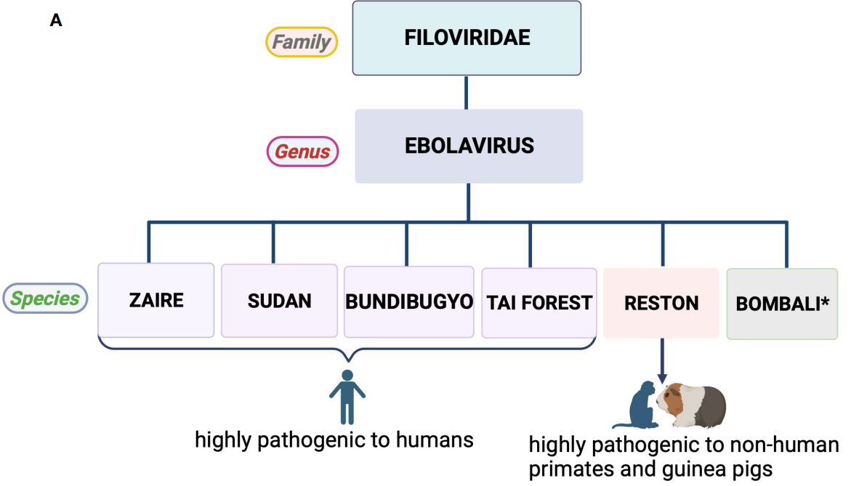
cause large outbreaks in humans
Front. Virol. 3:1227314.
Notes:
Taxonomy/classification of Ebola virus. (A) Most species of the genus Ebolavirus are lethal to humans and non-human primates, with the exception of Bombali virus (*no human infections recorded)

Slide 4
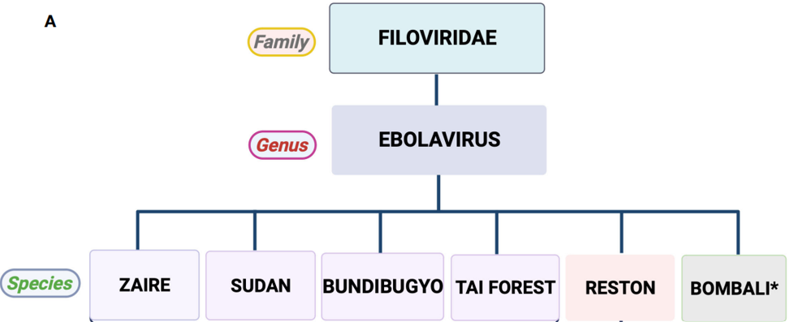
Year | Place of origin
1976: | simultaneous outbreaks in Yambuku, northern Zaire along Ebola River (Lingala = "Black River“; DRC) and Southern Sudan
1990: | outbreak of a mystery disease in Reston, Virginia, USA, among cynomolgus crab-eating macaque monkeys brought from the Philippines
1994: | an ethnologist fell ill after examining a dead chimpanzee in Tai National Park, Ivory Coast
2007: | new strain emerged in Bundibugyo, Western Uganda
2018: | Bombali ebolavirus (BOMV) 1st discovered in bats in Sierra Leone; *pathogenicity in animals or humans unknown
https://doi.org/10.1016/j.heliyon.2023.e19036
Notes:
Where do these names come from?
1994: an ethnologist fell ill after examining a dead chimpanzee in Tai National Park in Ivory Coast [5]. The virus was distinct from viruses linked to outbreaks in the DRC and Sudan. Thus, it is referred to as Tai Forest ebolavirus [9].

Slide 5
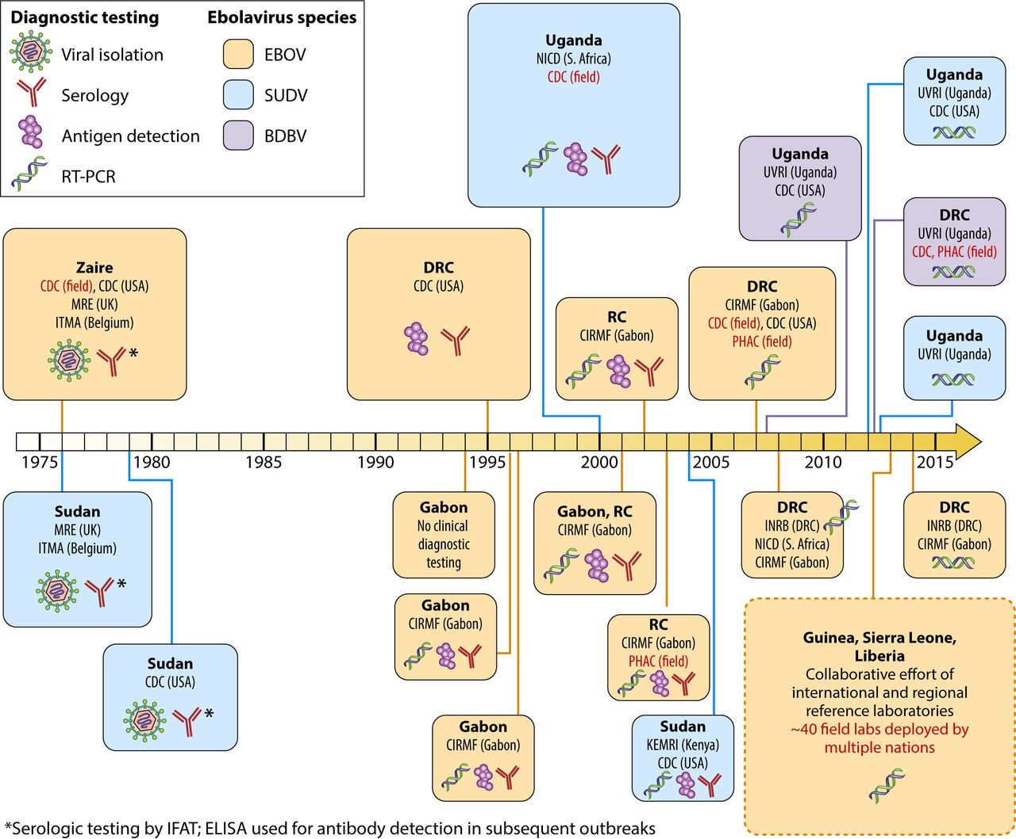


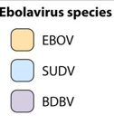
,
(Zaire)
Clin Microbiol Rev. 2016 Oct;29(4):773-93.
Notes:
Since ebolaviruses were first identified in 1976, over 20 outbreaks have been reported
Summary of Ebola outbreaks that have been reported in different countries
Size of box denotes relative size of the outbreak, the largest outbreak to date, occurred in 2013–16 predominantly affecting Guinea, Sierra Leone, and Liberia.
Color of box denotes the outbreak’s Ebola virus species

Slide 6
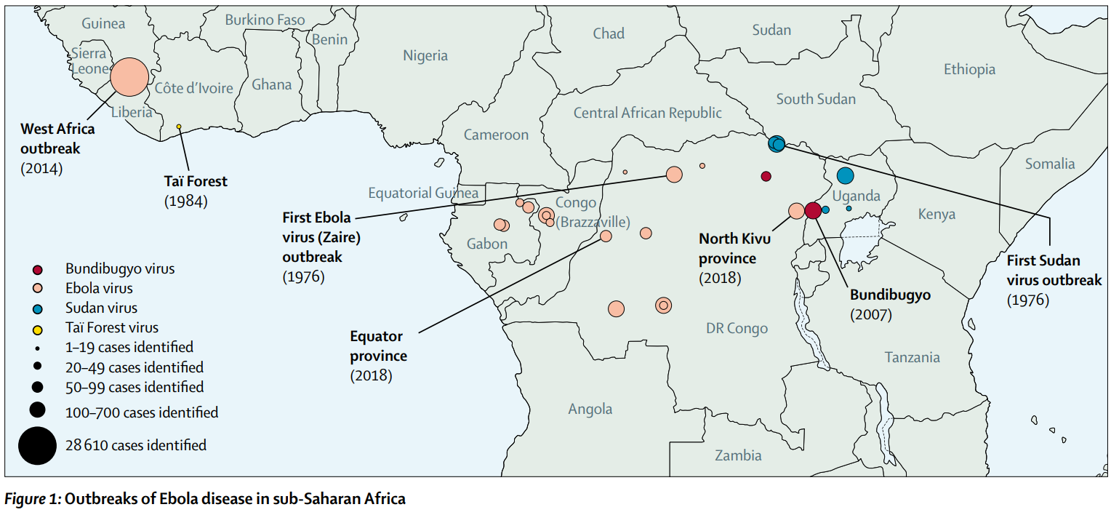
Lancet 2019; 393: 936–48
Notes:
mostly in DRC, Congo and Gabon; Most of these outbreaks have occurred in isolated rural areas,
2013–16 outbreak included both rural and urban areas, and was associated with very high incidence and mortality (>28 000 cases with >11 000 deaths; CFR >60%). Due to under-reporting, the true burden might have been considerably higher

Slide 7

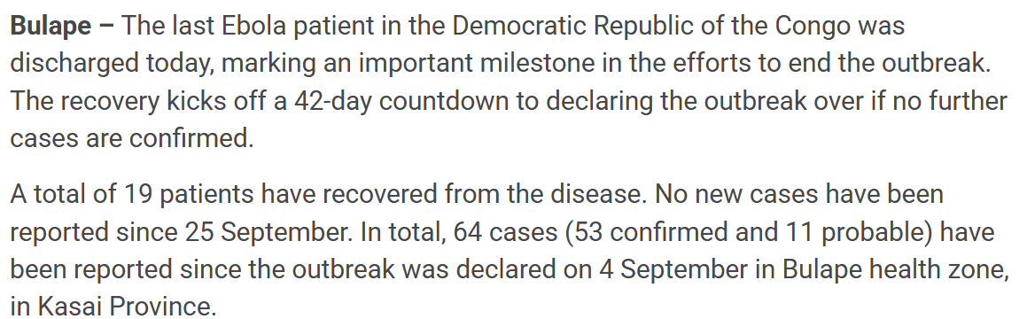
19 October 2025

Slide 8
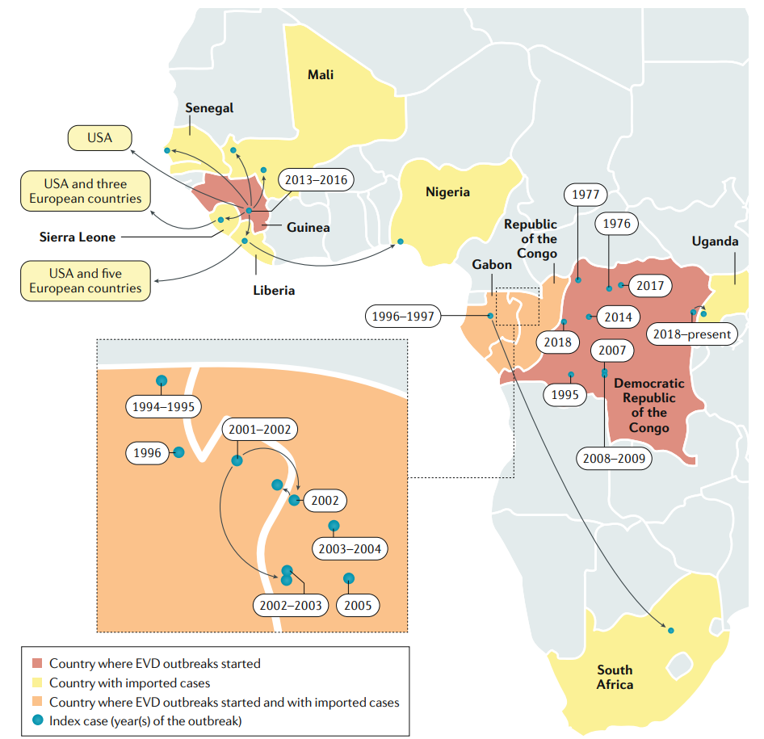
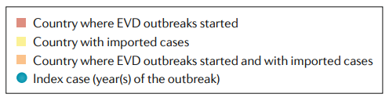
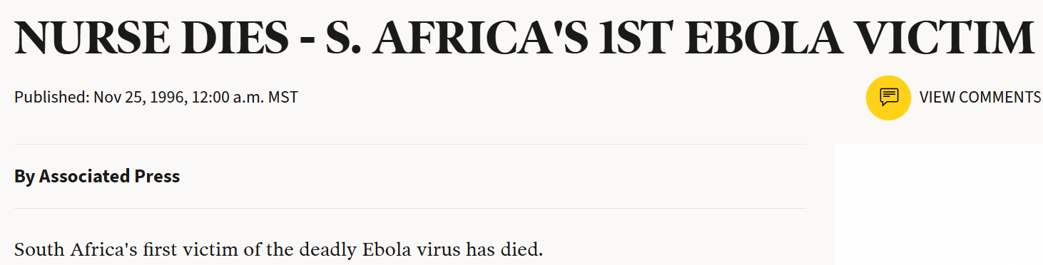

Nat Rev Dis Primers 6, 13 (2020).
Notes:
The first case of Ebola fever diagnosed in South Africa. Was a nurse had been exposed on 29 October to the blood of a very ill doctor who had been brought from Libreville, Gabon on 27 October. The doctor recovered and was discharged

Slide 9
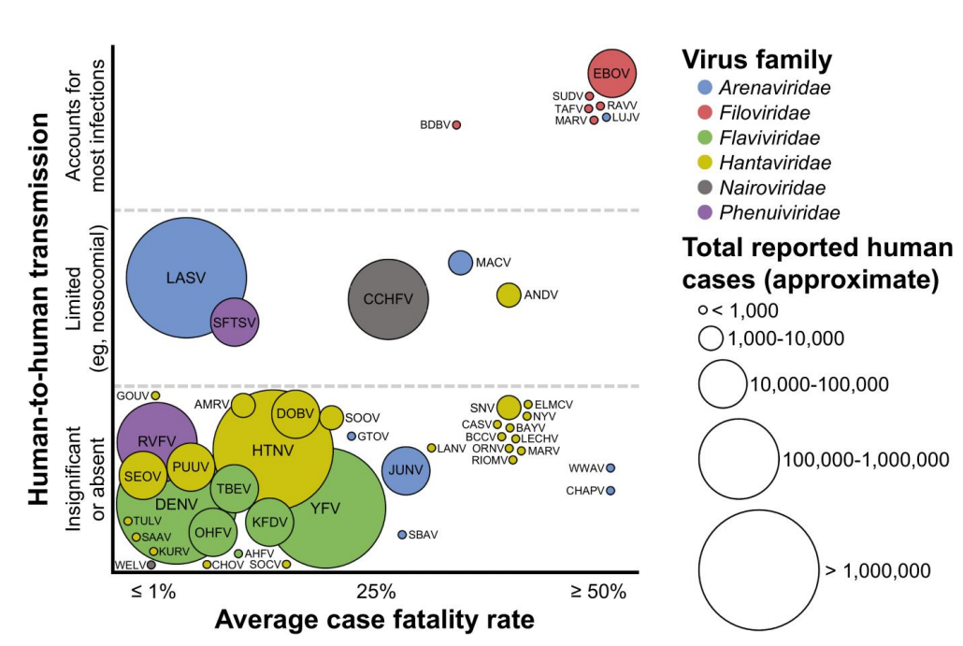
Open Forum Infect Dis. 2025 Aug 2;12(8):ofaf464 .
Notes:
Figure 2. Average case fatality rates, approximate cumulative known cases, and degree of direct human-to-human transmission for the hemorrhagic fever viruses by family. The vertical divisions along the y-axis are discrete categories (ie, a position higher or lower within a given transmission category does not have any significance). The x-axis is a spectrum from ≤1% to ≥50%. The case fatality rates as shown indicate the overall estimated case fatality rates for all infections with a given virus, not exclusively those infections that progress to hemorrhagic fever. Approximate cumulative known cases are indicated by circle size. For viruses that have caused

Slide 10
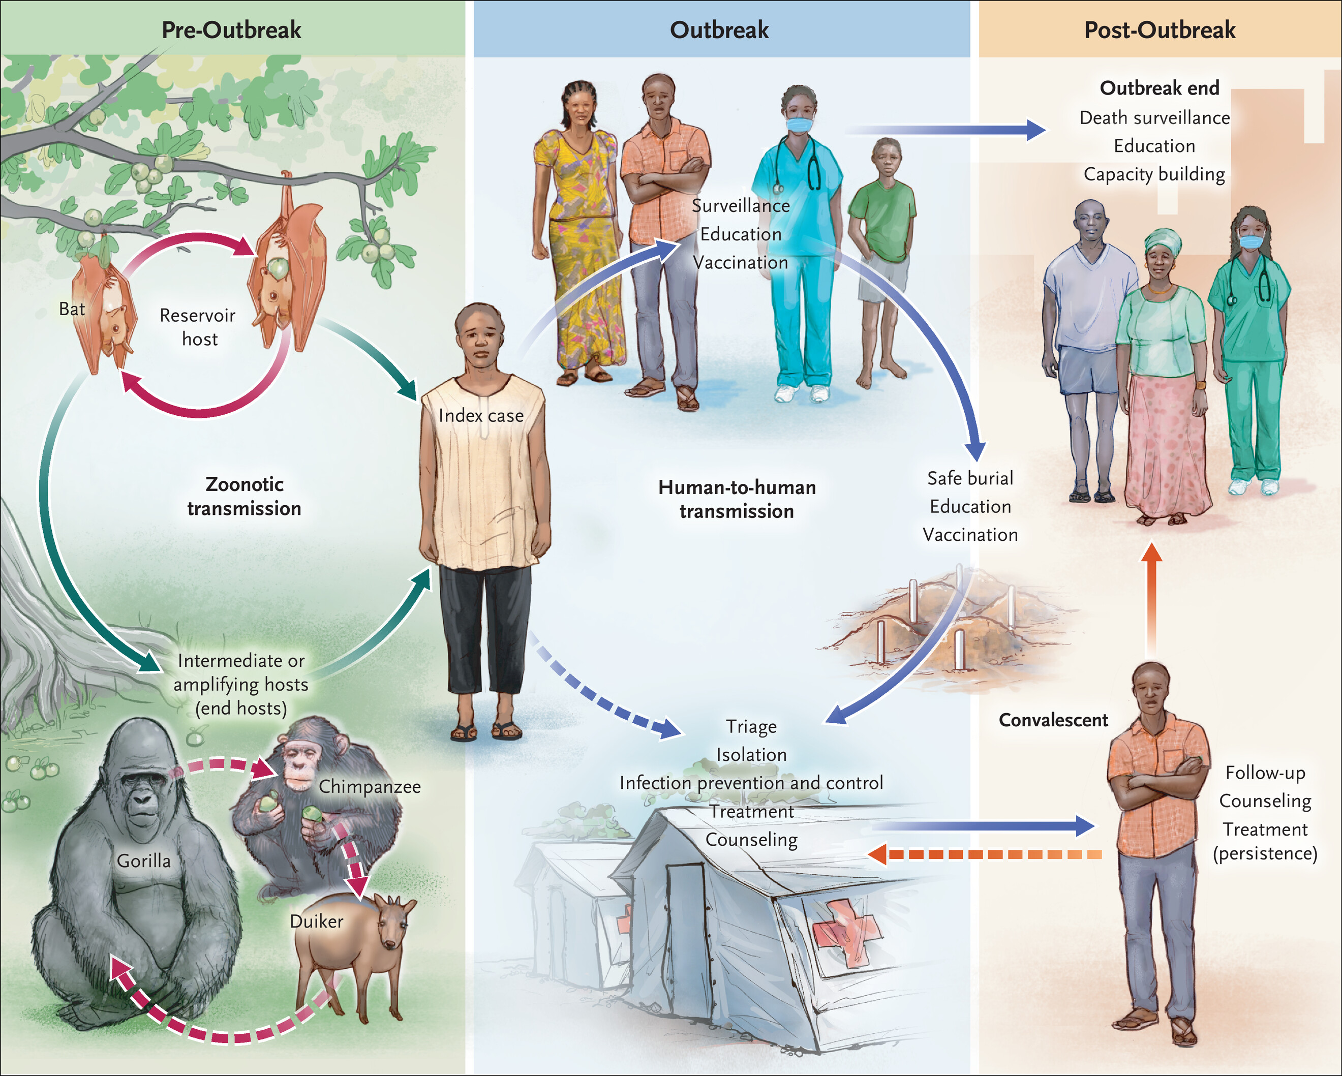
Pteropodidae Fruit
N Engl J Med 2020;382:1832-1842
Notes:
Evidence suggests that fruit bats are the reservoir hosts of EBOV. These bats can spread the disease to intermediate/amplifying hosts aka end hosts such as apes, monkeys & antelopes
A spill-over event occurs when a human becomes infected through contact with a reservoir or amplifying host
H-H-T spreads the virus to other people through contact with blood, fluids of infected persons
Persistence of virus in sites e.g brain, eyes, testicles may spread disease; Survivors may develop PES
Duikers, non-human primates, cats, foxes, hogs, antelopes, porcupines, and rodents = intermed. hosts

Slide 11
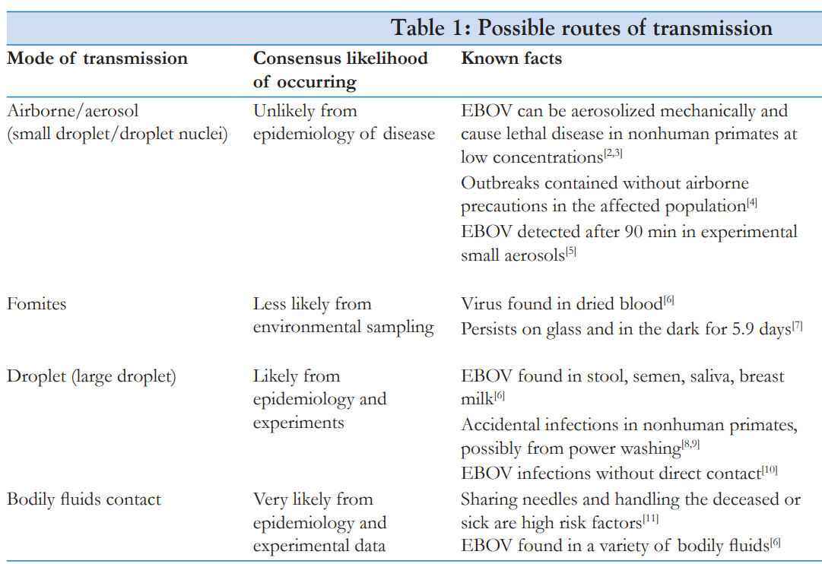
a
Can survive on utensils, bedding, clothing, furniture, doorknobs,
electrical switches for weeks^{b}
J Family Med Prim Care 2019;8:2189-201
Heliyon. 2023 Aug 8;9(8):e19036
Notes:
ROT inform necessary IPC measures

Slide 12
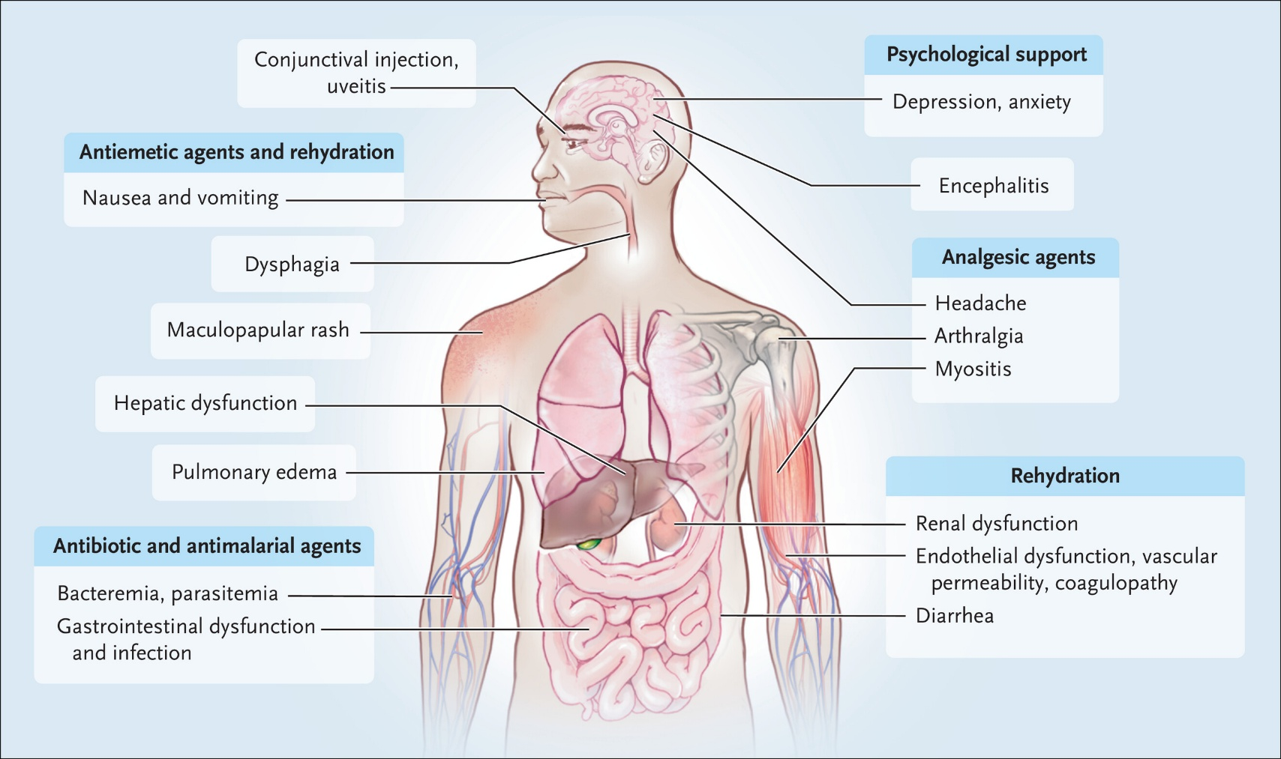
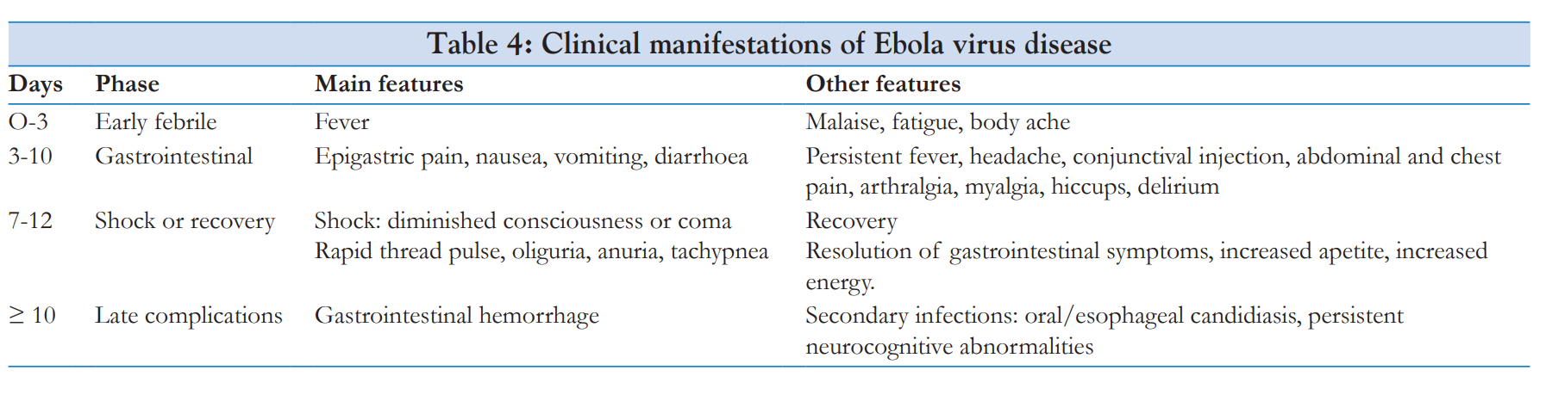
Clinical progression
J Family Med Prim Care 2019;8:2189-201
N Engl J Med 2020;382:1832-1842
Notes:
- EVD which better reflects the variable symptoms and downplays bleeding as a clinical hallmark.
- Clinical presentation due to key organs affected during Ebola virus infections
- lncubation period is 2 to 21 days (typically, 6 to 10 days) and probably depends exposure dose and route
- Initially, infection is manifested as a nonspecific febrile illness characterized by malaise, fatigue, and myalgia.
- Thereafter gastrointestinal manifestations develop in many patients, with anorexia, nausea, vomiting, and diarrhea. Fluid losses can be substantial — up to 10 liters per day resulting in shock
- Other common signs and symptoms are dysphagia, headache, conjunctival injection, abdominal pain, arthralgia, and a maculopapular rash.
Bleeding occur in <50% of affected patients, usually manifested as bleeding from the gums, petechiae, oozing from venipuncture sites, subconjunctival hemorrhage, and blood in vomitus and stool
viral septic shock (tissue breakdown), multisystem organ failure, and immune paralysis can occur in severe cases

Slide 13
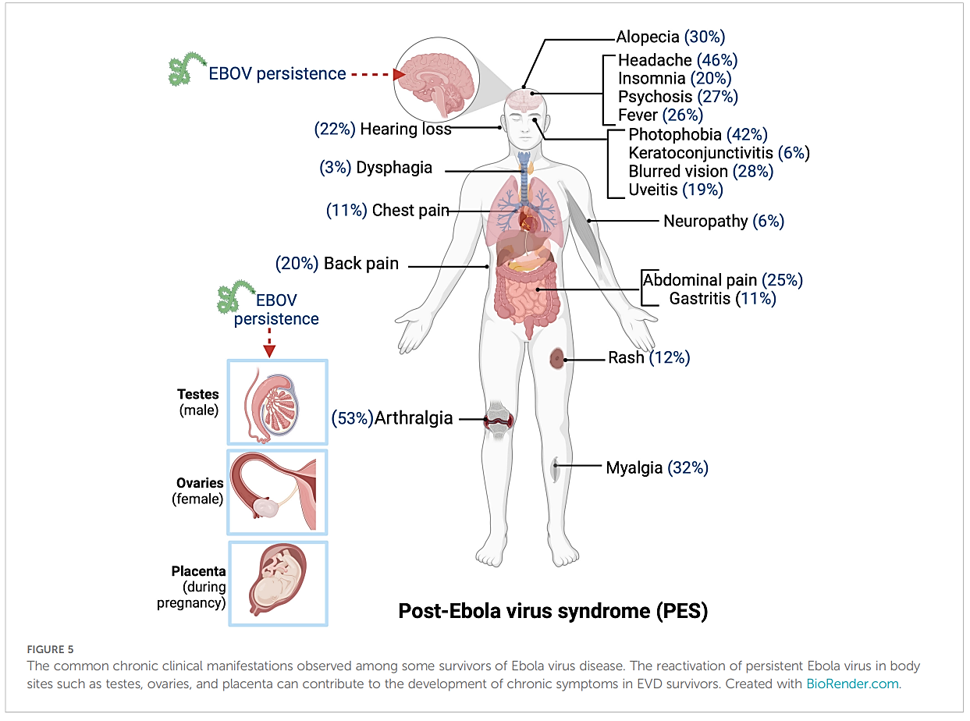

Persistence in semen, vaginal fluids, sweat, aqueous humor, urine, breast milk
Front. Virol. 3:1227314.

Slide 14
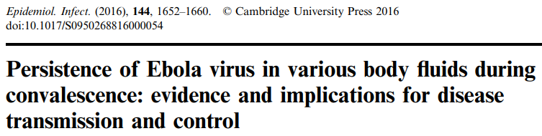
Systematic review
EBOV RNA detection:
semen (day 272)
aqueous humor (day 63)
sweat (day 40)
urine (day 30)
vaginal secretions (day 33)
conjunctival fluid (day 22)
faeces (day 19)
breast milk (day 17)
Conclusion:
Convalescent patients to abstain from sex for at least 9 months or use condoms until semen tests are negative
Breastfeeding to be avoided during convalescent phase

Slide 15
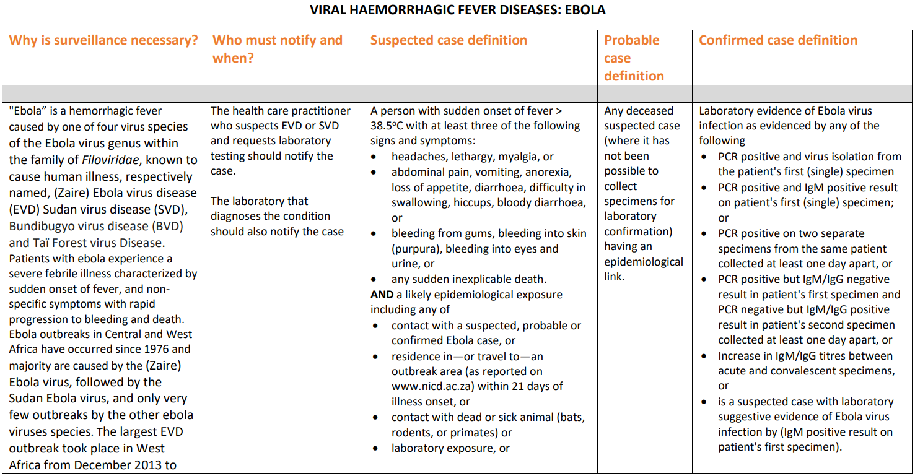
Clinical Diagnosis

Slide 16
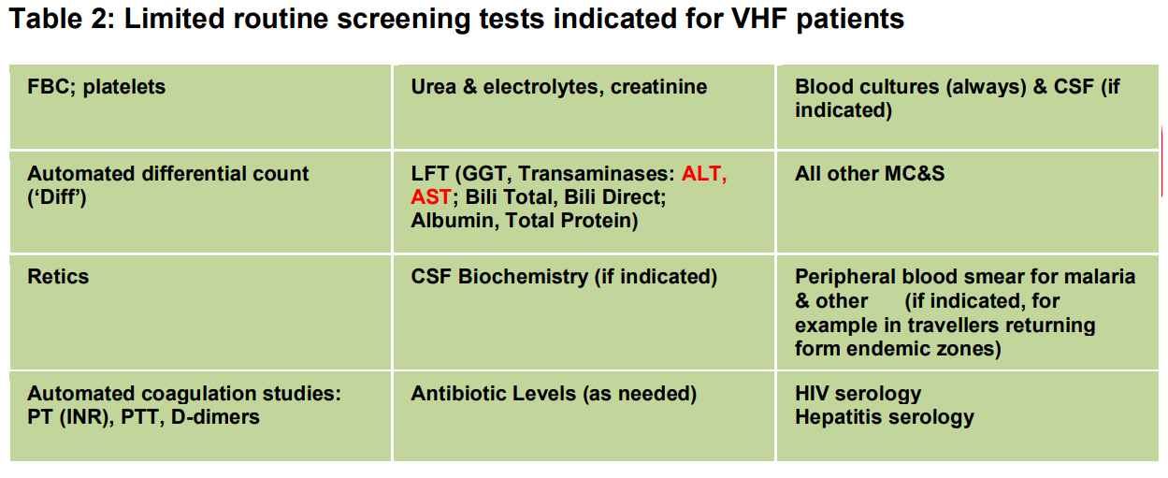
Laboratory Diagnosis
Routine
Internal institutional transfer:
- sealable, leak-proof plastic bag with absorbing material to contain specimen tubes
- outer sealable container (e.g plastic jar)
- robust outer carrier bag
Notes:
Routine haematological, biochemistry and microbiological screens are performed in the routine NHLS laboratory.
Specimens must be packaged appropriately
absorbent material (e.g. cotton wool sheets)

Slide 17
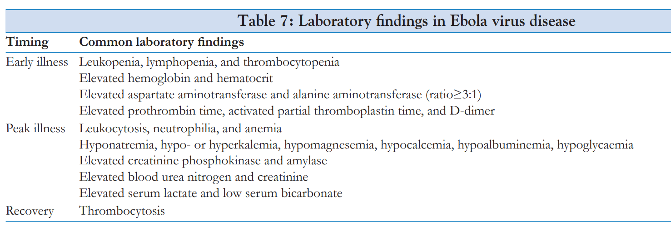
J Family Med Prim Care 2019;8:2189-201.

Slide 18
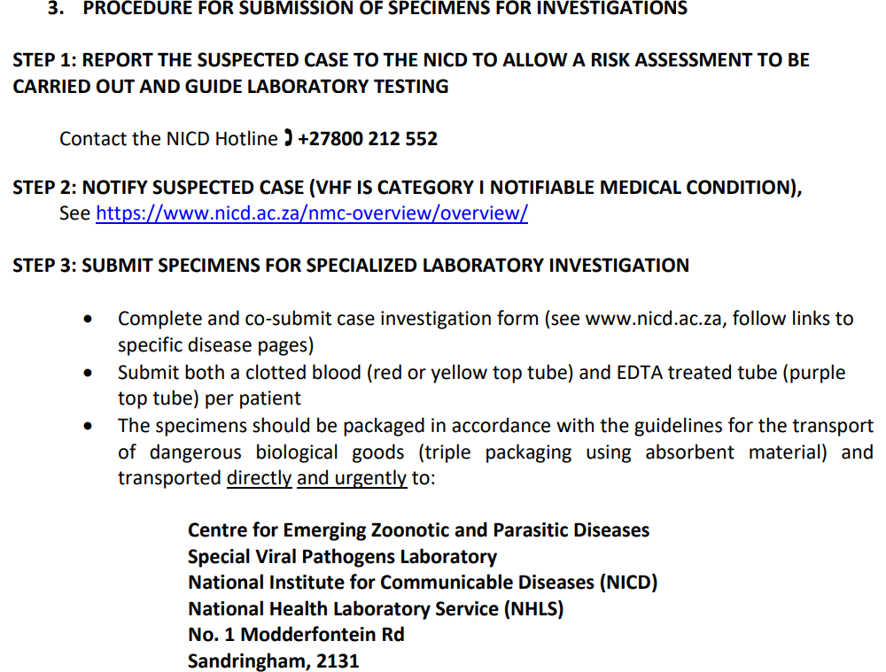
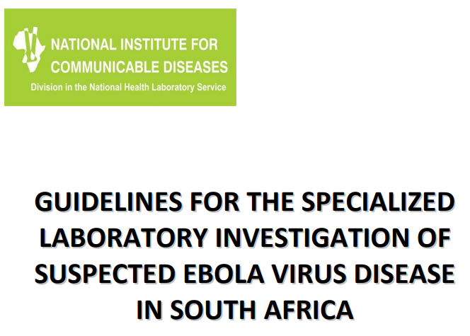
Specialized Laboratory Diagnosis
Transport of specimens to NICD
4.1.1 Private pathology laboratories: As per internal institutional arrangement
4.1.2 National Health Laboratory Service (NHLS): Follow protocol as per GPS00059
12

Slide 19
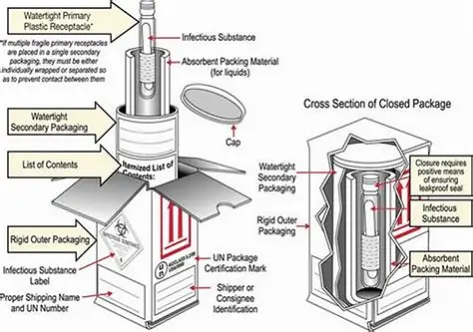

Slide 20
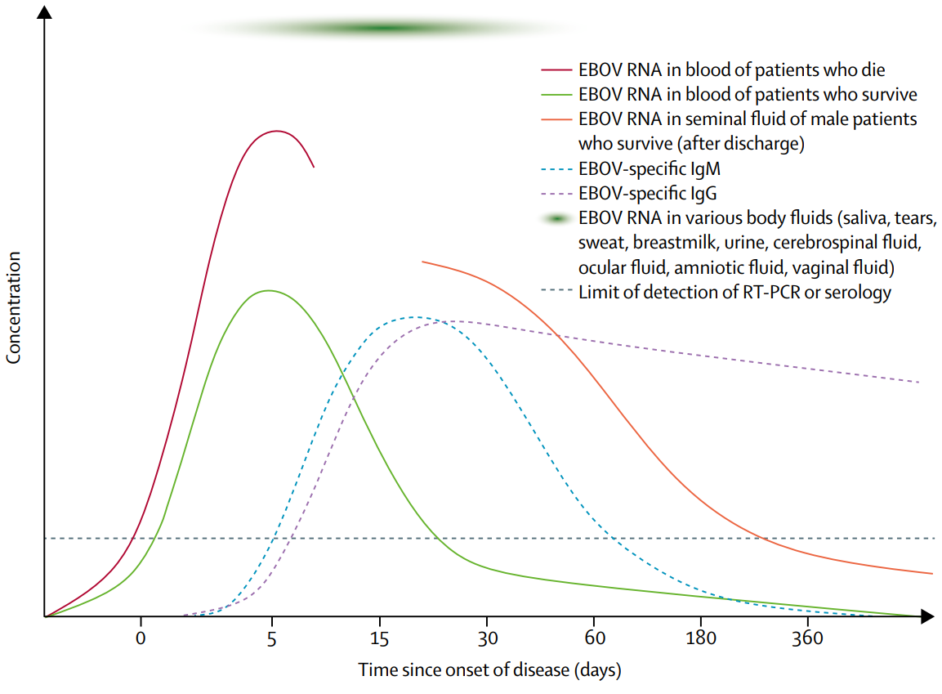
Specialized Laboratory Diagnosis
Lancet 2019; 393: 936–48

Slide 21
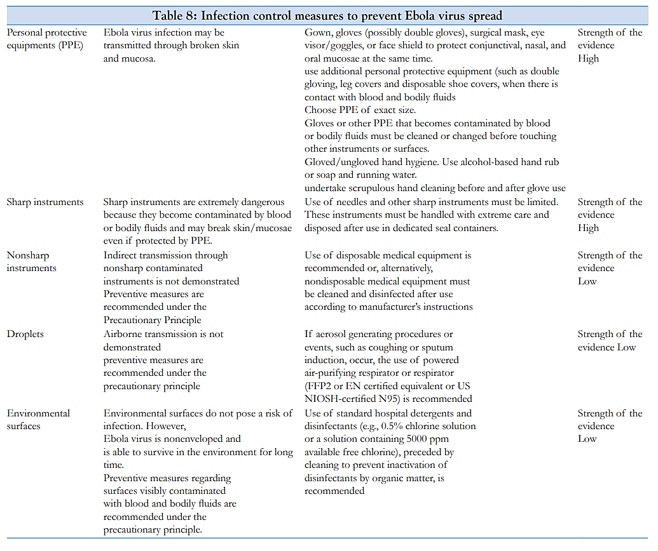
J Family Med Prim Care 2019;8:2189-201.

Slide 22
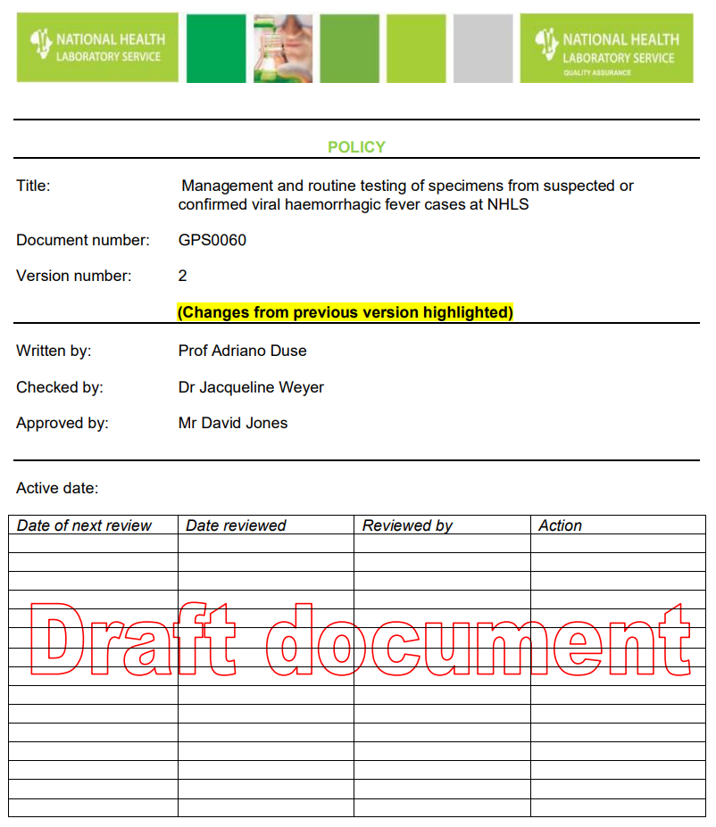
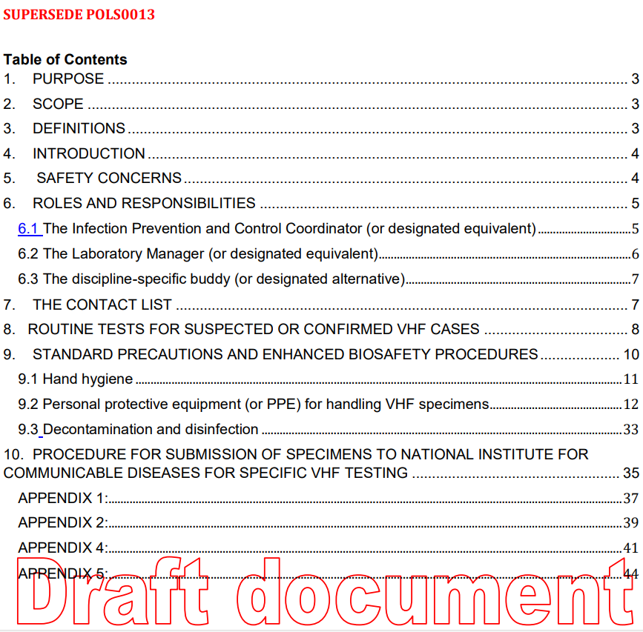
Q-Pulse7/docs/active/GPS0060v2
Notes:
The purpose of this document is to stipulate the laboratory requirement for the management and routine testing of specimens from suspected and confirmed cases of viral haemorrhagic fever (VHF) in laboratories of the National Health Laboratory Service (non-NICD laboratories).
This document must be considered by all staff that will be involved in the management or the processing (including ALL pre-analytical, analytical and post-analytical procedures) of specimens from suspected or confirmed cases of VHF at the NHLS. This document should be used in conjunction with the SHE policies and other relevant laboratoryspecific procedures of the National Health Laboratory Service. It is strongly recommended that sitespecific standard operating procedures are developed using this document and site-specific risk assessments (GPS00039) as a basis to provide details and specifics per laboratory site

Slide 23
Infection Prevention and Control Coordinator (IPCC)/designated equivalent roles and responsibilities
Immediate coordinated communication:
clinical virologist/microbiologist (registrar/pathologist) on-call OR Laboratory Manager (in a regional hospital without a pathologist).
contact NICD (hotline)/Centre for Emerging Zoonotic and Parasitic Diseases to confirm if suspicion is credible
once credible suspicion established, on-call virologist/lab manager will be the IPCC responsible for managing further notifications, communication & monitoring of potential contacts
- other personnel to be contacted:
SHE Program Manager | Business Manager
Regional Occupational Health Nurse Manager | IPC Nurse on call
Occupational Health Medical Practitioner | Provincial CDC or equivalence in PDoH
ID Consultant | SANBS (if blood transfusions will be required)
Notes:
- Laboratory Manager (or designated equivalent)
- discipline-specific buddy (or designated alternative)

Slide 24
Standard precautions and biosafety procedures:
Infection prevention
EBOV infectious dose: 1-10 viral particles may cause productive infection
Hand hygiene
PPE (guided by risk assessment & extent of contact)
Decontamination and disinfection
Sharps and waste management
Additional transmission-based/enhanced precautions:
Specific to route of transmission
Notes:
standard precautions
- represent the basic level of infection control precautions which are to be used, as a minimum, in the care of all patients
reduce the risk of transmission of pathogens from both recognized and unrecognized sources
enhanced precautions: applied to contain spread of infections by contact, respiratory droplets or airborne route

Slide 25
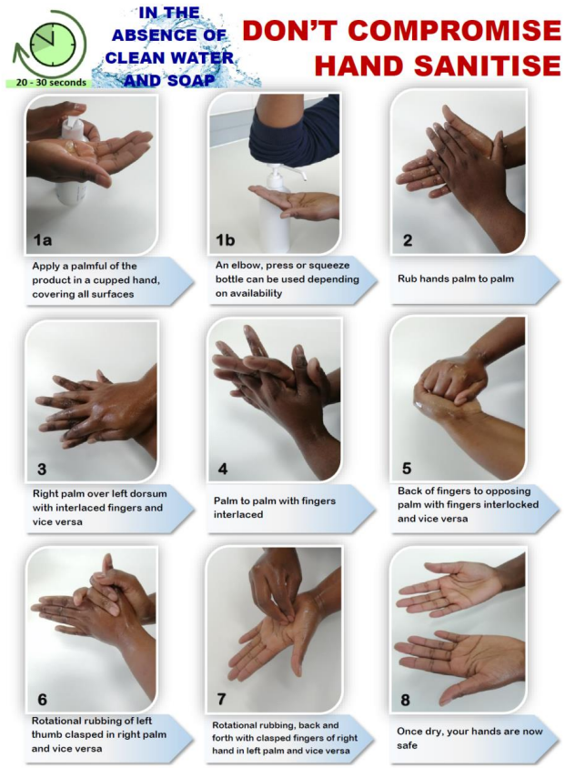
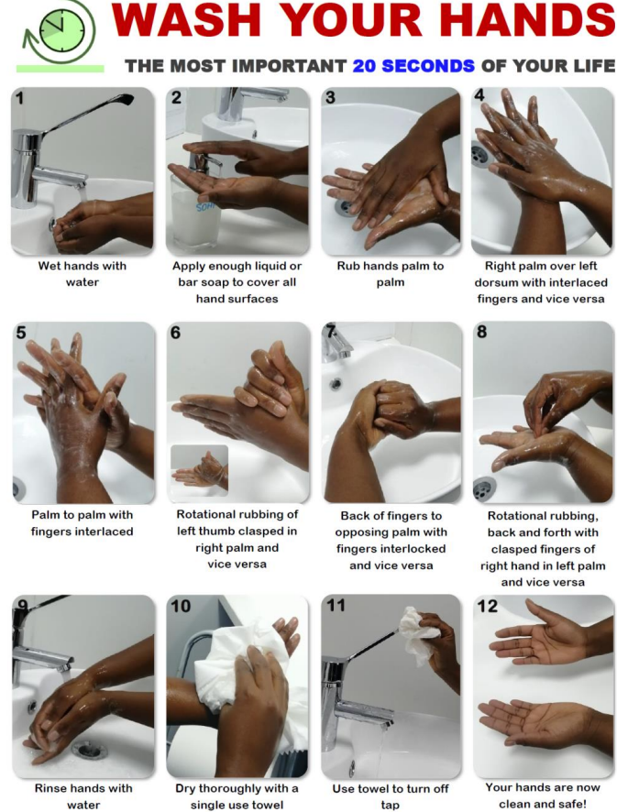
1. Hand hygiene
Hand washing:
- good quality anti-microbial soap e.g chlorhexidine gluconate 4% hand soap (Bioscrub)
Hand rubbing:
- emollient-containing alcohol-based hand-rub (eg. DGerm)
Notes:
Note the difference in procedure for hand washing and hand rubbing with alcohol-based handrub (ABHR)
- Use a good quality anti-microbial soap such as chlorhexidine gluconate 4% hand soap (eg. Bioscrub) for washing, and an alcohol-based handrub solution which contains an emollient, for hand rubbing/sanitizing.

Slide 26
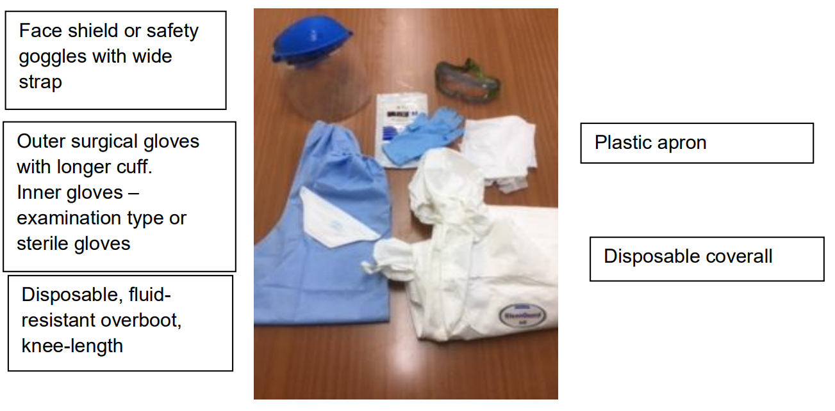
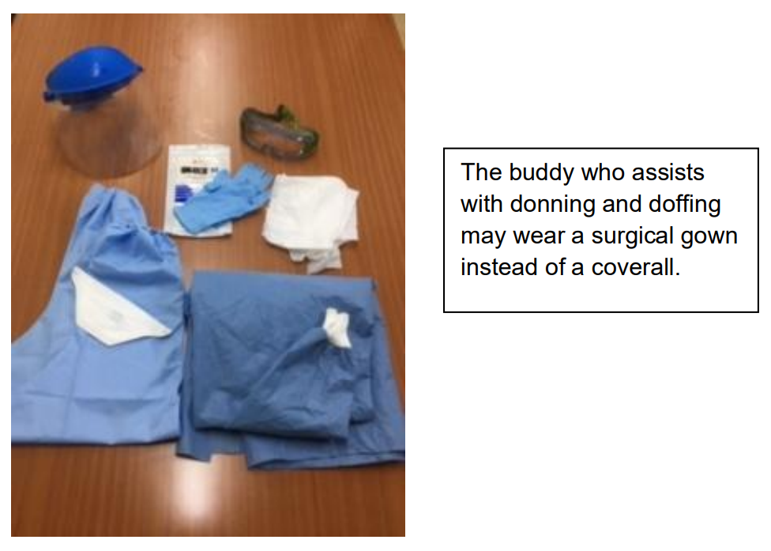
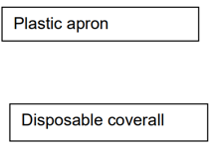
2. PPE kit for handling of VHF specimens includes
Components of a VHF PPE kit for laboratory technologist working with VHF specimens
Components of a VHF PPE kit for laboratory buddy to the technologist working with VHF specimens
Stock Control: !!some PPE should not be stockpiled, eg. N95 respirators and gloves (perish over time)
Ensure critical PPE level for 4 days or 10 complete sets accessible at designated labs as stipulated by regional SOP
Good-quality PPE- do not deviate from Oracle-listed items checked for suitability

Slide 27
PPE for handling VHF specimens
Coverall suit | Impervious coverall suit for once-off use. Certified according to EN1426:2003 and in line with WHO specifications. Preferably include neck coverage – longer zip – to chin. Seams should be protected.
N95 respirator | Filtration of 95% of oil-free particulate material, and approved/certified for offering protection against infectious agents. Preferably fit-tested per individual staff member
Safety goggles | Well-fitted (not safety spectacles) with impervious seal around the goggle (no breathing slits or holes in the seal), wide, adjustable headband, anti-fog. Reusable (to be disinfected between uses). Use of disposable face-shields/visors for staff members that wear prescription spectacles
Inner gloves | Good quality fitted examination gloves. Nitrile gloves may be used where staff have latex allergies.
Outer gloves | Good quality fitted surgical gloves with extended cuff (to allow for taping to coverall sleeves to prevent slippage of the gloves)
Boot covers (overboots) | Good quality knee-length, fluid-resistant designed to prevent slipping and can be removed easily. boot cover should protect against overt splashes so do not opt for ones that are made of breathable fabric only. Universal size will accommodate most foot sizes.
Apron | Good quality plastic disposable apron worn over coverall to prevent major splashes from reaching the inner layer of the PPE kit. Preferably with plastic neck and body ties and mid-calf length (i.e. extra-length)
Optional items | Disposable scrub suits worn under coverall. Personal old t-shirts and comfortable pants can be dedicated for this purpose (advisable to keep set in laboratory). Personal clothes may be damaged during chlorine-based disinfection (i.e. bleaching of clothes may occur). Comfortable, closed and flat-heeled personal or laboratory shoes may also be worn under knee-length boot covers. Shoes should cover foot entirely and should not be slip-on shoes/clogs which

Slide 28
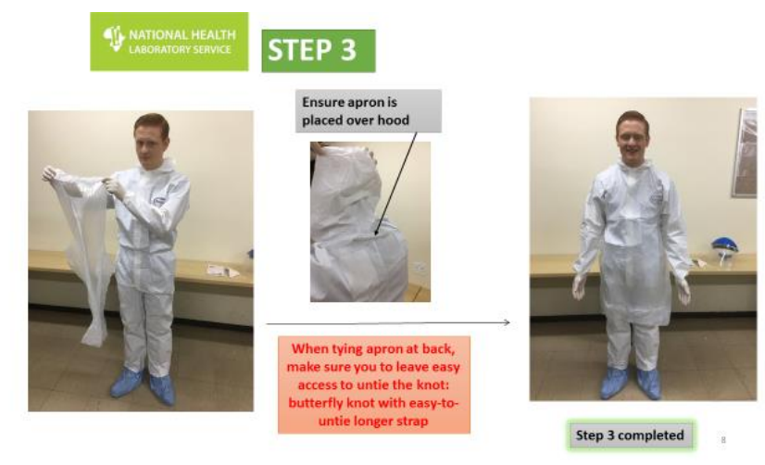
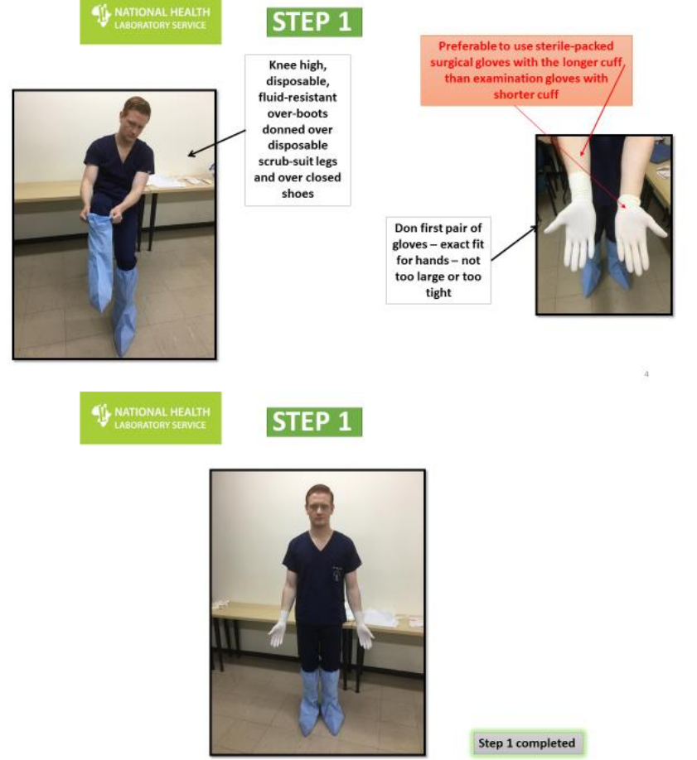
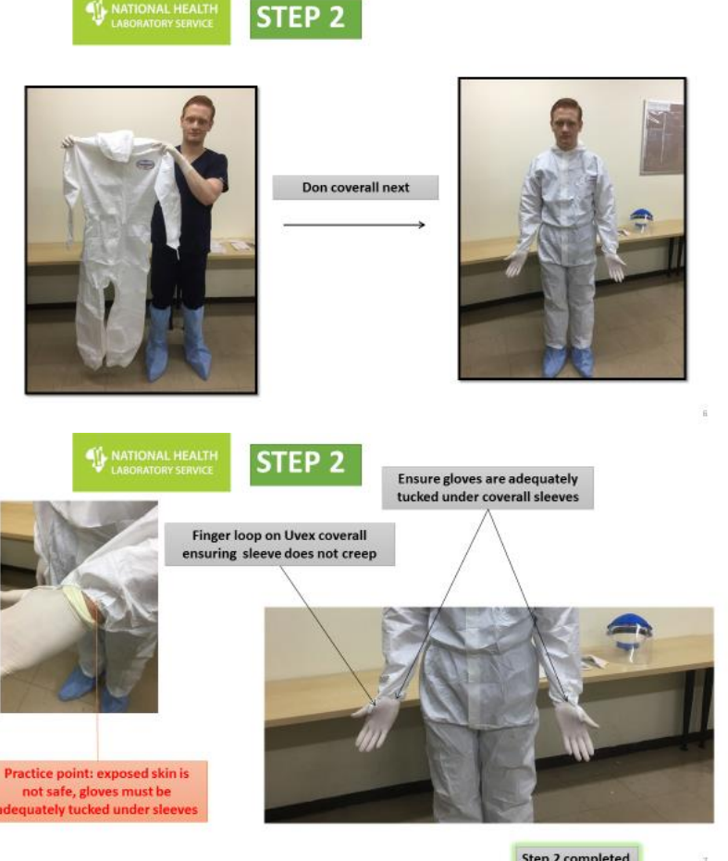
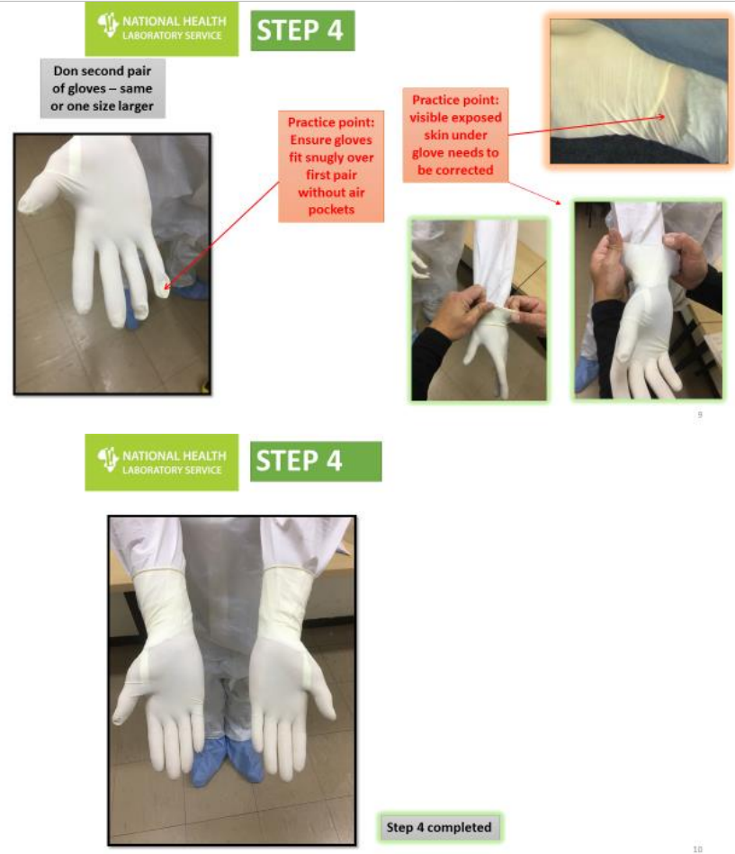
Q-Pulse7/docs/active/GPS0060v2

Slide 29
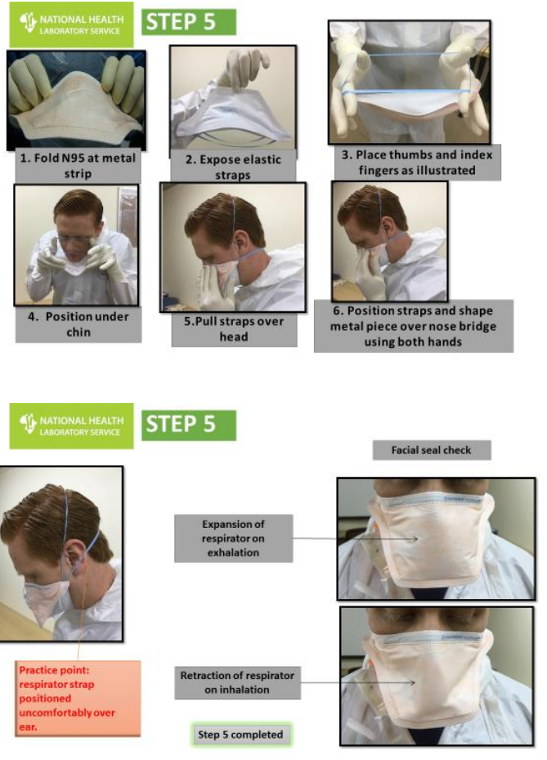
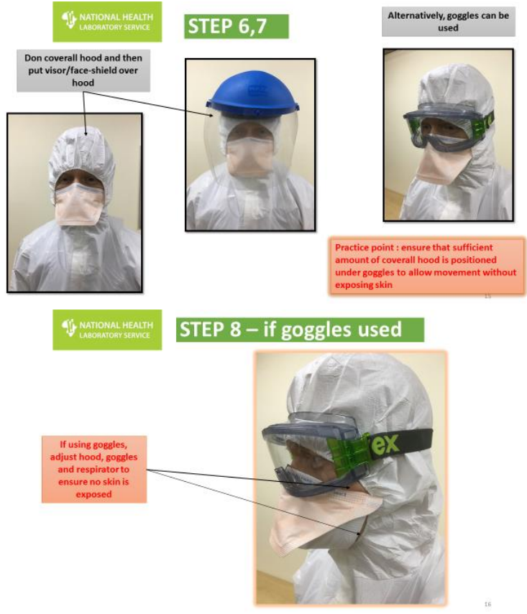

Slide 30
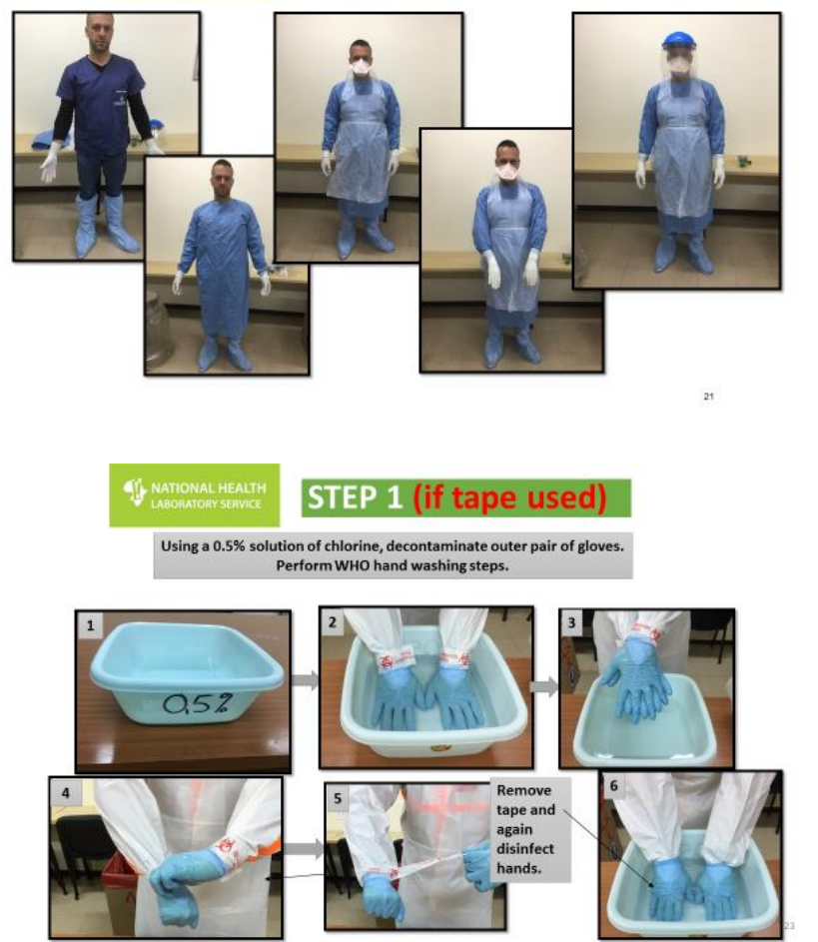
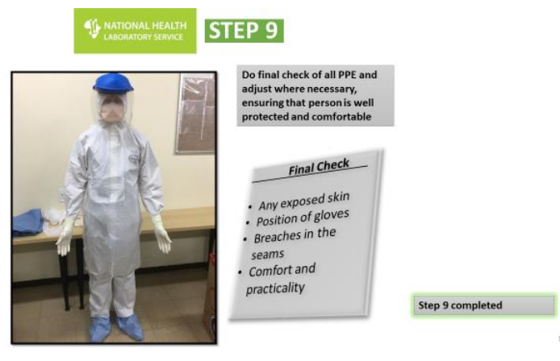

Slide 31
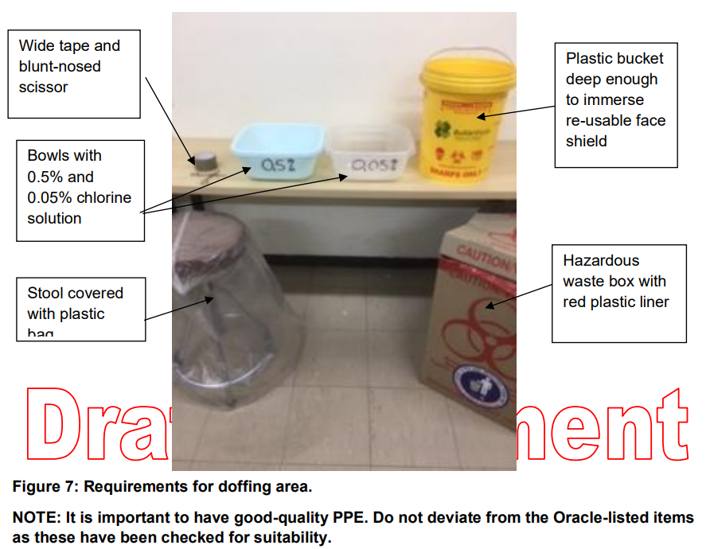
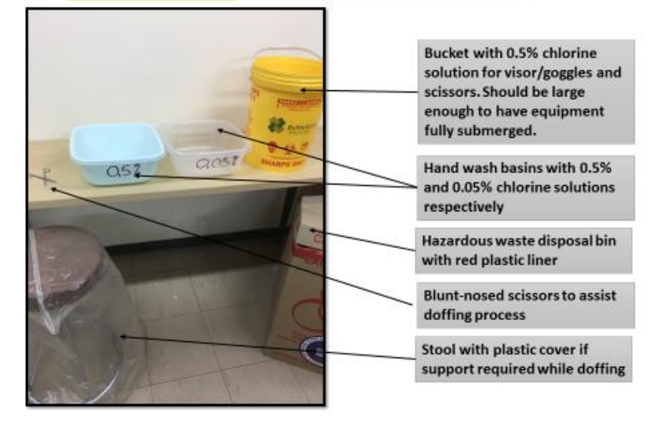
Requirements for donning & doffing areas

Slide 32
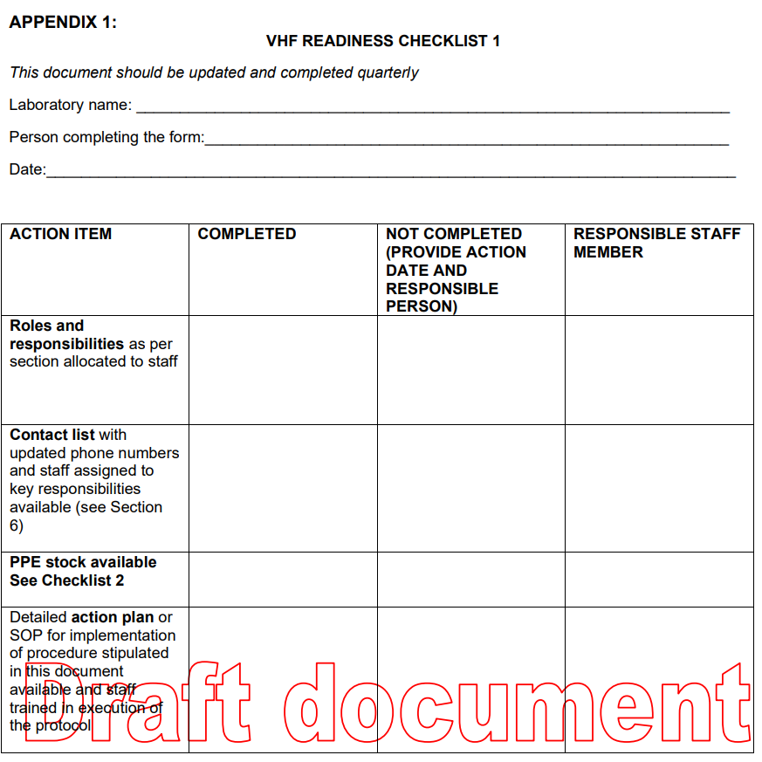
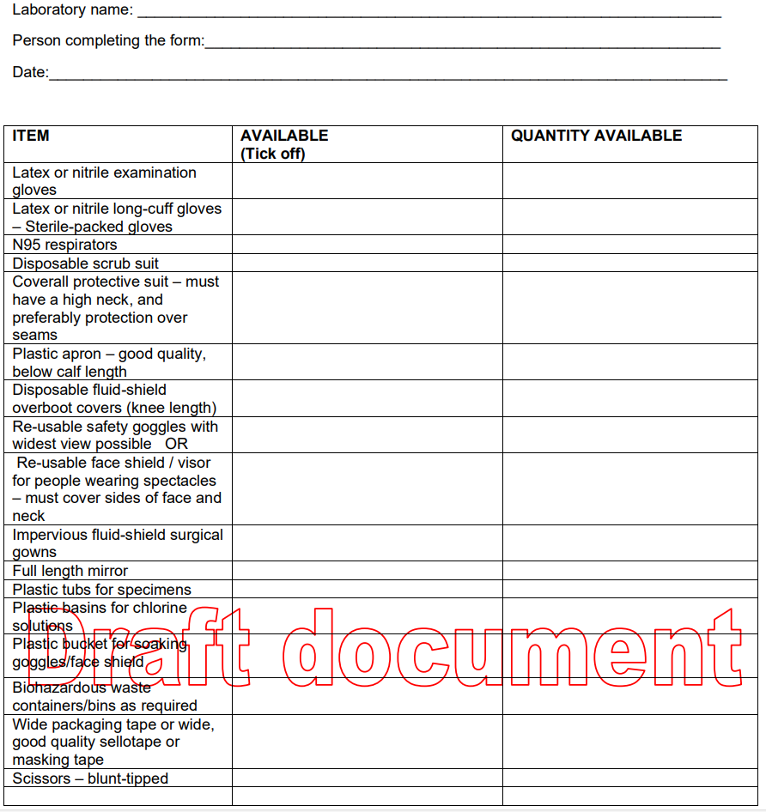
Q-Pulse7/docs/active/GPS0060v2

Slide 33
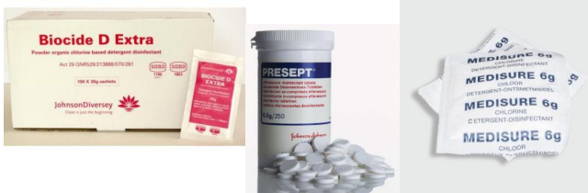
3. Decontamination and disinfection
General considerations for chlorine-based disinfectants:
Chlorine-based disinfectants are recommended
0.5% (5000 ppm chlorine) for excreta, spills of body fluids (blood, vomit etc)
30min contact time for complete decontamination
!!never spray onto spills/bodily fluids to prevent aerosolization- flood spill/material with disinfectant
use on surfaces (floor, tables, chairs, etc.), PPE (face-shield / goggles – note: rinse goggles in clean water after disinfection & allow to dry completely between uses)
0.05% (500 ppm available chlorine) for disinfecting clothes (soak for 30 min); skin
Notes:
Chlorine-based disinfectants are the preferred disinfectants when working with HF viruses and many other pathogens
Different concentrations for different purposes:

Slide 34
3. Decontamination and disinfection
General considerations for chlorine-based disinfectants:
Prepare fresh solution every day
do not use disinfectant older than 24 hr; don’t ‘top up’
use opaque plastic containers to prevent breakdown of chlorine by light
Use gloves and goggles when diluting chlorine
potent irritant to eyes, upper respiratory tract, lungs
0.014 - 0.054 ppm: tickling of nose
0.04-0.097 ppm: tickling of throat
0.06 - 0.3 ppm: itching of nose & cough, stinging, or dryness of nose & throat
0.35 - 0.72 ppm: burning of conjunctiva & pain after 15 min
Safe storage in separate, dry & ventilated room away from fuel/fire, sunlight

Slide 35
3. Decontamination and disinfection
General considerations for the use of alcohol-based disinfectants:
WHO-recommended formulation of alcohol-based hand rubs contains 60–80% alcohol
75% isopropanol or 80% ethanol (WHO Guidelines on Hand Hygiene in Health Care, 2009)
Evaporates quickly & non-toxic with topical application
may contribute to drying skin unless emollient included
flammable & requires special storage in large amounts (>40 litres)
Notes:
Alcohol solutions containing 60–80% alcohol are usually considered to have efficacious microbicidal activity; concentrations >90% being less potent
evaporates quickly & non-toxic with topical application so does not cause skin irritation, and is less likely to cause allergies

Slide 36
4. Sharps and waste management
Use of sharps should be limited/avoided
Waste containing materials and specimens from suspected/confirmed VHF cases deemed isolation waste (NHLS Policy POLS0014)

Slide 37
Clinical management
Specific (U.S. FDA approved)
Inmazeb (REGN-EB3; atoltivimab, maftivimab & odesivimab); for Zaire ebolavirus infections in adult & and children¹
Ansuvimab (Ebanga; mAb114); for Zaire ebolavirus infections in adult & and children²
Supportive
Rehydration, treatment of symptoms
Vaccination
Licensed, WHO prequalified
Ervebo® (rVSV∆G-ZEBOV-GP); adults & children >1y; replication-competent live attenuated recombinant; one dose; recommended for use in outbreaks; only vaccine available in global stockpile³
Zabdeno®/Mvabea® (Ad26.ZEBOV and MVA-BN-Filo); two-dose regimen³
Drugs. 2021 Jan;81(1):175-178
Drugs. 2021 Apr;81(5):595-598
https://www.who.int/news-room/questions-and-answers/item/ebola-vaccines
Notes:
only licensed vaccines are for EVD, several candidate vaccines are at different stages of development.
Ervebo compassionate use in Guinea in 2015 and for 345 000 people during the 2018-2020 outbreaks in the Democratic Republic of the Congo.

Slide 38

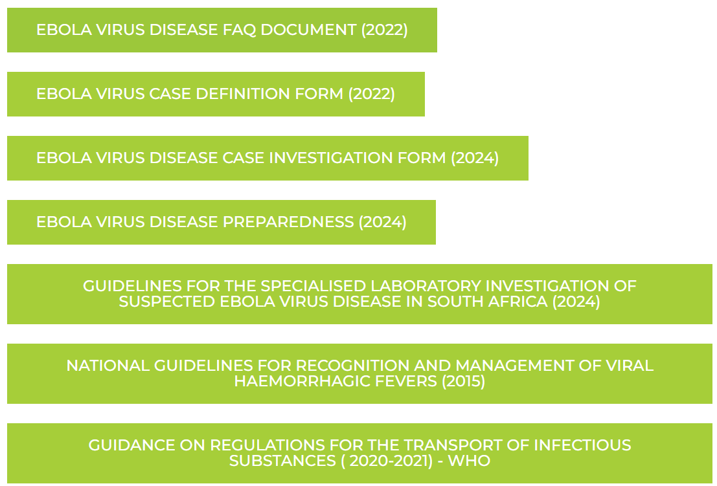
NICD Outbreak Response Unit: Outbreak@nicd.ac.za
NICD Hotline: 0800 212 552 (only for HCW)
NICD website

Slide 39
THANK YOU
NICD Outbreak Response Unit: Outbreak@nicd.ac.za
NICD Hotline: 0800 212 552 (only for HCW)
NICD website: www.nicd.ac.za

