Slide 1
Patient Surveillance
Marietjie du Toit
Renè Schoombie
Life Healthcare

Slide 2
Infection Prevention and Control
The role of patient surveillance
Monitors patterns of infectious diseases and their causes.
Enables preventative and control measures to be put in place.
Prevents outbreaks or early detect them to initiate timely action.
Identifies groups of patients at risk of disease.
Provides information for planning infection prevention and control and allocate resources.
Identifies interventions which have been successful and those which have not.
Identifies HAIs as early as possible.
Assists in the investigation and resolution of HAI’s
Environmental Surveillance
Patient Surveillance
Staff Surveillance

Slide 3
Types of Patient Surveillance
Continues surveillance - Organisms | Continues surveillance - Conditions
Review the laboratory results for the presence of significant organisms The IPS need to know the facts that contributes towards the disease profile of your HCF Managed and identify problematic organisms and the need to be followed up on These are defined as bacteria/viruses or fungi that require immediate intervention by the IPS Develop a process to flag these organisms to be reviewed often. | The same broad approach applies, but focused on specific groups of patients It is a matter of know your numbers and have a clear view of what it presents in your HCF This method requires close liaison between the IPS and the ward/unit staff. It relies on the staff being able to identify these patients who should be monitored and where infections are recognized A typical example would be patients with TB/MDR TB or patients other diseases.

Slide 4
Types of Patient Surveillance
Targeted surveillance | Ward visit surveillance
This surveillances is done periodically at one point in time and not continuously This surveillance is made up of a particular case mix: Isolated/cohorted patients Ventilated patients Patients with central lines High risk patients according to your own levels HAIs Bundles It can reflect changing patterns of HAIs within a population It can also assist with the development of a baseline to enable comparison and trending | Ward rounds may lead to other types of surveillance when a problem is identified Will identify new infections and problem areas Allow for interaction with nursing and ancillary staff Form a close relationship with all staff Create training opportunities

Slide 5
Types of Patient Surveillance
Comprehensive Surveillance
This type of surveillance is carried out in order to detect all HAIs in all patients all the time All patients are observed during a specified time e.g. 1 month This surveillance will use information such as: Patient documentation such a vital signs General reports Laboratory results Discussions with staff Discussions with the patient It can also create training opportunities Leads to other types of surveillance
When the IPS plans her patient surveillance he/she should take into consideration the following:
Which surveillance type
Which level to implement – taking into consideration the implementation schedule

Slide 6
Let’s Discuss surveillance: WHO carries out surveillance?
The IPS will act as the coordinator and leader of the surveillance process
The Plan
Levels of surveillance
After planning and prioritising the different areas in your facility according to the risks you will have:
3 Risk Levels:
LOW
MEDIUM
HIGH
Who will carry out the surveillance?
What type of surveillance
What time frame
What is the denominator
What is the sample size
Insure correct and accurate information
Information to be verified
All information to be cascaded to the relevant role players

Slide 7
Patient surveillance – Implementation schedule
Low-(e.g.1x week)
Medium (e.g. 3x week)
High (at least daily)
General wards.
Patients with catheters in general wards as part of the CAUTI bundle compliance audit
Day patients
Patients who had scopes
Patients transferred from other institutions
SSI bundle compliance to be conducted on patients who had surgery
Patients with devices in ICU/HC to conduct the CLABSI/CAUTI and VAP bundle compliance audits
Patients with significant organisms including MDRO’s
Isolated patients
Patients with predisposing conditions
Patients with specific organisms as part of a cluster
ICU & NICU patients
Patients with devices
Patients with HAI’s
Patients with notifiable diseases
Readmissions
Theater cases in ICU
This implementation schedule will depend on each different facility. Subjected to the IPSs definition

Slide 8
Aspects of Patient surveillance
Hand over process between day and night staff – you need to have a view of new admissions, change in condition,
Significant organisms present in your facility.
Know on the tip of your fingers which organisms are present in your facility
Significant conditions present in your facility. Know on the tip of your fingers which conditions are present in your facility
Which are your high risk units… If it changes, are you aware?
At any given point you need to know who your high risk patients are and where the admitted
Know which devices are present and where these patients are admitted
Isolated and cohorted patients:
Notifiable diseases
Type of precautionary measures
IP bundles
Patient documentation

Slide 9
Bundle compliance as part of patient surveillance
One of the main focus area as part of patient surveillance is the Infection Prevention Bundle compliance audits
What is a bundle:
A small, straightforward set of practices (3 – 5 elements)
When practiced collectively and reliably it improves patient outcomes
They are structured in such a way to improve the process of care and patient outcomes
They resemble a list, but the specific elements make them unique
All elements of the bundle must be completed for every patient every time
Ensuring adherence to infection prevention bundles such as:
Central Line-Associated Bloodstream Infection (CLABSI) bundle
Catheter-Associated Urinary Tract Infection (CAUTI) bundle
Ventilator-Associated Pneumonia (VAP) bundle
Surgical Site Infection (SSI) prevention bundle
Peripheral line blood stream infection (PLABSI)

Slide 10
HAI surveillance
Main HAI’s
Healthcare Associated Infection
A HAI is a localised or systemic condition resulting from an adverse reaction to the presence of an infectious agent(s) or its toxin(s) that was not incubating or present on admission to the healthcare facility
An infection is considered an HAI if all elements of a Centre for Disease Control (CDC) site specific infection criterion were not present on admission (POA) but were all present after the 3rd calendar day of admission to the facility
The day of admission to the facility is calendar day one
The definition of a gap day is a calendar day during which no infection criterion elements are present
CLABSI (Central Line Associated Bloodstream Infection)
VAP (Ventilator Associated Pneumonia)
CAUTI (Catheter Associated Urinary Tract Infection)
SSI (Surgical Site Infection)
Take into consideration other site - specific HAIs that do not fit the above 4 but is reporting HAIs for example, but not limited to:
(Using the CDC definitions to define)
UTI (Urinary Tract Infection)
Non-CLABSI (Non- central line associated bloodstream infection)
GIT (Gastrointestinal tract infection)
Pneu (Non-ventilator associated pneumonia), often referred to as HAP

Slide 11
Remember the HAI definitions
As the subject matter expert, the IPS is the custodian of HAIs and must make the final call with regards to the identification and of classification, after consultation with the UM, IPC champion and the physician/ surgeon
What are the key terms and abbreviations the IPS need to know and understand.
Of particular importance:
Date of event
HAI
Infection window period
Present on admission
Repeat infection timeframe
CAUTI
VAP
CLABSI
SSI
NEC
BSI
Skin and soft tissue

Slide 12
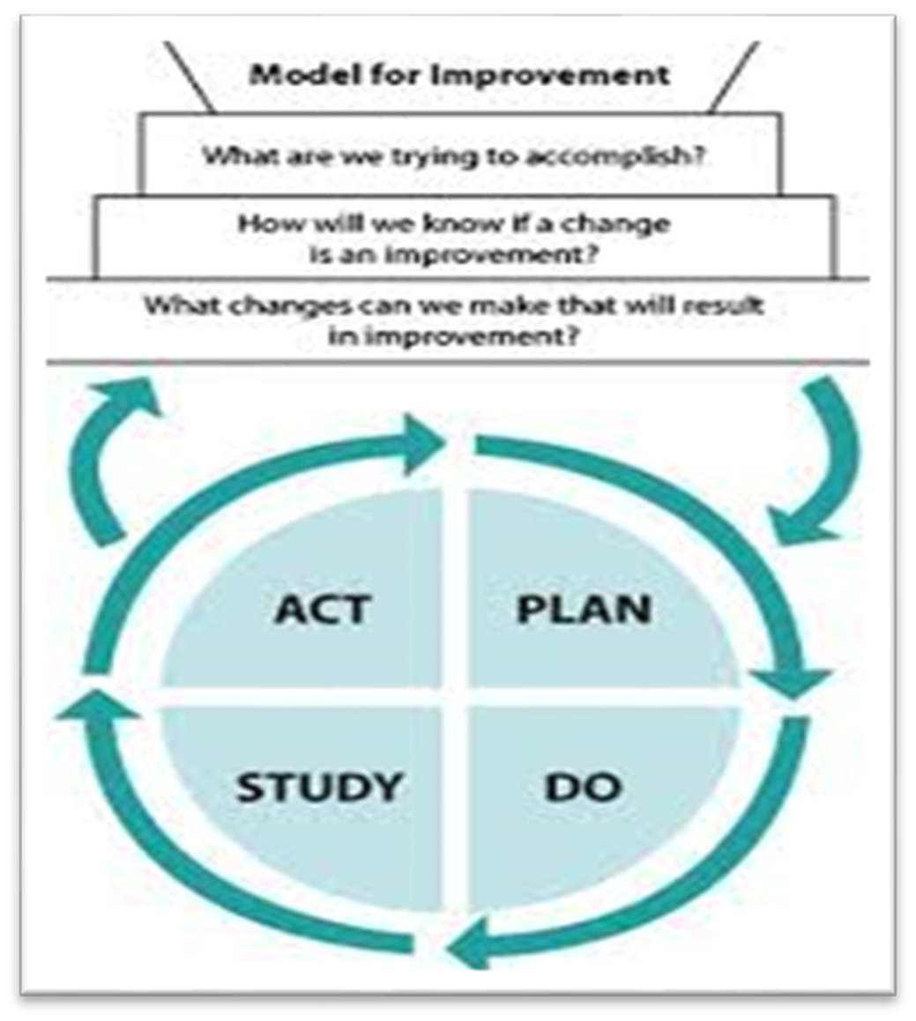
HAI Surveillance – Manage your cases
Use the PDSA cycle to manage all actions addressing the root cause/s of your HAIs
The know how…
Who will investigate
What is the time frame
How to address the root cause
Who needs to sign off
Can you print
Do you have a HAI buddy
Where do you discuss your HAIs
Do you trend your HAIs:
Unit
Causing organisms
Type
The investigation of a HAI is a legal requirement and we need to follow a structured and formalised process

Slide 13
PDSA Cycle in HAI Surveillance
Plan
Identify the Problem:
Define the specific HAI issue (e.g., increase in surgical site infections or catheter-associated infections).
Set Objectives:
Determine what you want to improve (e.g., reducing infection rates by 20% in six months).
Develop a Plan:
Create an intervention strategy, such as implementing hand hygiene training, improving catheter care protocols, or enhancing environmental cleaning.
Define Metrics:
Choose key performance indicators (KPIs) like infection rates, compliance with hygiene protocols, and patient outcomes.

Slide 14

PDSA Cycle in HAI Surveillance
2. DO
Implement the Plan:
Put the planned interventions into action in a controlled manner (e.g., in a specific unit or department).
Train Staff:
Educate healthcare workers on new procedures and ensure compliance.
Collect Data:
Monitor and document infection rates, adherence to protocols, and any operational challenges.

Slide 15

PDSA Cycle in HAI Surveillance
3. Study
Analyze Results:
Compare infection rates before and after intervention to assess effectiveness.
Identify Successes & Gaps:
Determine what worked and what needs improvement.
Review Feedback:
Gather input from healthcare workers and patients to refine the approach.

Slide 16

PDSA Cycle in HAI Surveillance
4. Act
Standardize Successes:
If the intervention is effective, integrate it into routine practice across the hospital.
Modify and Retry:
If results are unsatisfactory, adjust strategies (e.g., increase monitoring, provide additional staff training) and repeat the cycle.
Expand and Sustain Improvements:
Scale up successful interventions hospital-wide and continue monitoring to ensure long-term success.

Slide 17

"Vigilant surveillance saves lives—stay observant, stay proactive, and protect our patients. Every moment of attention, every action taken, and every risk mitigated brings us closer to a safer future. Together, through unwavering dedication and diligence, we can make a lasting impact. Stay committed, stay vigilant, and continue being the safeguard our patients depend on."

Slide 18
Thank you Renè Schoombie 0844979332 rene.debeer@lifehealthcare.co.za

Slide 19


