Slide 1
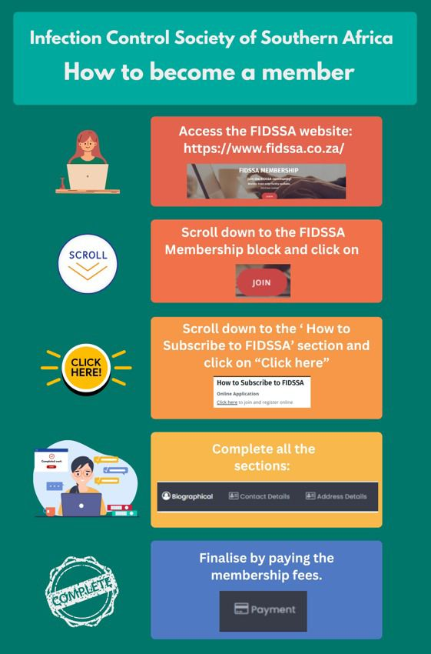
We may come from different facilities, face different battles, and tackle unique challenges—but at our core, we are united by the same mission: Preventing Infections And Saving Lives.
This fight is too big for any of us to take on alone. We need each other—to share strategies, to lift each other up when the weight of this work feels heavy, to remind ourselves that we are part of something bigger.
If you’re an IP and you haven’t built those connections yet, start today.
💡 Reach out to an IP at another facility.
💡 Send a message to someone whose work inspires you and start a conversation.
Every day, we fight critical battles, but we don’t have to fight them alone. There’s a vast network of IPs with diverse backgrounds, perspectives, and experiences.
Step out of your silo. Build those connections. Strengthen our community.
Join ICSSA.

Slide 2
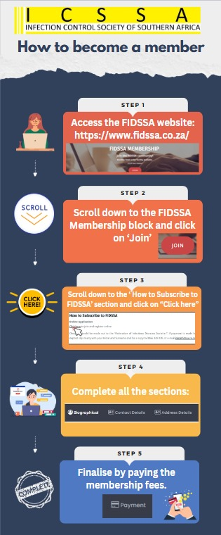
We have different settings, different challenges but the same core mission, preventing infections in our facilities. We need each other. To share strategies. To validate frustrations. To remind ourselves that the challenges we face aren’t just ours alone. If you’re an IP and you haven’t built those connections yet, start today
Reach out to an IP at another facility
Send a message to someone whose work you admire and get the conversation started. We fight battles every day but we don’t have to fight them alone. There are thousands of IPs out there, with tons of different backgrounds, perspectives, personalities. Get out there and get to know them. Don’t keep yourself in a silo.
Join ICSSA

