Slide 1
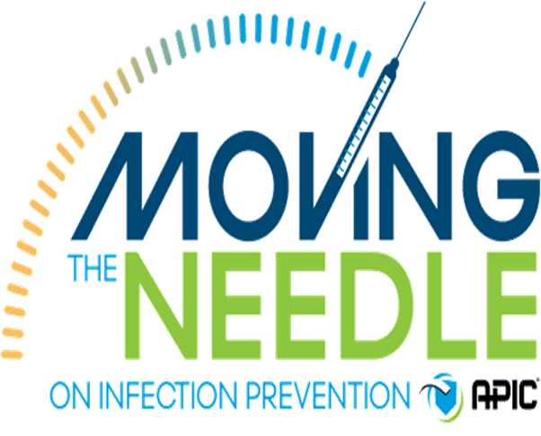
Moving the needle in Infection Prevention
Reflection on the International Infection Prevention Week
Renè Schoombie

Slide 2
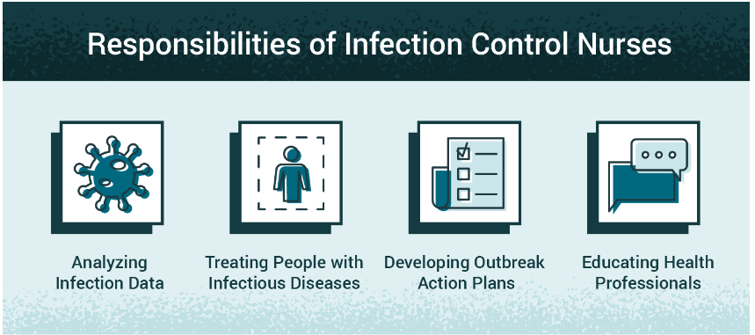
International Infection Prevention Week (IIPW) shines a light on the demanding work Infection Prevention Specialists (IPS) do every day to keep patients healthy and safe.
Why:
This is about moving beyond awareness. It’s about taking concrete steps to improve infection prevention and control in ways that truly make a difference.
We’re looking at how infection prevention specialists (IPS) can make changes that create safer healthcare environments for patients and staff.

Slide 3

Overview of the Theme
Moving the Needle: The Goal of IIPW 2024
Purpose:
Elevate infection prevention practices across all healthcare settings.
The phrase “Moving the Needle” symbolizes real progress.
It challenges us to think about how we can enhance IPC practices in ways that are practical and sustainable.
Focus:
Engage all stakeholders to implement actionable, job-ready improvements.
From administrators to front-line staff, to create lasting changes in infection prevention.

Slide 4

Moving the Needle…on the Profession’s Development
Question: How can we ensure that career advancement and professional development opportunities are accessible to all healthcare workers?
“We’re all IPs!”
Infection prevention is a shared responsibility,
Make career advancement and professional development accessible to all healthcare workers
How:
Continuous Learning:
Encourage all health workers to stay updated on the latest IPC practices.
Skill Development:
Promote skill-building through regular training and review of current IPC literature.
Be part of Infection Control Societies
Best Practice Integration:
Motivate collegues to integrate evidence-based practices into their daily routines.
Notes:
Infection prevention is a shared responsibility, and we’re all part of this mission. To “move the needle” on our profession, we need to make career advancement and professional development accessible to all healthcare workers, regardless of their educational background or role.

Slide 5
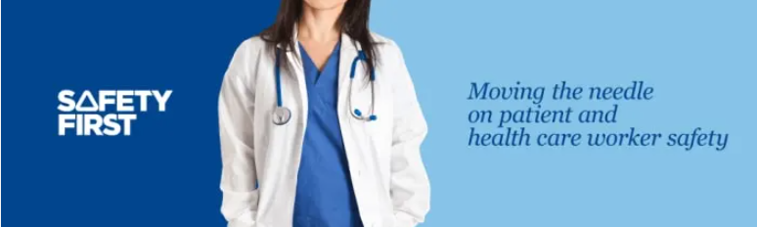
Moving the Needle…on Healthcare Worker Safety
Question: How can we enhance occupational health and sharps safety protocols to ensure they are equitable for all healthcare workers, especially those in under-resourced areas?
Message: “Occupational health and sharps safety are vital for all healthcare workers. Let’s create equitable safety protocols that protect everyone.”
How:
Protecting Staff from Infections
Prioritize the health and safety of healthcare workers through improved infection control measures.
PPE Compliance
Ensure proper usage and availability of PPE.
Workplace Hazard Control
Minimize exposure to pathogens and infectious agents in all departments.
Notes:
Protecting healthcare workers’ health and safety is essential. To ensure fairness, we must prioritize resources for under-resourced areas so everyone has access to safe working conditions, regardless of location

Slide 6
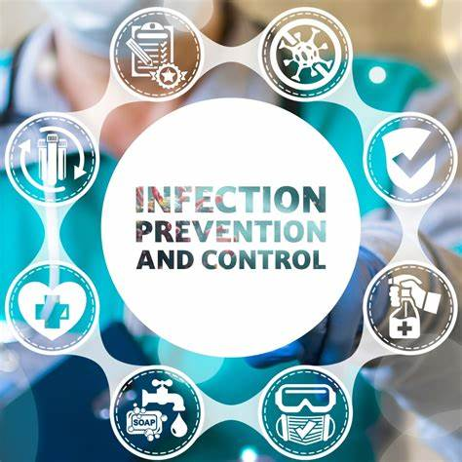
Moving the Needle…on Patient Safety
Question: How can we ensure equal access to infection prevention resources so all patients receive the highest standard of care?
Message: “Access to infection prevention resources is crucial. Let’s ensure that every patient receives VIP care.”
How:
Reducing Healthcare-Associated Infections (HAIs):
Focus on lowering HAIs through stringent hygiene and sanitation protocols.
Building Patient Confidence:
Safe environments build patient trust in our healthcare services.
Effective Clinical Practices:
Implement evidence-based clinical interventions for infection prevention.
Notes:
Presenter Note: Our goal is to provide equal care to all patients. Infection prevention resources should be distributed fairly so that every patient, regardless of background, receives the same high-quality, safe care.

Slide 7
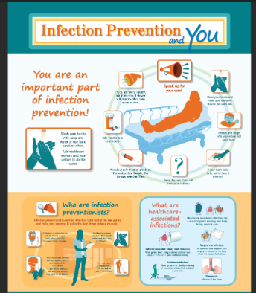
Moving the Needle…on Public Health Preparedness
Question: How can we address the unique needs of diverse communities in public health preparedness plans?
Message: “Public health preparedness must be inclusive. Make our communities feel less vulnerable, arming them to confront both known and emerging infectious agents with confidence.”
How:
Community Preparedness:
Teaching them basic infection prevention skills and support community organizations
Strengthen systems to address disease outbreaks and healthcare emergencies.
Coordinated Response Efforts:
Develop a well-organized response framework involving all levels of healthcare.
Strengthening Public Health awareness:
Investing in, training, and partnerships to increase preparedness.
Notes:
Presenter Note: Public health preparedness must consider the diversity of our communities. By tailoring preparedness plans to meet unique needs, we can offer comprehensive support and ensure no one is left behind during health crises.

Slide 8
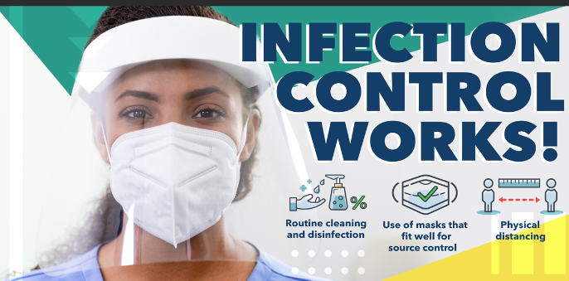
Moving the Needle…Across the Continuum of Care
Question: How can we implement infection prevention practices equally across all healthcare settings?
Message: “Infection prevention should be consistent and similar in every setting.
Let’s ensure all patients benefit from the same standards.”
How:
IPC from Admission to Discharge:
Emphasize infection prevention at every stage of patient care.
Seamless Transition of Care:
Implement standardized precautions across all patient interactions.
Improving Health Outcomes:
Consistent IPC protocols across the continuum lead to healthier, safer patient outcomes and reduces HAI’s
Notes:
Presenter Note: To protect every patient equally, infection prevention practices need to be consistent across all care settings. Whether a patient is in a hospital, clinic, or long-term care, they should receive the same high standard of infection prevention

Slide 9
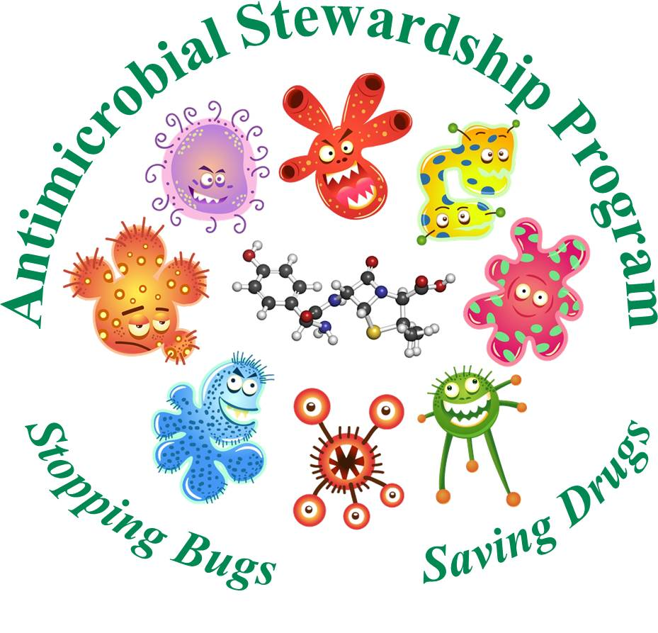
Moving the Needle… Antimicrobial Stewardship (AMS)
Question: How do we ensure that our antimicrobial stewardship efforts effectively benefit both individual patients and the community at large?"
Message: "By promoting responsible antibiotic use, we protect patient health, reduce resistance, and ensure these lifesaving treatments remain effective for everyone." “
How:
Education and Training: Provide regular AMS training for healthcare providers on responsible prescribing and resistance risks.
Prescription Monitoring and Feedback: Implement systems in collaboration with the clinical pharmacist to track antibiotic use and provide feedback to prescribers.
Public Awareness Campaigns: Engage patients and the community in understanding when antibiotics are necessary and safe.
Notes:
Antimicrobial stewardship is crucial in protecting patient safety and public health. By optimizing antibiotic use, we reduce resistance and improve patient outcomes. Let’s work together to promote AMS practices through training, monitoring, and public awareness, ensuring responsible antibiotic use across our facility.

Slide 10
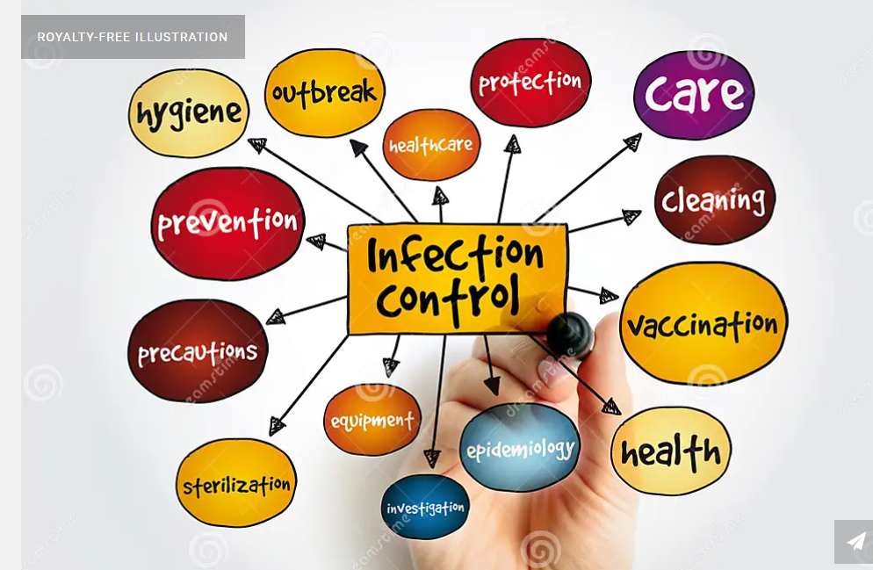
Conclusion – Moving the Needle Together
Message: “We celebrate International Infection Prevention Week to recognize the important role each of us plays in infection prevention.
Together, let’s keep moving the needle!”
How: :
Staying Ahead in 2025
Stay Informed
Analyze Your Data
Understand All Aspects
Collaborate
Be Adaptable and Engaged
Reach out to IPC societies and become
members e.g. ICSSA.
Notes:
To wrap up, I want to emphasize that we all have a part to play in advancing infection prevention., let’s commit to moving the needle forward, step by step, to create a safer, more equitable healthcare environment for everyone.

Slide 11
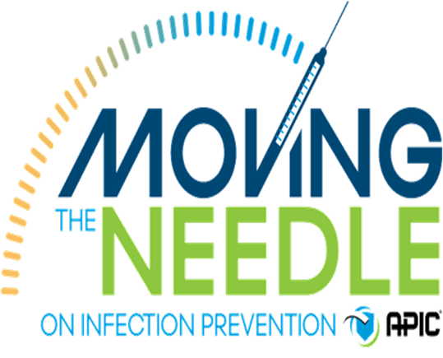
Thank You

