Slide 1

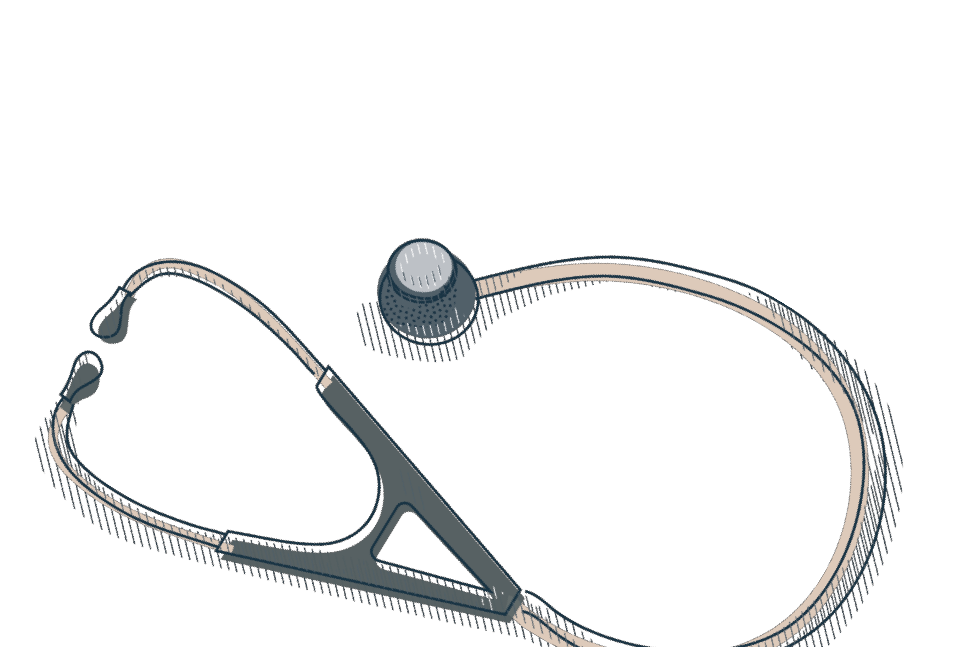
Legionella Prevention in hospital settings water systems
Dr Caroline Maslo, MD, PhD
20 November 2024

Slide 2
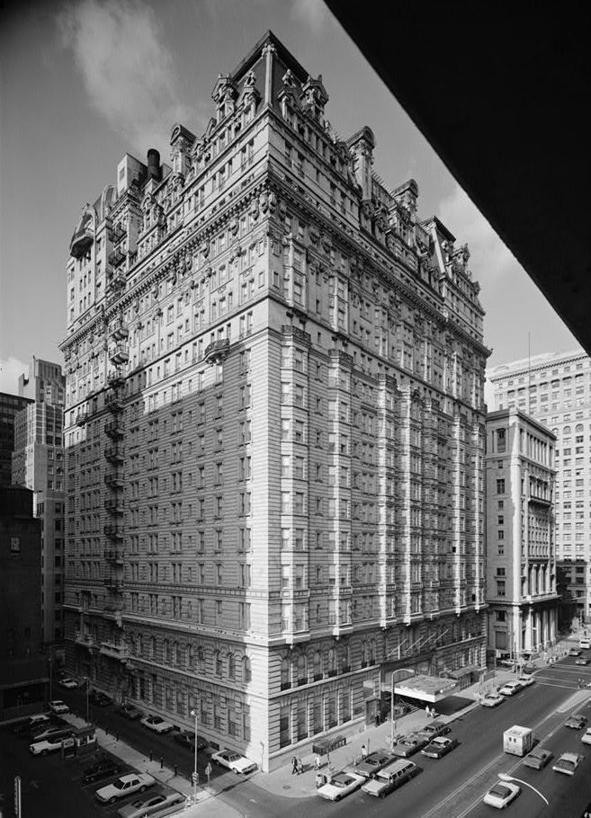
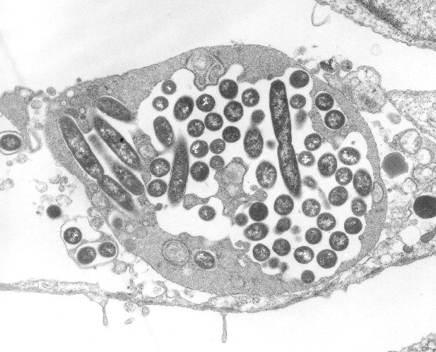
Legionella and Legionnaires’ disease
The 1976 Legionnaire’s disease outbreak centered on the Bellevue-Stratford Hotel, where the disease’s victims had gathered for an annual American Legion convention.
221 cases
34 deaths
Legionella
Aerobic small gram-negative bacilli
59 species – about 20 pathogenic
L. pneumophila, L. micdadei
L. longbeachae
L. pneumophila has 17 known serogroups, serogroup 1 being most prevalent in human disease

Slide 3
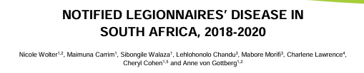
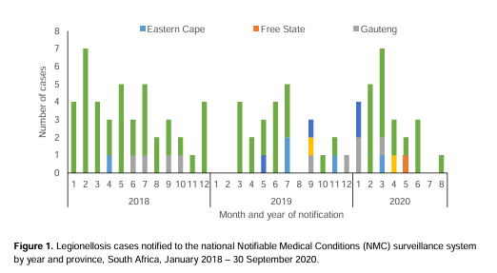
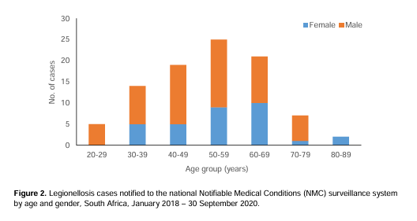
EPIDEMIOLOGY
93 cases
72/93 western Cape
84 hospitalized patients
81% underlying illness
18.8% HIV positive
20.3% deceased

Slide 4
CLINICAL PRESENTATION
TRANSMISSION: Respiratory contamination from inhalation of water droplets

Slide 5
PONTIAC FEVER
Mild respiratory disease that “gets better without treatment” (CDC)
Flu-like symptoms=
Cough, Fever, muscles ache
No signs of pneumonia
Lasts 2-5 days
No specific treatment
Most patients are not ill enough to seek medical attention
Rarely diagnosed before PCR respiratory pannels

Slide 6
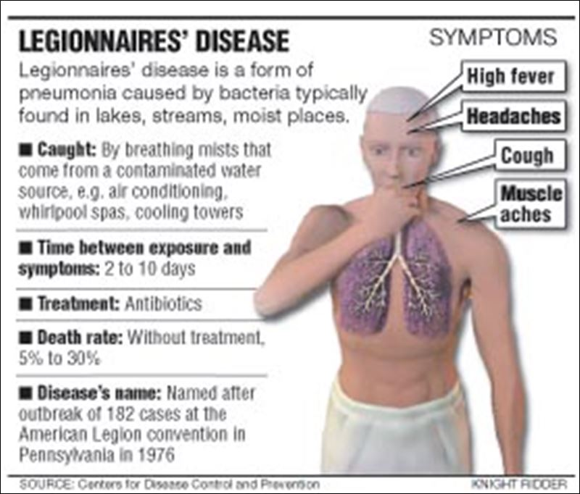
Legionaires’ disease =pneumonia
1- Non –specific presentation,
2-Grow on specific mediums
3-Not treated by antibiotics usually prescribed
for common pneumonia.
“If you don’t look for it you miss it”
Clinicians need to be informed
immediately if the water system is positive for legionella.
Mortality 10-25%

Slide 7
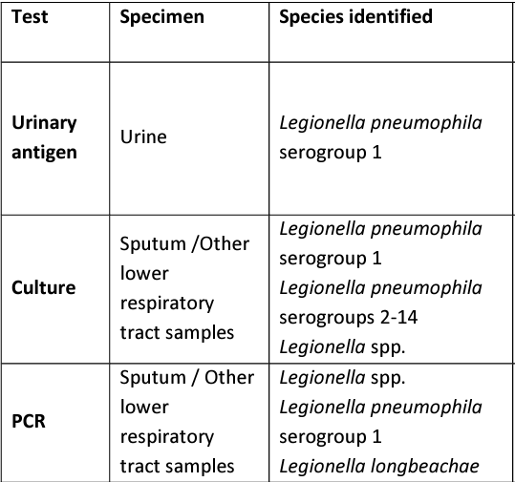
Testing patients for legionella
Most isolates grow within 3-5 days. However, a negative result is only released after 7-10 days of incubation
Results are positive usually up to 7 days after treatment

Slide 8
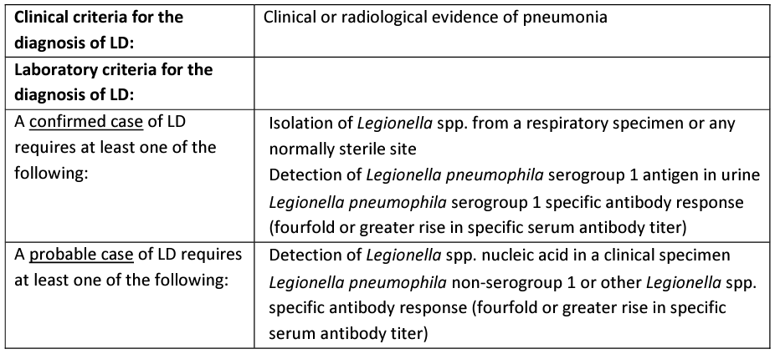
DoH notification within 7 days
Use the appropriate definitions for case declaration

Slide 9
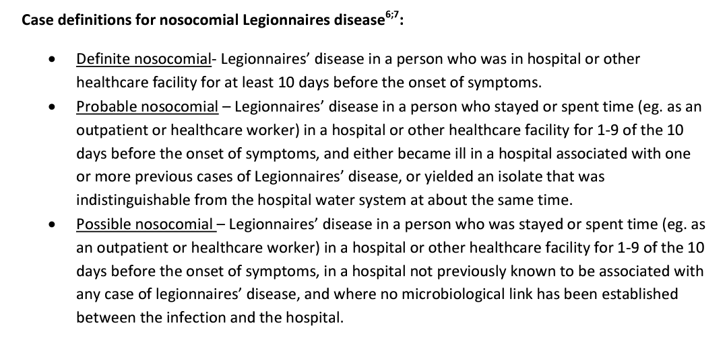
DoH notification within 7 days
Use the appropriate definitions for case declaration
Confirmed case: positive culture OR UA positive or positive serology
Probable case: PCR positive or other legionella detected.

Slide 10
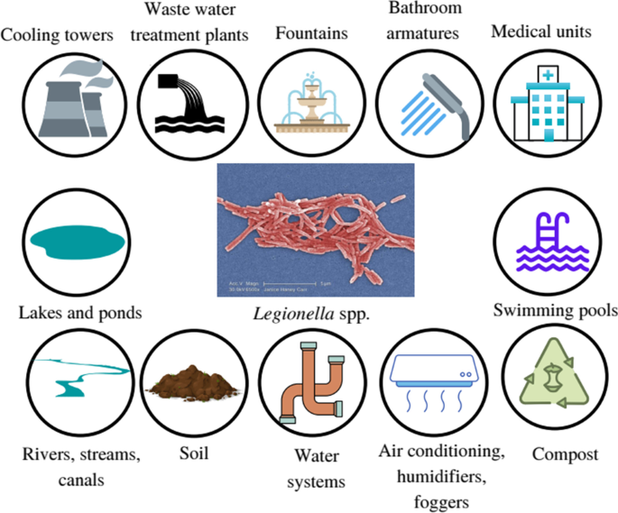
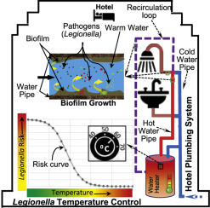
Legionella reservoirs
Found in lakes and ponds
Little interactions with humans
Becomes a threat when infects human water systems
Any point of the water system can be colonized with legionella

Slide 11
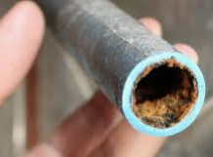
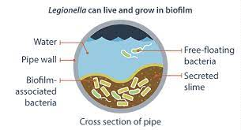
Biofilm Formation
Biofilms are slimy layers that develop on surfaces in water systems. Legionella bacteria can attach and multiply within biofilms, providing them with protection and nutrients. Biofilm formation can occur in areas with scale buildup, sediments, or areas with inadequate cleaning and disinfection practices.
Chlorine doesn’t destroy the biofilm

Slide 12
RISK FACTORS FOR LEGIONELLA GROWTH
1- Stagnant Water
Stagnant water provides an ideal environment for Legionella growth. Areas of the water network that are rarely or infrequently used, such as unused or closed-off wings, low occupancy rooms, or sections of the plumbing system with low flow rates, are particularly susceptible to bacterial proliferation.
Stagnant water in hospital settings are all wards with low occupancy or all rooms where the shower is not used daily (i.e. oncology wards where patients maybe too sick to use the shower daily).

Slide 13
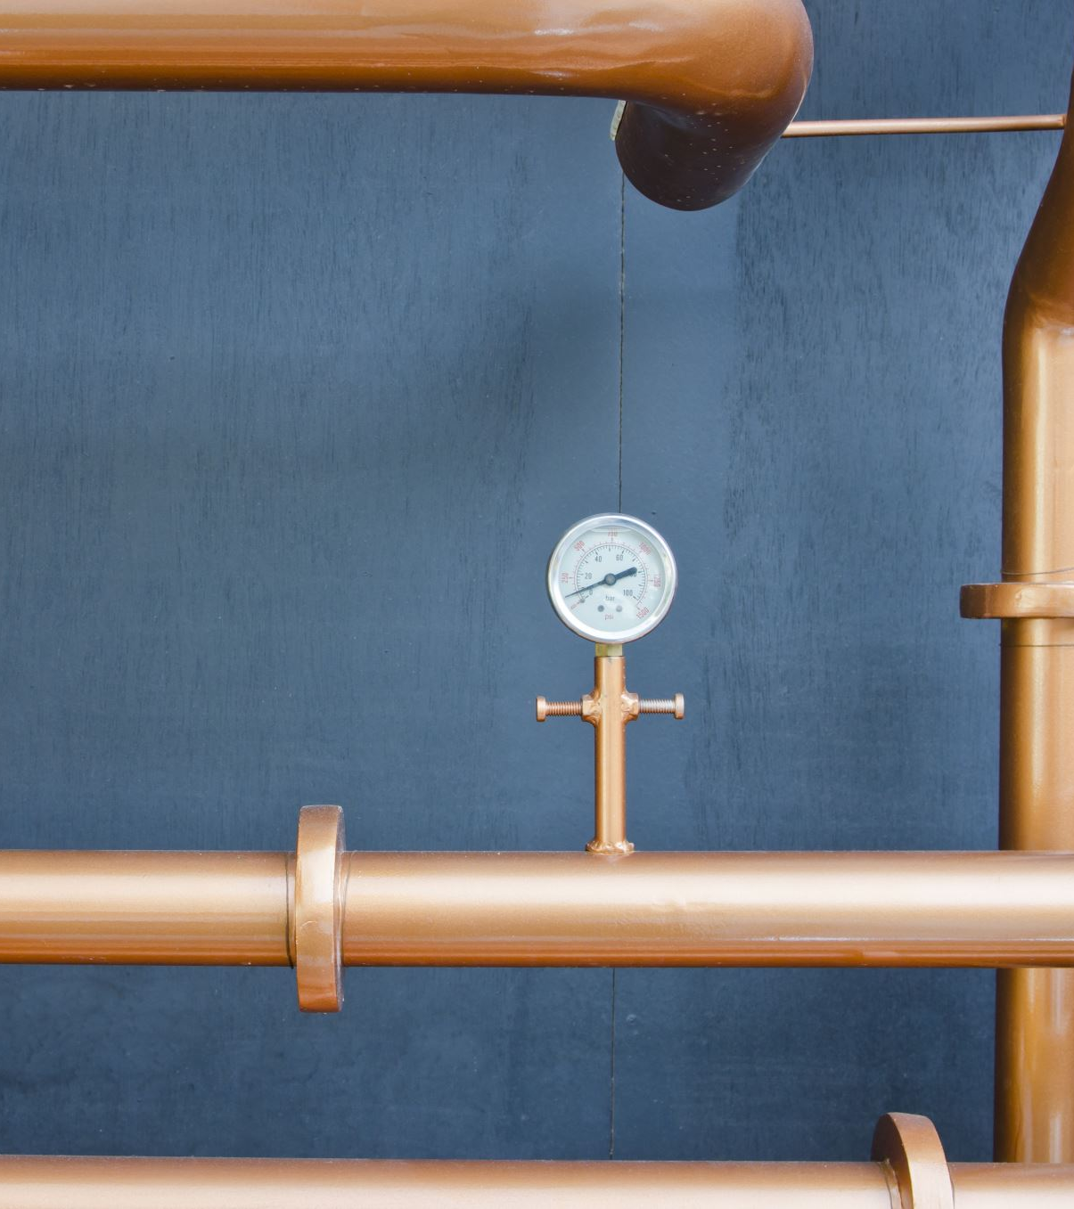
2- Disruption- damage of biofilm
Construction (including renovations and installation of new equipment): Vibrations and changes in water pressure can dislodge biofilm and release Legionella or other waterborne pathogens.
Water main breaks: Changes in water pressure can dislodge biofilm and release Legionella or other waterborne pathogens.
Changes in municipal water quality (pH, chlorine…)

Slide 14
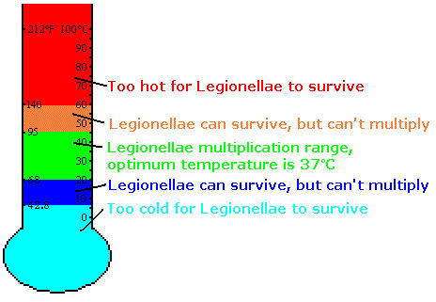
Hot water should be stored above 60˚C and delivered to taps above 50˚C. Cold water should be stored below 20˚C.
3- Temperature: Legionella bacteria thrive in warm water environments. If the temperature of the water in the hospital's distribution system is not adequately controlled, especially in hot water tanks, warm water pipes, or poorly insulated areas, it can promote the growth and survival of Legionella.
The tap temperature should be taken after the water has run for 60 seconds. Beware of cross-contaminating water samples with the thermometer probe. Use 70% alcohol to disinfect the probe between samples. Sent to NHLS preferably on Mondays

Slide 15
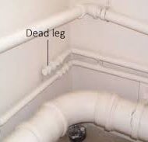
Other risks
4 Dead Legs and Dead Ends:
Dead legs refer to sections of the water network that have little to no flow, such as pipes that have been capped or disconnected. Dead ends occur when a pipe terminates without proper flushing or circulation. These areas can promote stagnation and create favourable conditions for legionella growth.
5- Contaminated Water Sources: If the hospital's water supply is contaminated with Legionella bacteria, it can introduce the pathogen into the water network. This can occur due to inadequate water treatment, contaminated municipal water supplies, or cross-connections with non-potable water sources.
6- Construction and Plumbing Work: During construction, renovation, or plumbing work, the water system may be temporarily disrupted or modified, which can lead to the introduction of Legionella into the network. Pipe damage, improper flushing, or inadequate disinfection following the work can increase the risk of contamination.
7- Water Treatment System Issues: Inadequate design, operation, or maintenance of water treatment systems, such as cooling towers or water filtration units, can contribute to Legionella contamination. These systems should be regularly inspected, cleaned, and properly disinfected to minimize the risk.
Annual cleaning of water tanks- disinfection of shower heads

Slide 16
Infection results from a combination of 1) high bacterial load 2) aerosol type 3) host immune system
Bacterial load in the water
(stagnation, temp too low or too high)
Decrease local or systemic cellular immunity
Oncology, haematology. Transplant units…
Mode of delivery of Legionella contaminated water – showers, taps, through tap water filled or rinsed nebulizers, humidifiers, ventilator tubing, nasogastric feedings or lavages) into the respiratory tract

Slide 17
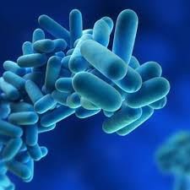
How to manage the legionella risk in a hospital?

Slide 18
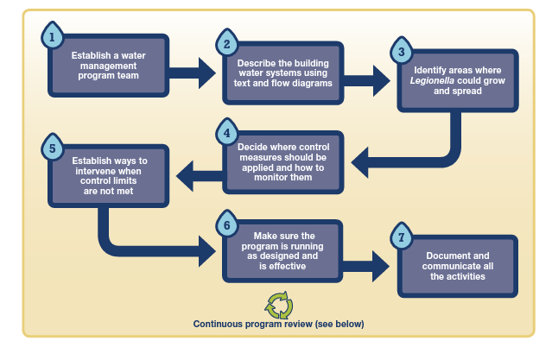
1- Establish a water management programme

Slide 19
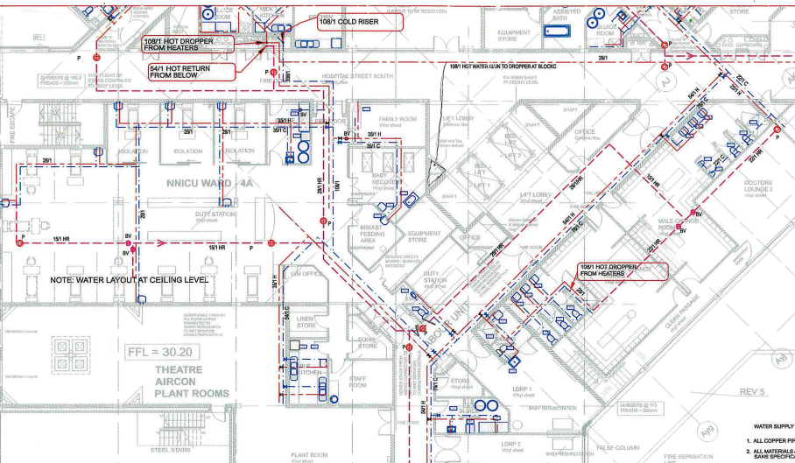
How to start water mapping
Map the whole water system from municipality water to the furthest points.
On this map highlight all points at risk for legionella colonization.

Slide 20

Legionella: Warm Water Program Management: outline drawing
Boiler 2
Boiler 1
R
4
NICU
Milk
Bank
Labour
ward
IT
Office
Maternity
Ward
Medical
ward
Night manager
Public Restroom
Change
rooms
Cath lab
AICU
CSSD
Theatre 1-6
Theatre
Recovery
Theatre kitchen
Surgical ward
Surgical HC
GIT
Public Restroom
3
2
General
Ward
Oncology Day ward
Linen holding
Doctors suites A
Pathcare
Public Restroom
Doctors suites C
1
Paeds Ward
PICU
Doctors Suites A
Ampath
Surgical Stores
NRC
Public Restroom
Doctors Suites C
Water supply tank 1
Water supply tank 2
G
Public restroom
Trauma
Unit
Main Kitchen
Pharmacy
Clinical Learning
X-ray
dept.
Management
Public restroom
OHS
clinic
Netcafe

Slide 21
Legionella: Water Program Management: outline drawing
Boiler 2
Boiler 1
R
4
NICU
Milk
Bank
Labour
ward
IT
Office
Maternity
Ward
Medical
ward
Night manager
Public Restroom
Change
rooms
Cath lab
AICU
CSSD
Theatre 1-6
Theatre
Recovery
Theatre kitchen
Surgical ward
Surgical HC
GIT
Public Restroom
3
2
General
Ward
Oncology Day ward
Linen holding
Doctors suites A
Pathcare
Public Restroom
Doctors suites C
1
Paeds Ward
PICU
Doctors Suites A
Ampath
Surgical Stores
NRC
Public Restroom
Doctors Suites C
G
Public restroom
Trauma
Unit
Main Kitchen
Pharmacy
Clinical Learning
X-ray
dept.
Management
Public restroom
OHS
clinic
Netcafe
Water supply tank 1
Water supply tank 2

Slide 22
Controlled positive sample 1-99 cfu/L
Poorly controlled positive sample 100-999cfu/L
Uncontrolled positive sample 1000+ cfu/L
Not detected
Legionella: Water Program Management: samples
Boiler 2
Boiler 1
R
4
NICU
Milk
Bank
Labour
ward
IT
Office
Maternity
Ward
Medical
ward
Night manager
Public Restroom
Change
rooms
Cath lab
AICU
CSSD
Theatre 1-6
Theatre
Recovery
Theatre kitchen
Surgical ward
Surgical HC
GIT
Public Restroom
3
2
General
Ward
Oncology Day ward
Linen holding
Doctors suites A
Pathcare
Public Restroom
Doctors suites C
1
Paeds Ward
PICU
Doctors Suites A
Ampath
Surgical Stores
NRC
Public Restroom
Doctors Suites C
G
Public restroom
Trauma
Unit
Main Kitchen
Pharmacy
Clinical Learning
X-ray
dept.
Management
Public restroom
OHS
clinic
Netcafe
Water supply tank 1
Water supply tank 2

Slide 23


High risk clinical areas
Water temp >52C
Water temp <52C
Controlled positive sample 1-99 cfu/L
Poorly controlled positive sample 100-999cfu/L
Uncontrolled positive sample 1000+ cfu/L
Not detected
Legionella: Water Program Management: High Risk clinical areas
Boiler 2
Boiler 1
R
4
NICU
Milk
Bank
Labour
ward
IT
Office
Maternity
Ward
Medical
ward
Night manager
Public Restroom
Change
rooms
Cath lab
AICU
CSSD
Theatre 1-6
Theatre
Recovery
Theatre kitchen
Surgical ward
Surgical HC
GIT
Public Restroom
3
2
General
Ward
Oncology Day ward
Linen holding
Doctors suites A
Pathcare
Public Restroom
Doctors suites C
1
Paeds Ward
PICU
Doctors Suites A
Ampath
Surgical Stores
NRC
Public Restroom
Doctors Suites C
G
Public restroom
Trauma
Unit
Main Kitchen
Pharmacy
Clinical Learning
X-ray
dept.
Management
Public restroom
OHS
clinic
Netcafe
Water supply tank 1
Water supply tank 2

Slide 24
Low occupancy unit
High risk clinical areas
Water temp >52C
Water temp >52C
Controlled positive sample 1-99 cfu/L
Poorly controlled positive sample 100-999cfu/L
Uncontrolled positive sample 1000+ cfu/L
Not detected
Legionella: Water Program Management: low occupancy
Boiler 2
Boiler 1
R
4
NICU
Milk
Bank
Labour
ward
IT
Office
Maternity
Ward
Medical
ward
Night manager
Public Restroom
Change
rooms
Cath lab
AICU
CSSD
Theatre 1-6
Theatre
Recovery
Theatre kitchen
Surgical ward
Surgical HC
GIT
Public Restroom
3
2
General
Ward
Oncology Day ward
Linen holding
Doctors suites A
Pathcare
Public Restroom
Doctors suites C
1
Paeds Ward
PICU
Doctors Suites A
Ampath
Surgical Stores
NRC
Public Restroom
Doctors Suites C
G
Public restroom
Trauma
Unit
Main Kitchen
Pharmacy
Clinical Learning
X-ray
dept.
Management
Public restroom
OHS
clinic
Netcafe
Water supply tank 1
Water supply tank 2

Slide 25
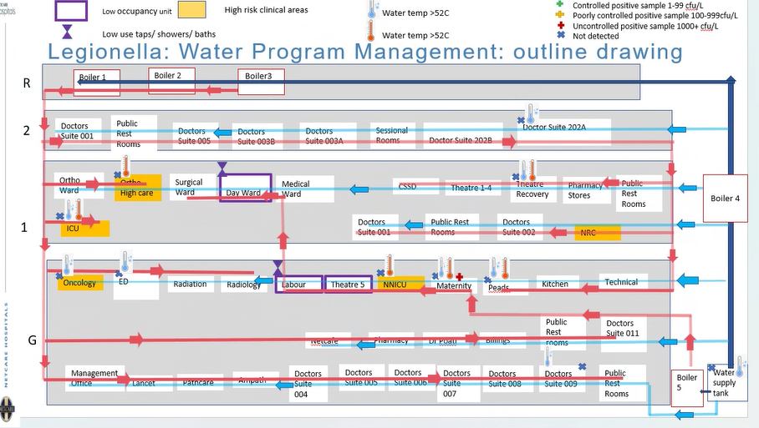
What to add on the risk map?
Previous positive results
High risk wards
Low occupancy wards
Temperature too low
Rooms/wards closed

Slide 26

Plan the system routine monitoring according to the risk level
Temperature monitoring (how, how often)
Flushing for sites non occupied (how, how often)
Block access to points not regularly used
Disinfection of shower heads
Disinfectant monitoring
Water sampling for legionella testing

Slide 27

Desing your Water Management Plan
1- Scope and Objectives: Clearly define the scope and objectives of the water management plan. Specify which areas and systems within the hospital's water network will be covered and outline the goals of the plan, such as preventing Legionella contamination and ensuring water quality.
2- Team Responsibilities: Identify the key individuals and departments responsible for implementing and managing the water management plan. This may involve representatives from facilities management, infection control, engineering, environmental services, and other relevant stakeholders.
3- Risk Assessment: Conduct a comprehensive risk assessment of the hospital's water systems to identify potential sources of Legionella contamination and other waterborne pathogens. This assessment should consider factors such as water usage, system design, maintenance practices, and patient population.

Slide 28
Sampling for hospitals Representative Sampling: Aim for a representative sampling strategy that covers a variety of water outlets throughout the hospital. This includes both hot and cold water sources, different floors or wings, and different types of fixtures (e.g., showers, sinks, faucets) to capture a comprehensive picture of Legionella contamination within the water system. (NICD)
Take hot and cold water samples from the following areas:
High risk areas such as: bone marrow and other transplant units, oncology & surgical unit, ICU, Renal unit, Neonatal ICU, Theatre
The tap most distant in the building from the mains inlet (cold). Representative samples from each wing
Representative samples from each floor
Cold water holding tank (roof tank)
Central hot water tank / representative samples from geysers
Separate buildings
Hot water taps where the temperature does not reach 50C within 30 seconds
Hot water taps where the flow is very slow. Cold water taps where the temperature is too high (lukewarm)
Taps that have thermostatic mixing valves to regulate the temperature
Showers and taps that are seldom used may be tested in a high risk area but ideally they should be flushed on a regular basis (weekly)
New areas not utilized yet
Decorative water features inside the building
Cooling towers
Air conditioning sumps

Slide 29
1- Staff Training and Education: Develop training programs and educational materials to ensure that staff members are aware of Legionella risks, prevention strategies, and their responsibilities in implementing the water management plan. This may include training on proper water temperature control, flushing protocols, and maintenance practices.
2- Documentation and Record Keeping: Establish procedures for documenting all activities related to the water management plan. Maintain records of risk assessments, monitoring results, sampling data, corrective actions, staff training, and any other relevant documentation. These records are essential for tracking compliance, evaluating the effectiveness of control measures, and demonstrating regulatory compliance.
3- Plan Review and Updates: Regularly review and update the water management plan to incorporate new guidelines, industry best practices, and lessons learned from monitoring and incident response activities. Ensure that the plan remains current and reflects any changes in the hospital's water systems or regulations.

Slide 30

Legionella control is a multidisciplinary effort, involving collaboration between technical staff, infection control teams, water management specialists, and relevant stakeholders within the hospital. Regular communication and coordination among these teams are crucial for effective Legionella prevention and management.

Slide 31
Thank you!

