Slide 1
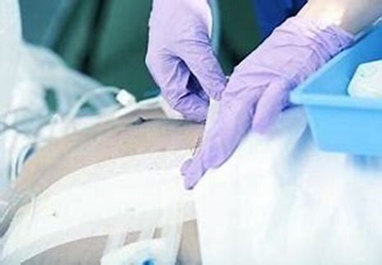
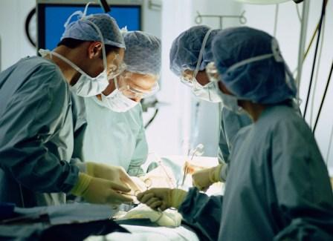



Surgical Site Infections
SSI Surveillance In A Nutshell
Rene Schoombie
Infection Control Specialist
Life Healthcare

Slide 2

Surgical Site Infection
Surgical site infection (SSI) is the most common health care–associated infection following surgery and is associated with significant morbidity and mortality, transfer to an intensive care unit setting, prolonged hospitalisations, and hospital readmission.
The CDC defines an SSI as an infection related to a surgical procedure that occurs near the surgical site within 30 days following surgery (or up to 90 days following surgery where an implant is involved).
Incisional SSIs are further divided into those involving
  only skin and subcutaneous tissues (superficial incisional SSI)
  those involving deeper softer tissues of the incision (deep incisional SSI)
  organ/space infections include abscess, anastomotic leak for intra-abdominal operations, and implant-associated infections.

Slide 3
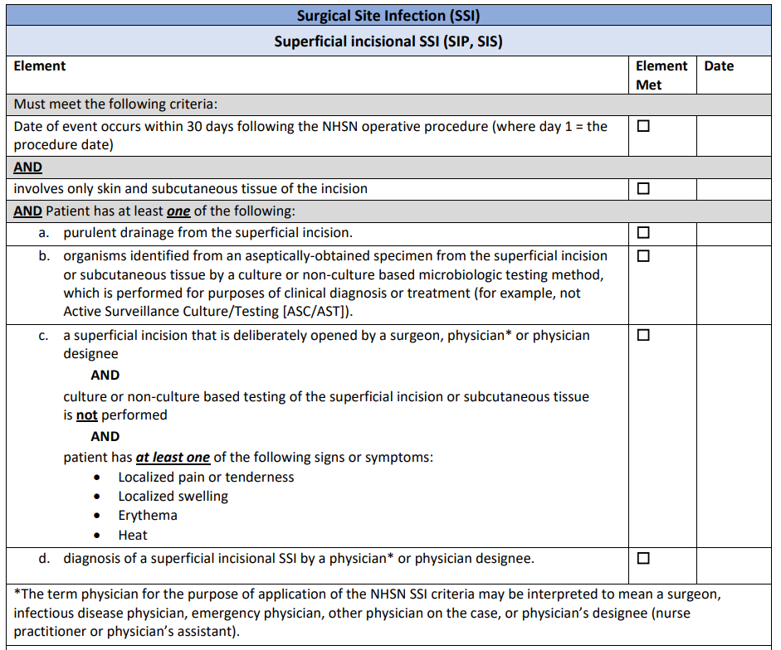
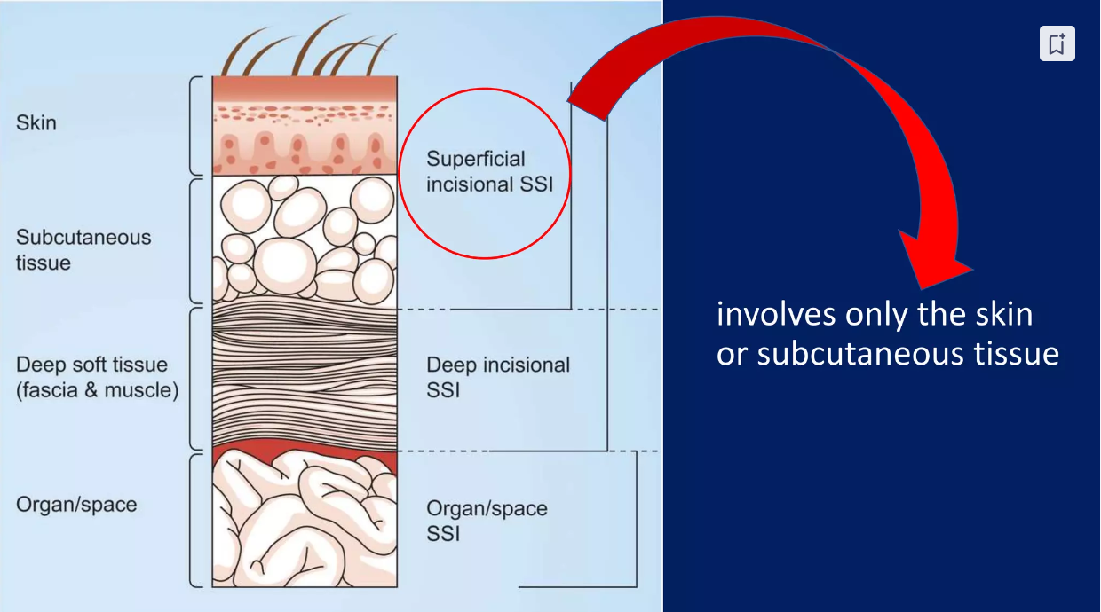
CDC Surgical Site Infection: Superficial Incisional SSI

Slide 4
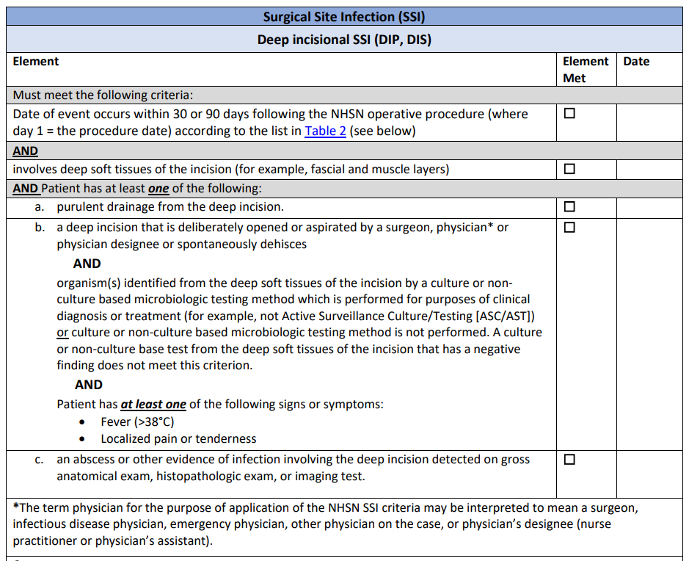
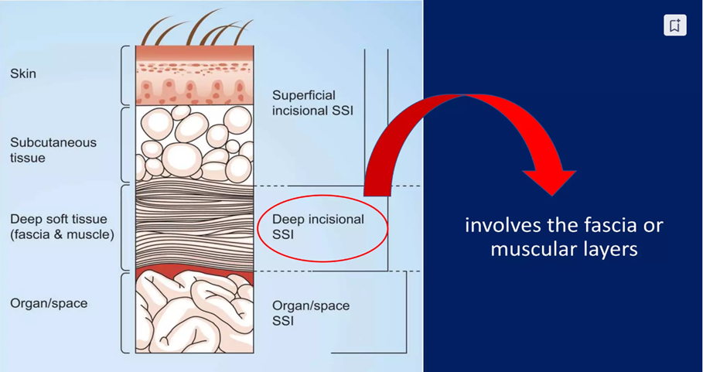
CDC Surgical Site Infection: Deep Incisional SSI

Slide 5
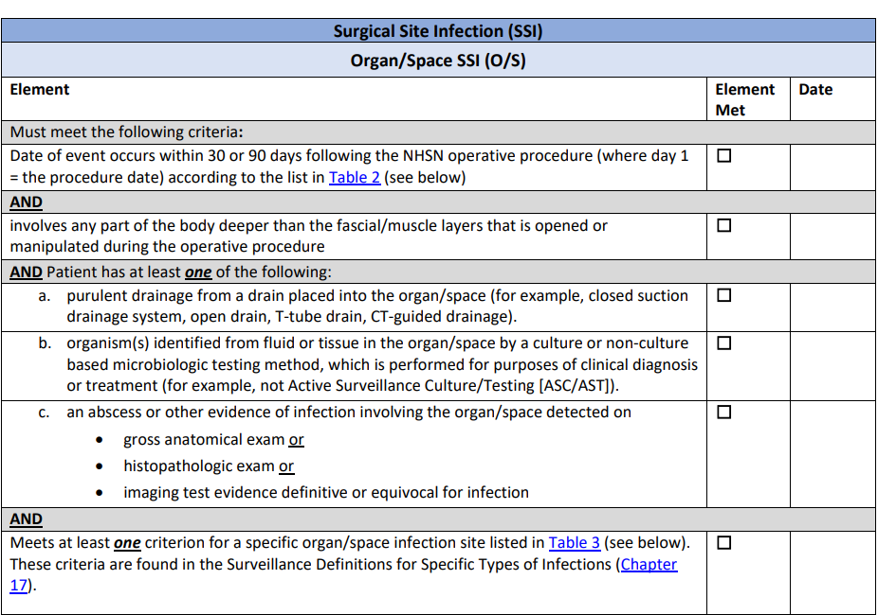
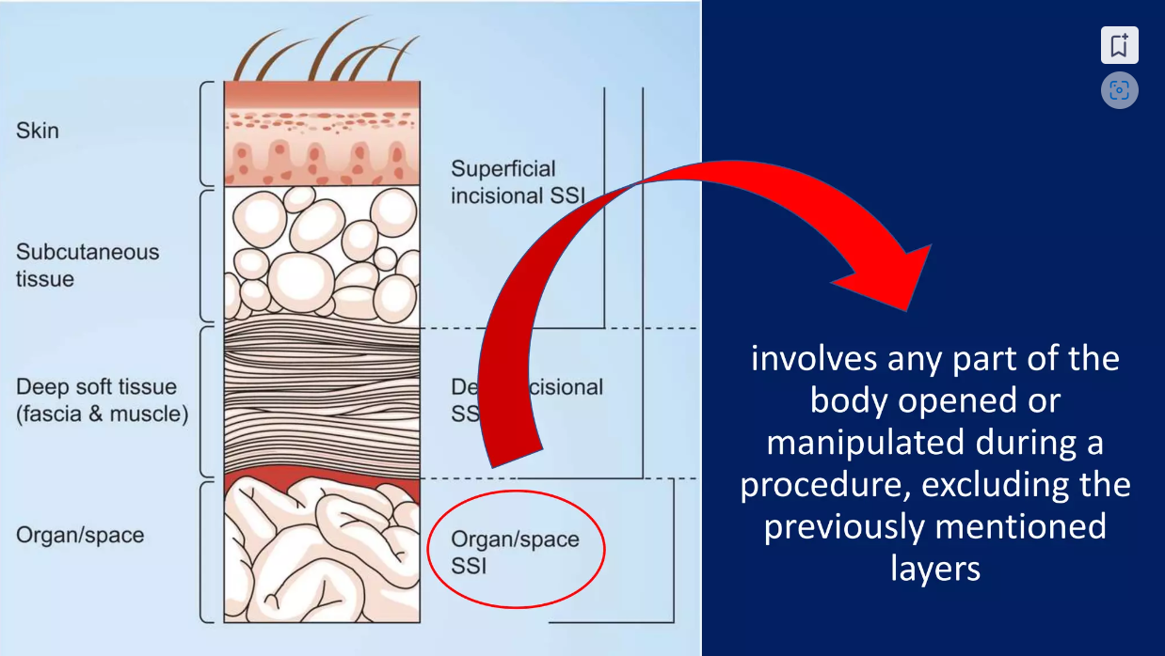
CDC Surgical Site Infection: Organ/Space SSI

Slide 6
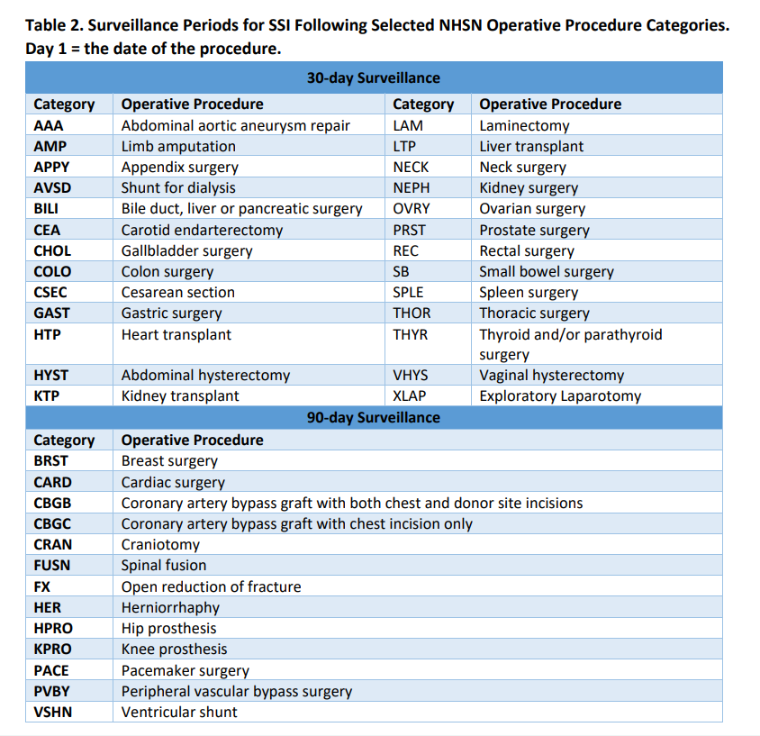
Surveillance Period For SSI

Slide 7
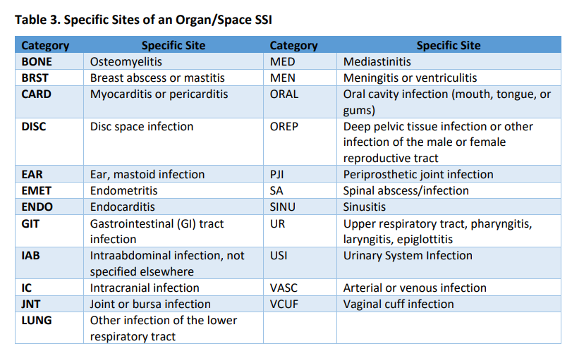
Specific Sites Of An Organ/Source SSI

Slide 8
Surgical Site Infection
Infection present at time of surgery (PATOS):
PATOS denotes that there is evidence of infection visualized (seen) during the surgical procedure to which the subsequent SSI is attributed.
Evidence of infection must be documented on the intraoperative notes.
E.g. of evidence of infection include but not limited to:
  Abscess infection
  Purulent/pus
  Phlegmon ( an inflammation of soft tissue that spreads under the skin or inside body – caused by pus).
  Feculent peritonitis ( the presence of pus in the abdominal cavity due to faecal matter).
  A ruptured/perforated appendix is evidence of infection at the organ/space level.
  Trauma resulting in a contaminated care. E.g a fresh gunshot wound to the abdomen may be a trauma with a high wound class but there would not be time for infection to develop.

Slide 9
Surgical Site Infection
Date of the event (DOE) for SSI:
For an SSI, the DOE is the date when the first element used to meet the SSI infection criterion
Occurs for the first time during the SSI surveillance period.
The DOE must occur within the SSI surveillance period to meet SSI criteria.
The type of SSI (superficial incisional, deep incisional, or organ/space) reported
and the DOE assigned must reflect the deepest tissue level where SSI criteria are met during the surveillance period.

Slide 10
Surveillance Methods
Direct Observation
The direct method with daily observation of the surgical site starting 24–48 hours postoperatively is the most accurate method of surveillance.
  Visit the ICU and wards – talk to staff and the patient
  While the direct method is used as the gold standard or studies, it is rarely used in practice because of its resource utilisation requirements and impracticality
Indirect Observation
Consists of a combination of the following:
  Screening for readmission and/or return to the operating room.
  Review of medical/nursing records
  Admission and re admission notes
  Patient charts for signs and symptoms of SSI
  Lab, imaging other diagnostic test reports
  Clinician/healthcare professional notes
  Electronic database
  SSI bundle compliancy

Slide 11
Factors Affecting Surgical Site Infection
Endogenous Patient
Co-morbid illness
Nutrition
Virulence/ colonisation
Altered immune response
Coexistent infection
Age
Obesity
General

Slide 12
Factors Affecting Surgical Site Infection
Procedural/ operation
Inadequate instrument sterilization
Surgical technique and drains
Duration of procedure
OR ventilation
Antimicrobial prophylaxis's
Skin antisepsis
Pre-operative shaving
Maintaining body temperature
Surgical/foreign material

Slide 13
Factors Affecting Surgical Site Infection
Exogenous
Extrinsic
Surgical team/attire
Theater traffic
Precautionary measures
Environmental cleanliness
Sterile conditions
Post operative care
Post-operative temperature and glucose control
Hand hygiene/gloves

Slide 14
Surgical Site Infection Prevention Strategies
Core-perioperative measures
Administer antimicrobial prophylaxis in accordance with evidence based standards and guidelines
  Administer within 1 hour prior to incision
  2hr for vancomycin and fluoroquinolones
  Select appropriate agents on basis of Surgical procedure
  Most common SSI pathogens for the procedure
Remote infections-whenever possible:
  Identify and treat before elective operation, including decolonization of organisms such as MRSA
  Postpone operation until infection has resolved
Do not remove hair at the operative site unless it will interfere with the operation;
  do not use razors
  If necessary, remove by clipping
Skin Prep
  Use appropriate antiseptic agent and technique for skin preparation
Maintain immediate postoperative normothermia*

Slide 15
Surgical Site Infection Prevention Strategies
Intraoperative Measures
• Operating Room (OR) Traffic
Keep OR doors closed during surgery except as needed for passage of equipment, personnel, and the patient
Prepare skin immediately before incision using an anti-septic preparation (CHG)
Attention to theater technique and discipline.
Cover the surgical incision with an appropriate interactive dressing at the end of the procedure

Slide 16
Surgical Site Infection-prevention Strategies
Post-operative Measures
Surgical Wound Dressing
  Protect primary closure incisions with sterile dressing for 24-48 hrs. post-op
Control blood glucose level during the immediate post-operative period.
  Measure blood glucose level at 6AM on POD#1 and #2 with procedure day = POD#0
  Maintain post-op blood glucose level at <200mg/dL
Discontinue antibiotics within 24hrs after surgery end time (48hrs for cardiac)*
Changing dressings
  Use an aseptic technique for changing or removing surgical wound dressings.
  Use sterile saline for wound cleansing up to 48 hours after surgery.
  Advise patients that they may shower safely 48 hours after surgery.
  Do not use topical antimicrobial agents for surgical wounds that are healing to reduce the risk of surgical site infection.
  Use an appropriate interactive dressing to manage surgical wounds that are healing

Slide 17

Surgical Site Infection- Lets Practice What We’ve Learned
Scenario 1:
39-year-old female was seen in the emergency unit on the 31/12/2023 complaining of severe abdominal plan.
Patient was admitted to the surgical general unit. Abdominal x-ray was done and showed a bowel obstruction.
CRP was elevated but PCT was normal.
Patient was apyrexial.
Seen by the general surgeon and patient was booked for theatre for an exploratory laparotomy.
Patient was taken to theatre on the 01/01/2023.
Intra-operative details:
Patient was not given antibiotic prophylaxis in theatre. Patient received Augmentin 2,4g intravenously in the unit at 12h15. Cutting time was 20h51.
Patient was transferred back to the general surgical unit post surgery.
Wound care was done in the unit. No signs of wound sepsis noted as per the nursing notes.
Patient was discharged on the 09/01/2023.
Patient was given a follow-up appointment to be seen in the wound clinic.

Slide 18
Surgical Site Infection- Lets Practice What We’ve Learned
Re-admission:
On the 27/01/2023 patient was again seen in the emergency department complaining of abdominal pain and constipation.
This time round patient was admitted in the Intensive care unit. Seen by surgeon. ( same surgeon as the previous admission)
Patient was taken back to theatre on the 27/01/2023 for an exploratory laparotomy for bowel obstruction.
Intra-operative details:
Patient was given Kefzol 1g intravenously as antibiotic prophylaxis treatment.
Post surgery, patient was taken back to intensive care unit.
On the 03/02/2023 patient complained of abdominal tenderness and pain. Patient was seen by surgeon.
CRP and PCT was taken and was elevated. Patient had a temperature of 38.5.
Blood cultures were negative.
Patient was taken back to theatre for a re-opening of the recent laparotomy.
According intraoperative notes patient procedure undertaking was incision and drainage of abscess. Wound specimens were taken and sent for culture.
Wound specimen cultures were positive for Enterobacter cloacae and Enterococcus faecalis.

Slide 19
Surgical Site Infection- Lets Practice What We’ve Learned
Classify the scenario using the Surgical site checklist.
Procedure Details:
Date of first procedure: 01/01/2023
  Operative procedure: XLAP – Exploratory laparotomy
2. Date of second procedure:27/01/2023
  Operative procedure: XLAP – Exploratory laparotomy for bowel obstruction. (New diagnoses)

Slide 20
Surgical Site Infection- Lets Practice What We’ve Learned
Question 1
Is it a 30 or 90 day surveillance period?
Surveillance Periods for SSI Following (XLAP) Exploratory laparotomy, for monitoring and identifying an SSI event procedure is based on the 30-day SSI surveillance period
Remember: Each trip to the OR for an NHSN operative procedure sets an SSI surveillance period for the surgical site.
If a patient returns to the OR for an NHSN operative procedure and the same surgical site is entered, the surveillance period for the prior NHSN operative procedure ends and a new SSI surveillance period begins.

Slide 21
Surgical Site Infection- Lets Practice What We’ve Learned
Question 2:
Identify the DOE ( Date of Event)
For an SSI, the DOE is the date when the first element used to meet the SSI infection criterion occurs for the first time during the SSI surveillance period.
DOE: 03/02/2023 as patient complained of abdominal tenderness and pain

Slide 22
Surgical Site Infection- Lets Practice What We’ve Learned
Question 3:
Is it a superficial incisional, deep incisional or organ space SSI?
Motivate the answer
Deep incisional SSI
Why:
Date of event occurs within 30
Involves deep soft tissues of the incision
A deep incision that is deliberately opened or aspirated
Organism(s) identified from the deep soft tissues of the incision
  cultures were positive for Enterobacter cloacae and Enterococcus faecalis.
Following signs or symptoms:
  fever, (>38°C); localized pain or tenderness. (03/02/23)
  an abscess (drainage of abscess)

Slide 23
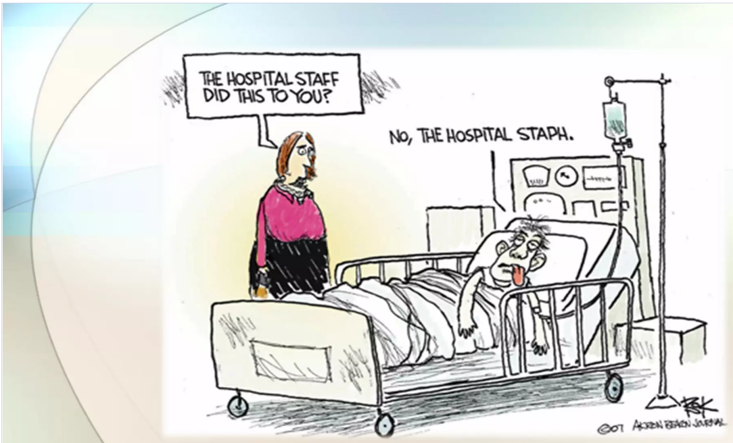
Thank you

