Slide 1

Is Cholera a threat in South Africa?
Dr Maria Botha
Clinical Microbiologist

Slide 2
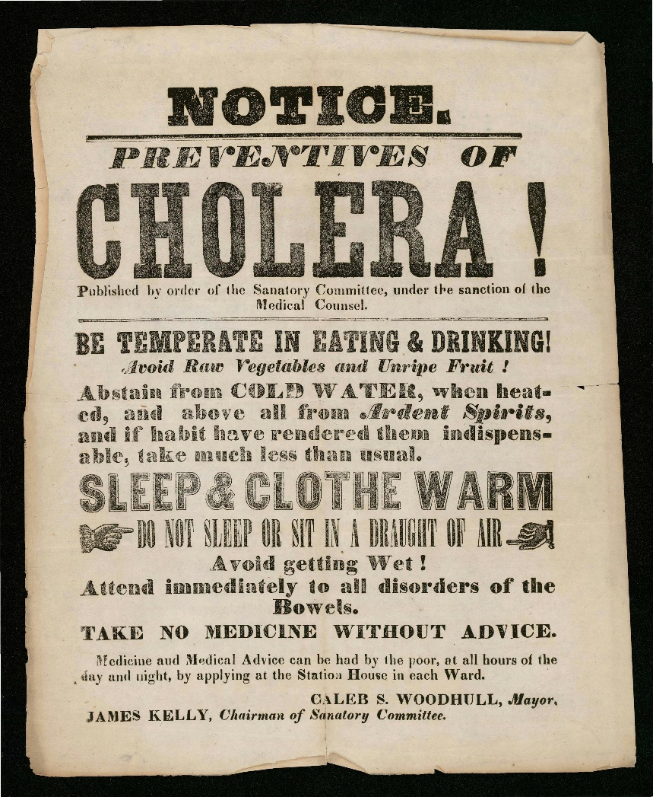

Cholera – calamitous past, ominous future *
New York 1849
*Lacey SW. 1995. Cholera: calamitous past, ominous future. Clin Infect Dis 20:1409–1419

Slide 3
What is Cholera?
WHO describes cholera as an acute intestinal infection caused by consumption of food or water contaminated with the bacterium Vibrio cholerae.
Untreated, cholera can kill within hours, and people living in places with poor sanitation and unsafe drinking water are most at risk.

Slide 4
Symptoms of Cholera
Most people infected with V. cholerae do not develop any symptoms, although the bacteria are present in their faeces for 1-10 days after infection and are shed back into the environment, potentially infecting other people.
Among people who develop symptoms, the majority have mild or moderate symptoms, while a minority develop acute watery diarrhoea with severe dehydration. This can lead to death if left untreated.

Slide 5
Diagnosis of Cholera
It takes between 12 hours and 5 days for a person to show symptoms after ingesting contaminated food or water
It is almost impossible to distinguish a single patient with cholera from a patient infected by another pathogen that causes acute watery diarrhea without testing a stool sample
While management of patients with acute watery diarrhea is similar regardless of the illness, it is important to identify cholera because of the potential for a widespread outbreak.
Stool culture on selective media and PCR (Biofire gastro panel)

Slide 6


Vibrio cholerae growing on thiosulphate citrate bile salt sucrose (TCBS) agar plates

Slide 7
Treatment of Cholera
Cholera is an easily treatable disease - with early and proper treatment, the case fatality rate should remain below 1%.
The majority of people can be treated successfully through prompt administration of oral rehydration solution (ORS).
Adult patients may require up to 6 L of ORS to treat moderate dehydration on the first day.
Severely dehydrated patients are at risk of shock and require the rapid administration of intravenous fluids.
These patients are also given appropriate antibiotics to diminish the duration of diarrhoea, reduce the volume of rehydration fluids needed, and shorten the amount and duration of V. cholerae excretion in their stool.

Slide 8
Antibiotics for Cholera
Severely ill patients. It is also recommended for patients who have severe or some dehydration and continue to pass a large volume of stool during rehydration treatment. Antibiotic treatment is also recommended for all pregnant women and patients with comorbidities (e.g., severe acute malnutrition, HIV infection).
Findings indicate that antibiotics reduced volume of stool output by 8–92%, duration of diarrhea by 50–56%, and duration of positive bacterial culture by 26–83%.
Antibiotics are given as soon as the patient can tolerate oral medication. The choice of antibiotic should be informed by local antibiotic susceptibility patterns. In most countries, doxycycline is recommended as first-line treatment for adults (including pregnant women) and children. If resistance to doxycycline is documented, azithromycin and ciprofloxacin are alternative options.

Slide 9
Treatment of Cholera
Mass administration of antibiotics is not recommended, as it has no proven effect on the spread of cholera may contribute to antimicrobial resistance.
Zinc for children under 5 - reduces the duration of diarrhoea and may prevent future episodes of other causes of acute watery diarrhoea
Breastfeeding encouraged
Antimotility agents and antiemetics have no established benefit for treatment of cholera, and might prolong infection or have sedating effects that interfere with effective oral rehydration

Slide 10
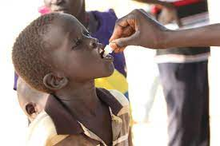
Oral cholera vaccines
Currently there are three WHO pre-qualified oral cholera vaccines (Dukoral®, Shanchol™, and Euvichol®) - require two doses for full protection.
The August 2017 WHO Position Paper on Vaccines against Cholera states that:
  OCV should be used in areas with endemic cholera (hotspots), in humanitarian crises with high risk of cholera, and during cholera outbreaks; always in conjunction with other cholera prevention and control strategies.

Slide 11
History of Cholera
Early texts from Greece (4th century) and India (5th century) describe cholera-like illness
One of the first detailed accounts of a cholera epidemic comes from Gaspar Correa—Portuguese historian and author—who described an outbreak in the spring of 1543 of a disease in the Ganges Delta
It reportedly killed victims within 8 hours of developing symptoms and had a fatality rate so high that locals struggled to bury all the dead.

Slide 12
Cholera Pandemics
Seven cholera pandemics have occurred in the past 200 years
The first cholera pandemic emerged out of the Ganges Delta with an outbreak in 1817, stemming from contaminated rice
The current (seventh) pandemic started in South Asia in 1961, reached Africa in 1971 and the Americas in 1991. Cholera is now endemic in many countries.

Slide 13
Endemic vs Epidemic Cholera
A cholera-endemic area is an area where confirmed cholera cases were detected during the last 3 years with evidence of local transmission (meaning the cases are not imported from elsewhere).
A cholera outbreak/epidemic can occur in both endemic countries and in countries where cholera does not regularly occur.
In cholera endemic countries an outbreak can be seasonal or sporadic and represents a greater than expected number of cases.
In a country where cholera does not regularly occur, an outbreak is defined by the occurrence of at least 1 confirmed case of cholera with evidence of local transmission in an area where there is not usually cholera.

Slide 14
Cholera serogroups
There are many serogroups of V. cholerae, but only two – O1 and O139 – cause outbreaks.
V. cholerae O1 has caused all recent outbreaks.
V. cholerae O139 – first identified in Bangladesh in 1992 – caused outbreaks in the past, but recently has only been identified in sporadic cases. It has never been identified outside Asia.
There is no difference in the illness caused by the two serogroups.

Slide 15

John Snow and the Broadstreet pump 1854

Slide 16
Infection Control for Cholera in Health Care Settings
Chemoprophylaxis with antibiotics is not indicated for healthcare providers
All staff should be trained on cholera prevention and infection control measures, such as handwashing and safe disposal of human waste
Handwashing with soap and clean water or 0.05% chlorine should be done before and after each patient contact
If soap and water are not available, use an alcohol-based hand sanitizer with at least 60% alcohol, or if neither are available, 0.05% chlorine solution

Slide 17
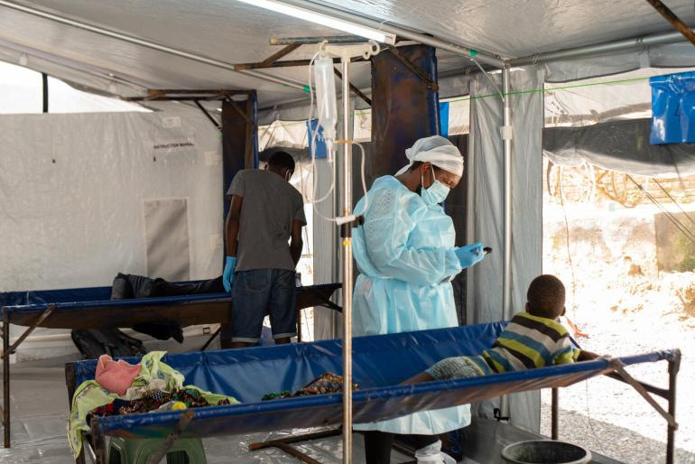
Several chlorine solutions can be used for surface disinfection:
2% chlorine: Used for disinfecting vomit, feces, and corpses
0.2% chlorine: Used for cleaning floors, boots, personal protective equipment (gloves, aprons, goggles), bedding, latrines, dishes
0.05% chlorine: Used for bathing soiled patients, handwashing, laundry

Slide 18

By definition, the detection of locally-acquired indigenous cholera cases is a confirmed cholera outbreak

Slide 19
Cholera South Africa 2023
A total of six confirmed cholera cases including one death have been reported in Gauteng Province.
All cases are adults, ranging in age from 19 to 44 years.
No confirmed cases have been reported in other provinces.
Isolates from all cases are identified as toxigenic Vibrio cholerae O1 serotype Ogawa, and are susceptible to ciprofloxacin.

Slide 20
Cholera outbreak in South Africa 2023
The first 3 cases were imported or import-related cases following travel to Malawi.
Cases 4 and 5 (one from the city of Johannesburg district, one in the city of Ekurhuleni district) acquired infection locally; they had not travelled, had no links to imported cases or to each other, and don’t reside or work in the same area. These two are classified as indigenous cases.
The 6th case is a Malawian national with no travel history

Slide 22
WHO: Cholera in SA
Public Health Actions
Trained outbreak response team
Issued out cholera educational messages on various platforms
Updated and disseminated case definitions, guidelines for specimen collection
Challenges/Gaps
Inadequate trained human resources for the response
Inadequate resources
Finalisation of national contingency plan

Slide 23
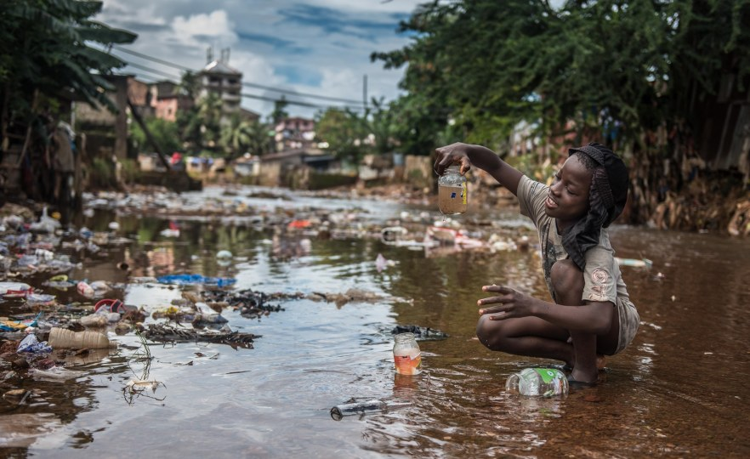
Cholera in Africa
23 Feb 2023:
Over 1 Billion in 43 Nations At Risk Amid Cholera Outbreaks, WHO Says

Slide 24
Epi Curve of Cholera Cases and deaths in WHO Afro Region, 1 January 2022 – 12 March 2023

Slide 25
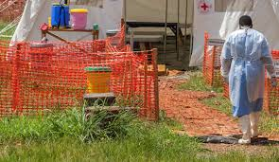
Africa is facing an exponential rise in cases, with infections in the single month of January at a third of the level reached in the whole of 2022, according to the WHO.

Slide 26
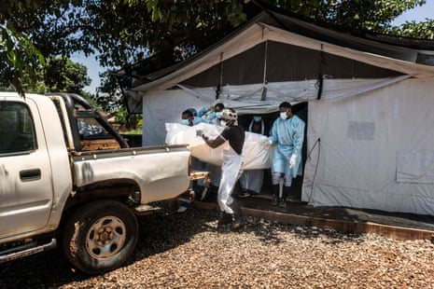
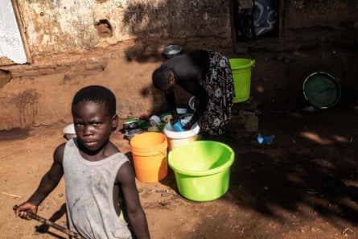
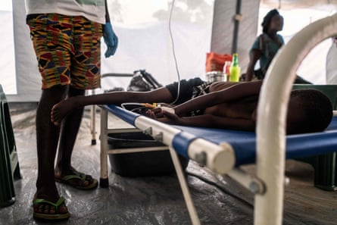
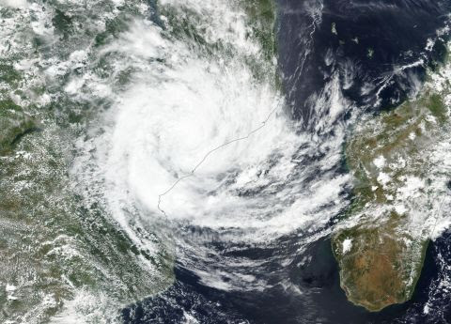
Malawi 2023

Slide 27
New York Times 22 Jan 2023
In a Nation That Nearly Wiped Out Cholera, the Disease Is Surging Back
Malawi, in southern Africa, had all but eradicated cholera, recording only two cases in 2021. But more than 900 people died of it over the past 11 months, and the government is scrambling to contain its spread.

Slide 28
Cholera in Malawi
Malawi is the most cholera affected country in Africa
Malawi is experiencing a widespread cholera outbreak, with 36 943 cases and 1210 associated deaths reported from all 29 districts since 3 March 2022.
Following floods in the southern region in January 2022, the Ministry of Health confirmed a cholera outbreak on 3 March 2022.
This is the deadliest outbreak of cholera in the country’s history.
Cholera has been endemic in Malawi since 1998 with seasonal outbreaks reported during the rainy season (November through May). However, the current outbreak has extended through the dry season

Slide 29
Contributing factors in Malawi
Unsafe drinking water and poor sanitation in cities like Lilongwe and Blantyre
The current economic crisis in the country: rather opt for cheaper sources of water than using piped water, which comes at a cost
Half the children are in need of humanitarian aid. Almost a quarter of a million children under five are expected to be acutely malnourished, and more than 60,000 severely malnourished, by the end of the month.
A severely malnourished child is 11 times more likely to die from cholera than a well-nourished child
Cyclone Freddy hit the country for the 2nd time in 1 month, damaging power supplies and other infrastructure. Tropical Cyclone Freddy is exceptional mainly due to the fact that it has lasted longer than any other in historical records and that it is the first tropical cyclone to hit both Mozambique and Madagascar twice.

Slide 30
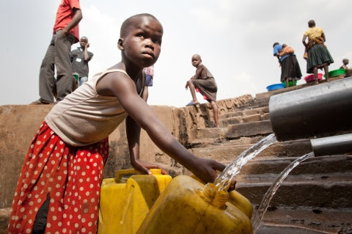
South Africa 2023
Water scarcity, social security and inequality

Slide 31
Risk factors South Africa: immediate
South Africa is experiencing cholera from importation (Malawi, Mozambique, Zambia, Zimbabwe) and possible local transmission, a situation that poses a risk of further spread within the country due to:
  population movements
  presence of unplanned human settlements and squatter camps
  flooding in some parts of the country
  areas with limited access to safe water and hygiene and sanitation facilities (WASH)9

Slide 32
Risk factors South Africa: Future
What is concerning is that Freddy is a harbinger of things to come.
Francois Engelbrecht, a professor of climatology and the director of the Global Change Institute at Wits University said along with climate change making cyclones more intense in a warmer world, it’s logical that tropical cyclones will last longer too. Earlier research by Engelbrecht and his team said there was an increased risk for an intense tropical cyclone to make landfall in South Africa – Daily Maverick 15 March 2023
The climate change crisis is inextricably bound to the lack of clean energy provision, inadequate infrastructure, social upheaval and the country’s water security, to name a few – Daily Maverick 13 March 2023

Slide 33
Cholera remains a global threat to public health and an indicator of inequity and lack of social development.
In October 2017, GTFCC partners launched a strategy for cholera control Ending Cholera: A global roadmap to 2030. The country led strategy aims to reduce cholera deaths by 90% and to eliminate cholera in as many as 20 countries by 2030.

