Slide 1
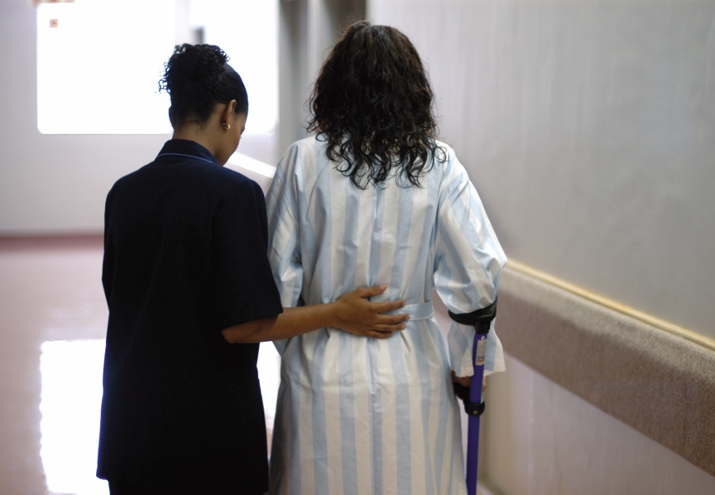
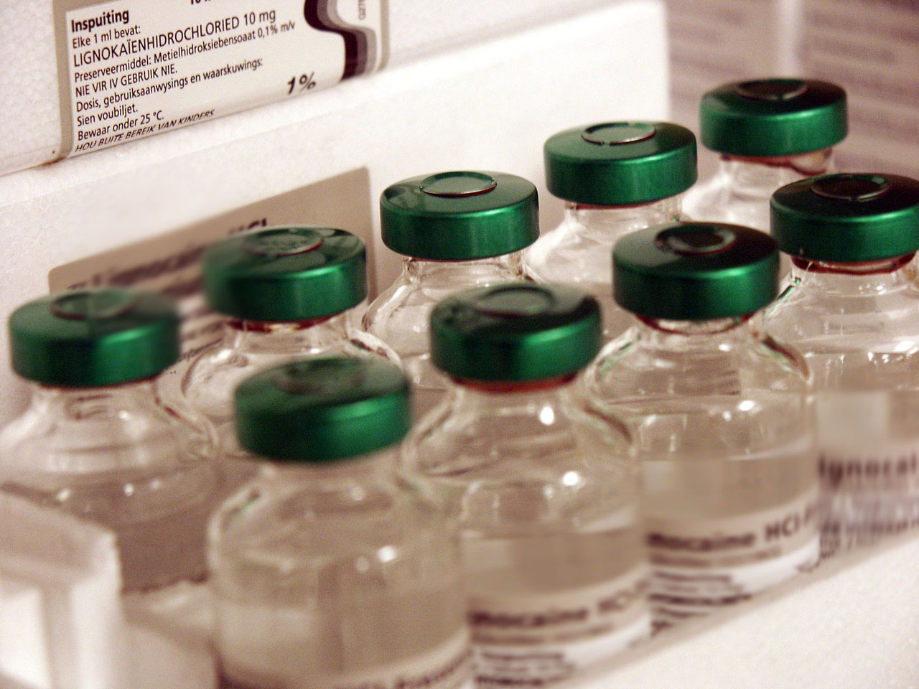
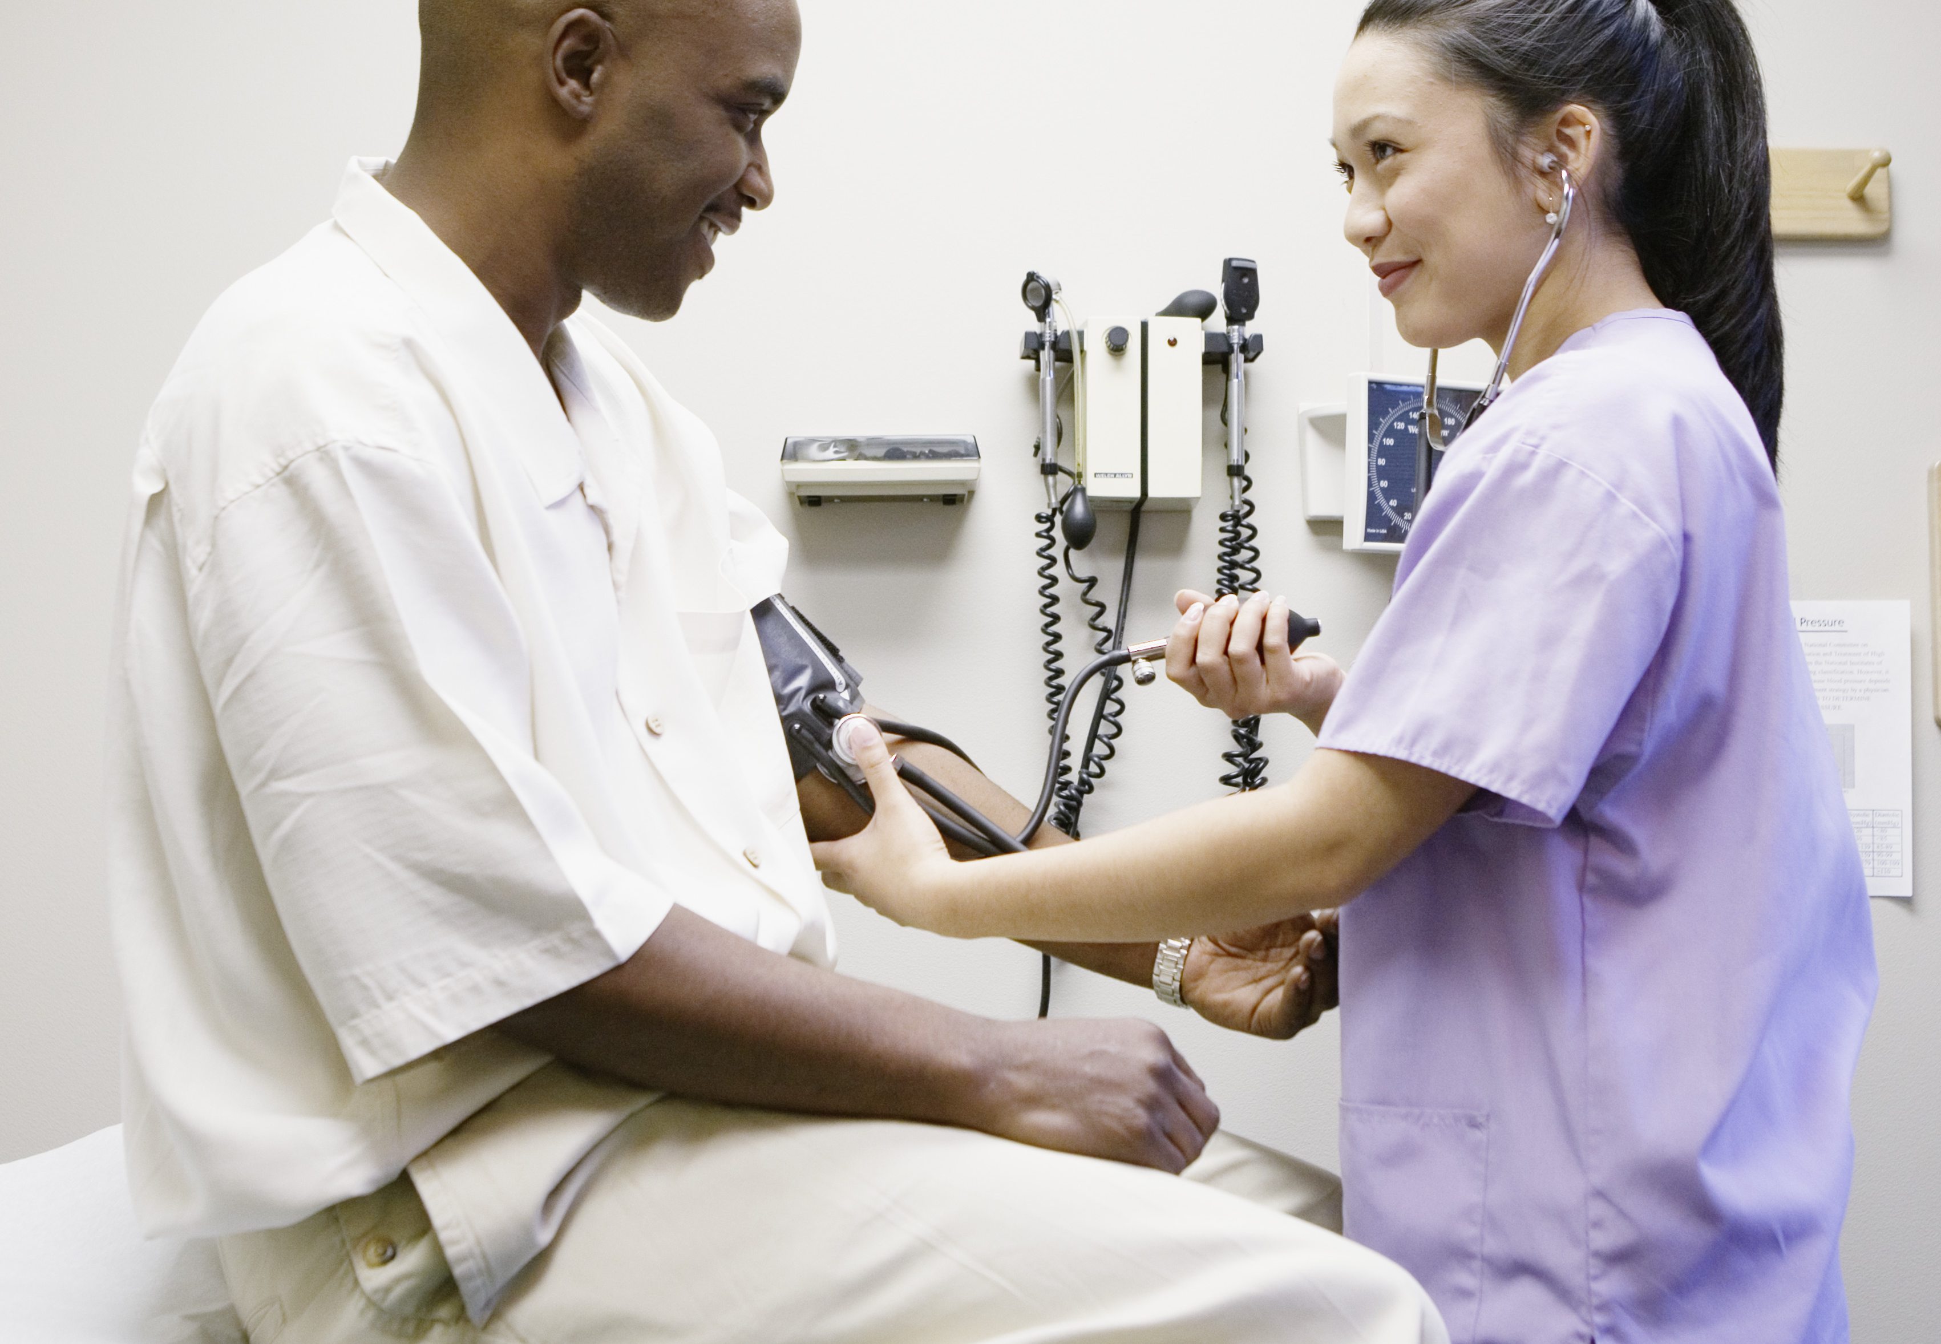
FIDSSA - 2022
Feedback session – Mishaan Daniel

Slide 2
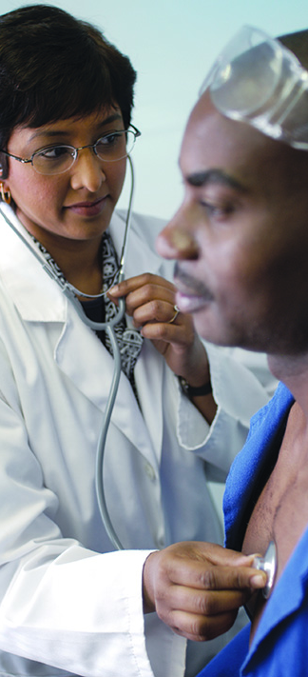
Insert quote here. The image to the left can be replaced with any portrait-orientated image.
– Insert quote author here

Slide 3
Day One – 3/11/2022 - Feedback
Pre – Congress workshops
Jan Erasmus – Solving IPC problems using scientific approach
Needs data, volume and trustworthy
Needs skill to analyse, analytical thinking, computer skills including Maths
Needs stakeholder/leadership involvement

Slide 4
Day One – 3/11/2022
Plenary session
The impact of COVID on IPC – Liza Sitharam ( Netcare prospective)
Healthcare associated infection – increase noted (Covid 19 infections, blood stream infections, ventilator associated pneumonias)
Increase in Candida auris, and CRE
Currently seeing an increase pan drug resistant micro-organism
Call all to action:
Strengthening our IPC systems by identifying gaps in the programme
Promoting a culture of IPC which is everyone's responsibility from leadership to support systems on the ground
To ensure resilience and sustainability in the programme
Continue education and training in infection prevention.

Slide 5
Day Two – 4/11/2022
Parallel session 2
Consisted of two breakaway session Infection control and What’s new in antibiotic stewardship in South Africa.
Attended the Infection Control breakaway session.
Consisted of the following discussions:
IPC leadership competencies – Jan Erasmus
Co-operation
Integrity
Passion
Leadership
Initiative

Slide 6
Day Two – 4/11/2022
Implementation of the National Strategic Framework – Reshma Misra
Core Components
IPC programme
Guidelines
Education and training
Surveillance
Monitoring
Monitoring and Evaluation in context with infection prevention and control – Reshma Misra
What is monitoring and evaluating
IPC is everyone's responsibility
Live it, sell it

Slide 7
Day Two – 4/11/2022
Implementation of an electronic tool for monitoring of hand hygiene: a central hospital perspective – Claudelle Perumal
Obtain buy in from senior management team.
Extensive training conducted with all categories of staff
Before each meeting we would nominate someone to demonstrate the hand rub technique
During hand over sessions in each department all staff take the time to demonstrate hand hygiene technique as well as recite the 5 moments
Place remainders in all patient care areas,

Slide 8
Day Two – 4/11/2022
Fungal diseases
Neonatal Candida infections and deaths in SA – Nelesh Govender
Gradual replacement of Candida parasilosis by Candida auris especially in NNICU.
Skin swabbing for Candida auris
A hospital’s experience with controlling candida auris – private versus public section – Sithembiso Velaphi and Evan Shoul
Standard precautions – Hand hygiene
Contact transmission-based precautions – wear gloves and a disposable apron when in contact with patient
Isolation or co-horting – Isolate infected and/or colonised patient in a single room
Environmental cleaning – All surfaces in the patients environment to be wiped down using a hypo-chloride solution ( 1000 parts per million)

Slide 9
Day Three – 5/11/2022
Tuberculosis
TB diagnostic – What is new and in the pipeline? Keeren Lutchminarain
Points of care testing
Subclinical TB – 57% of people don’t have symptoms. Most other symptoms experienced don’t bother people enough to warrant being diagnosed.
Overview of TB vaccines – Kogie Naidoo ( CAPRISA)
Various new TB vaccines in the pipeline
Mycobacterium indicus pranii – Therapeutic vaccine – given intradermal
Prevents TB disease in HIV patient – 2023
New TB vaccine trial – prevention of recurrence
TB vaccine for HIV exposed/Unexposed new-born
BCG re-vaccinations for young adults – trials to be done
BCG aerosol study – 2027

Slide 10
Day Three– 5/11/2022
Emerging infections and outbreaks
Pathogen X – Prof Lucille Blumberg
The unknown set of pathogens from which disease X can emerge is large but limited
Likely origin is zoonotic
Surveillance is key at the human animal environment interfaces
Strengthen global governance mechanism to ensure adoption of preparedness plans based on the One Health approach
Build on existing programme
“Not a matter of if but when”

Slide 11
Day Three– 5/11/2022
Emerging infections and outbreaks
Monkeypox: a re-emerging zoonosis
First human case 1970 in DRC – 9 month year old admitted with suspected smallpox – sample was sent to WHO Moscow which revealed monkeypox.
Outline of the disease
Mysterious hepatitis in children, what do we know thus far

Slide 12
Thoughts
What resonated throughout the conference was the need to remain passionate in regard to Infection prevention.
Not to lose ones momentum in doing good because once you loss your momentum and passion, one losses one vision and goals.
In the end the main focus is the patient which could be a family member, a friend, a colleague, a loved and cherish one and that is why we do what we do.

Slide 13

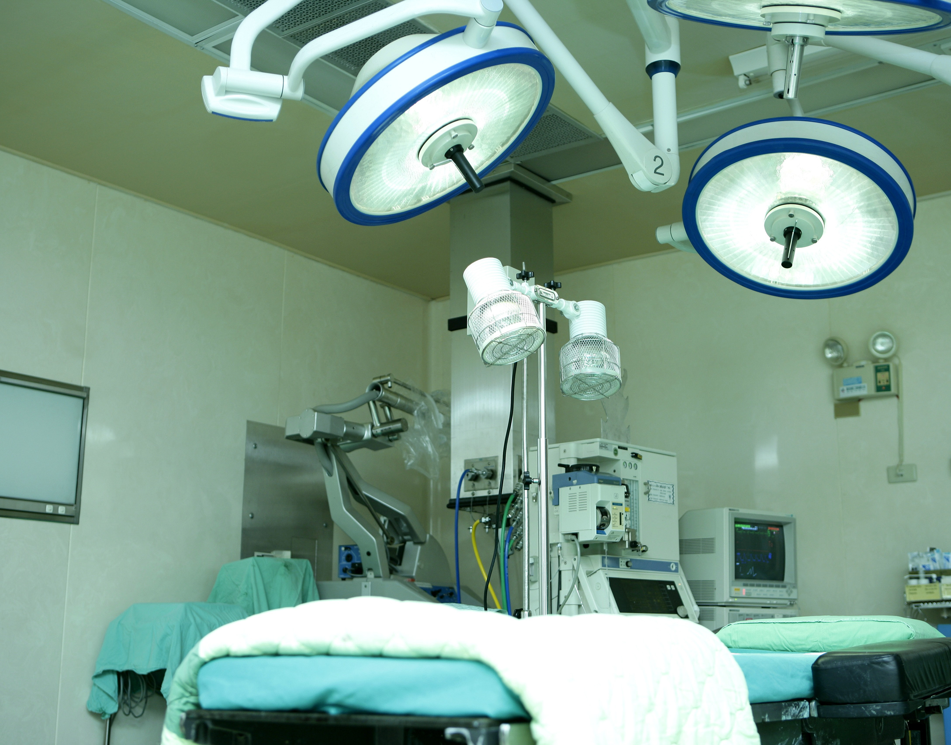
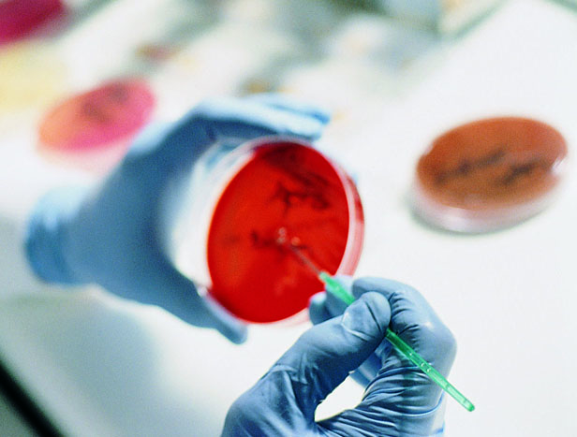
The images to the right are editable and can be replaced with your own images. Replace this text with your own section title and suitable description.

