Slide 1
AFP & Measles Surveillance
Dr Yarumia Ndombi
MBBCh(Wits), DCH(SA), Dip HIV Man(SA)
GICS Mini Symposium Presentation – November 2022

Slide 2
Content
Acute Flaccid Paralysis
  Disease surveillance
  Case definition
  Polio
  AFP Surveillance
Measles
  Overview
  Measles
  Measles surveillance

Slide 3
Disease Surveillance
the spread of disease is monitored in order to establish patterns of progression.
The main role of disease surveillance is to predict, observe, and minimize the harm caused by outbreak, epidemic, and pandemic situations.
increase knowledge about which factors contribute to such circumstances.
A key part of modern disease surveillance is the practice of disease case reporting

Slide 4
Acute Flaccid Paralysis
Acute Flaccid Paralysis or AFP is a clinical syndrome, which refers to a collection of signs and symptoms, instead of a diagnosis.
AFP is defined by the acute onset of weakness or paralysis with reduced muscle tone in children (<15 years)
There are many infectious and non-infectious causes of AFP.

Slide 5
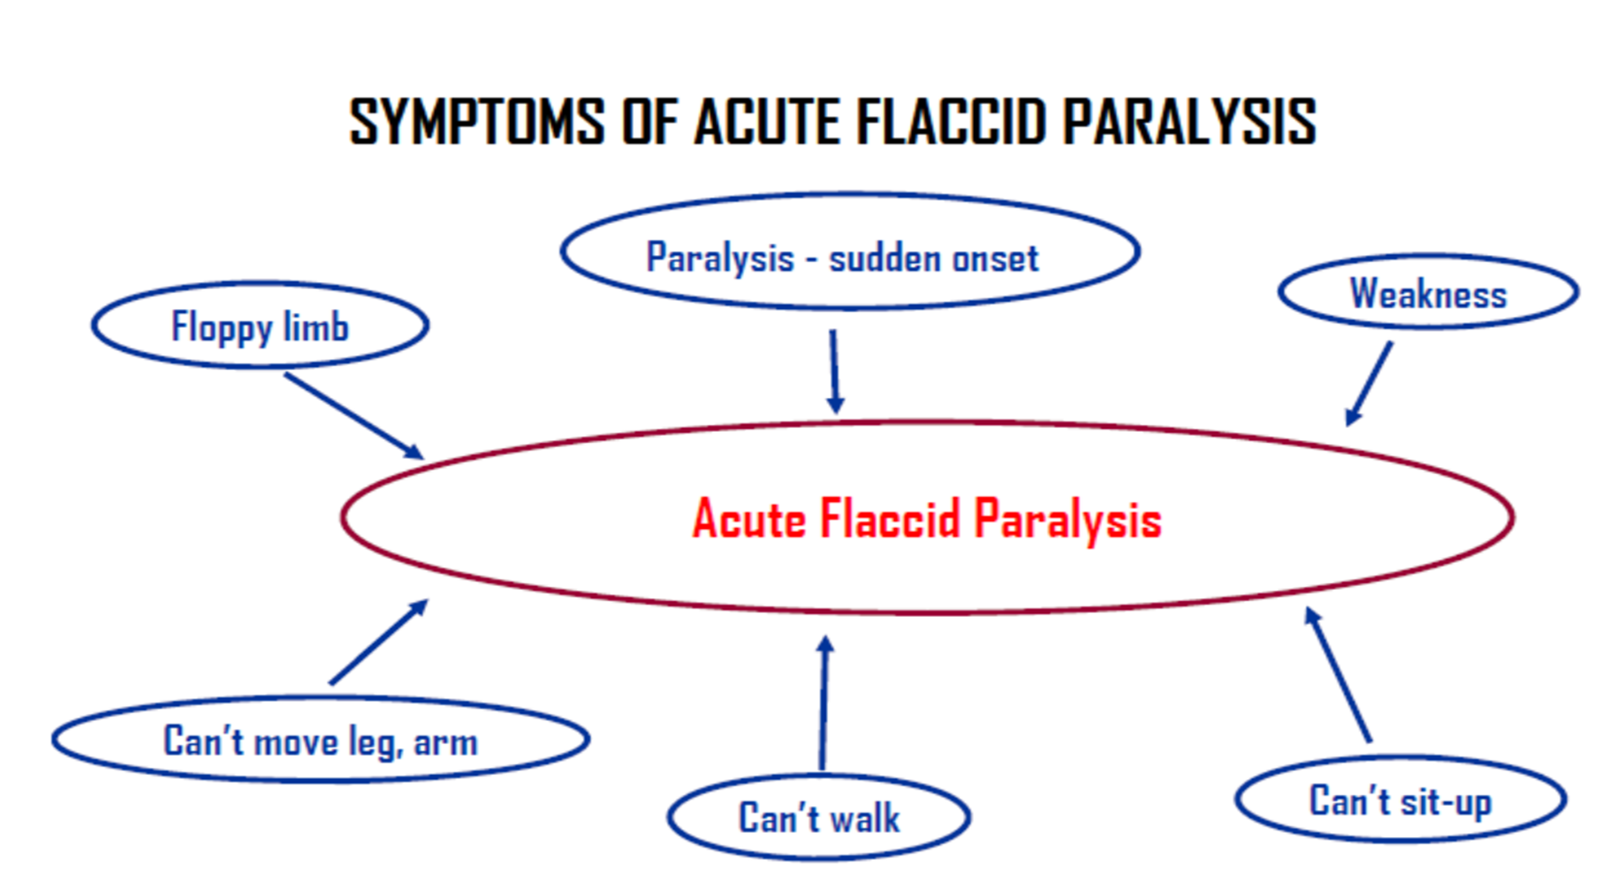

Slide 6
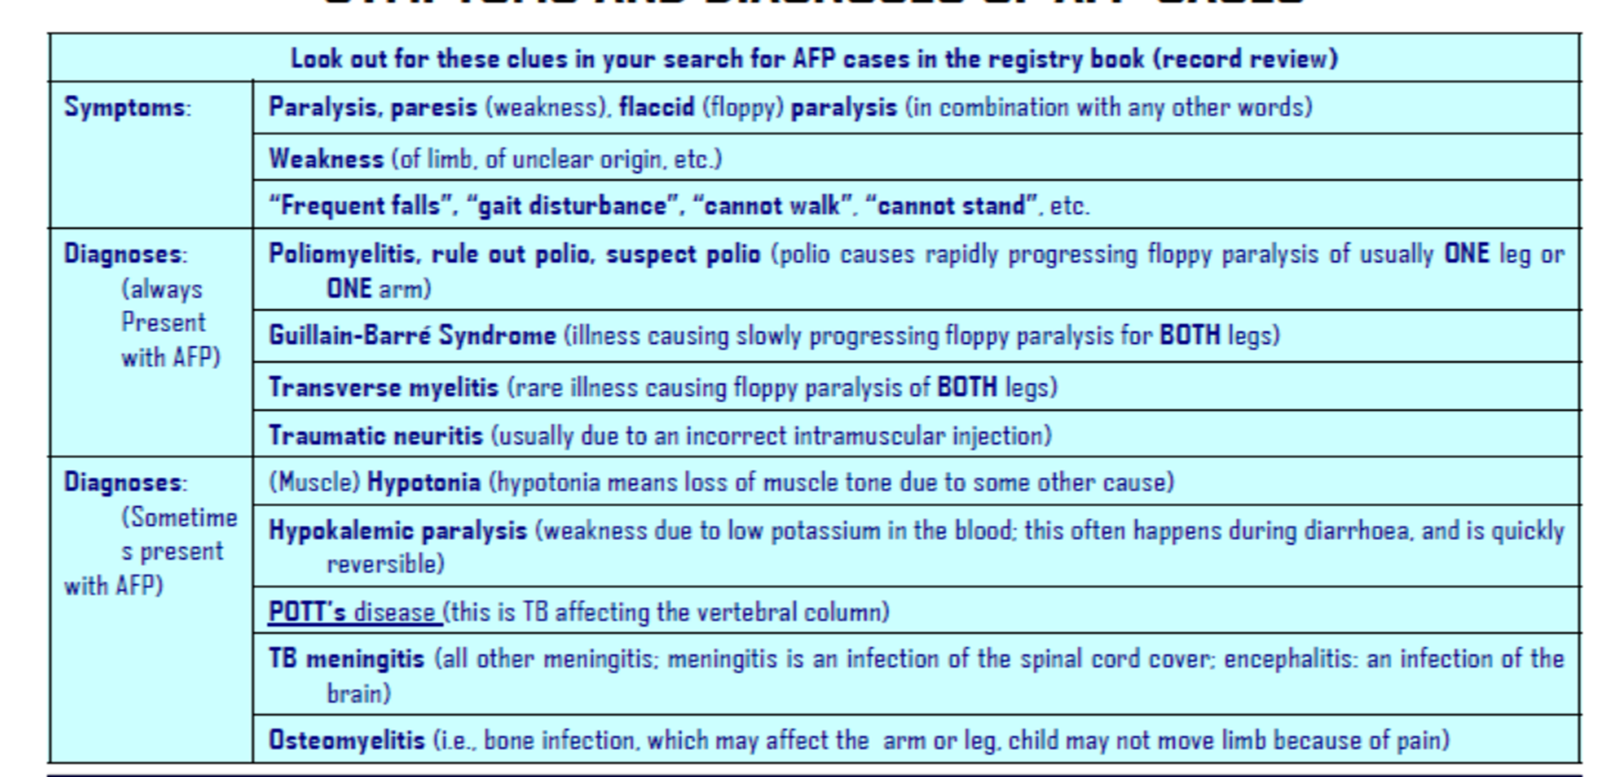
Acute Flaccid Paralysis

Slide 7
Acute Flaccid Paralysis - Polio
Polio, caused by the wild poliovirus (the natural circulating strain) is one of the causes of AFP.
In line with the worldwide campaign to eradicate polio, there is a global monitoring process where clinical cases of AFP are identified and investigated to depict whether these cases are a direct result of the wild poliovirus.

Slide 8
Eradication of Polio
remains a public health priority due to the paralytic effects of the virus on children and impact on global health system.
The Polio Eradication Strategy 2022–2026 lays out the roadmap to securing a lasting and sustained world, free of all polioviruses (wild poliovirus & vaccine-derived polioviruses)
The global effort to eradicate polio has been declared a Public Health Initiative of International Concern, under the International Health Regulations of the WHO.

Slide 9
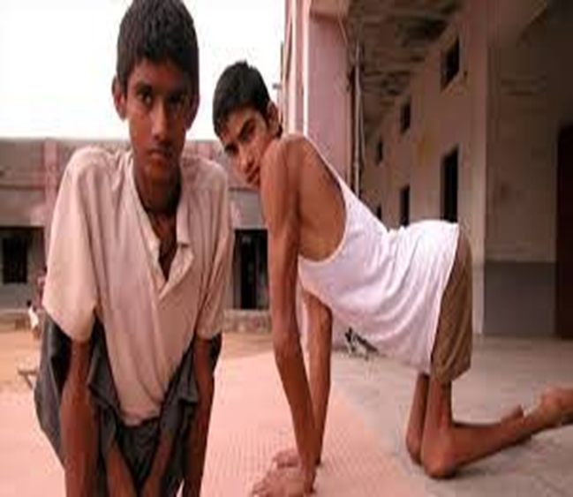
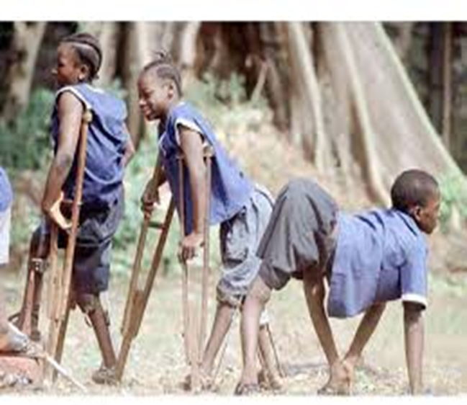
What are the symptoms of Polio?
95% of all individuals infected with polio have no apparent symptoms.
Another 4%–8% of infected individuals have symptoms of a minor, non-specific nature,
such as sore throat and fever, nausea, vomiting, and other common symptoms of any viral illness.
About 1%–2% of infected individuals develop nonparalytic aseptic (viral) meningitis,
with temporary stiffness of the neck, back, and/or legs.
Less than 1% of all polio infections result in the classic “flaccid paralysis,” where the patient is left with permanent weakness or paralysis of legs, arms, or both.

Slide 10

How do we maintain a polio free status?
Africa declared a polio free region in 2020.
to maintain status and keep the population protected countries must ensure that population immunity remains high.
routine immunization coverage of >90% with polio vaccines.
High quality surveillance
In 2017 South Africa’s certificate was revoked due to poor surveillance – reinstated 2019
There is still the high possibility of Importation and acquisition of the Wild Polio Virus from countries where Polio is still endemic

Slide 11

There is still the high possibility of Importation and acquisition of the Wild Polio Virus from countries where Polio is still endemic
The target for South Africa is to find 4 cases of AFP / 100,000 children to investigate for polio.
If we are not looking hard enough for polio, we may not find a case if one occurs in South Africa.

Slide 12
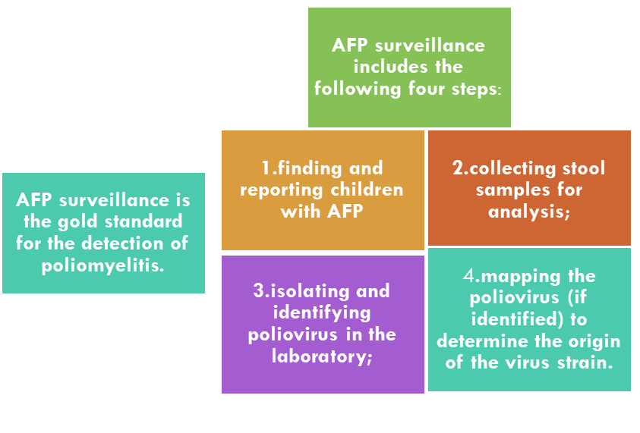
How is AFP Surveillance conducted?

Slide 13
How is AFP Surveillance conducted?
Complete a notification form ( manual or electronic copy on NMC APP)
Complete an AFP case investigation form (CIF)
Submit two stool specimens 24-48 hours apart on ice, with a completed laboratory specimen
The stool specimens should arrive in the laboratory within 72 hours after collection
Notify the district immediately

Slide 14
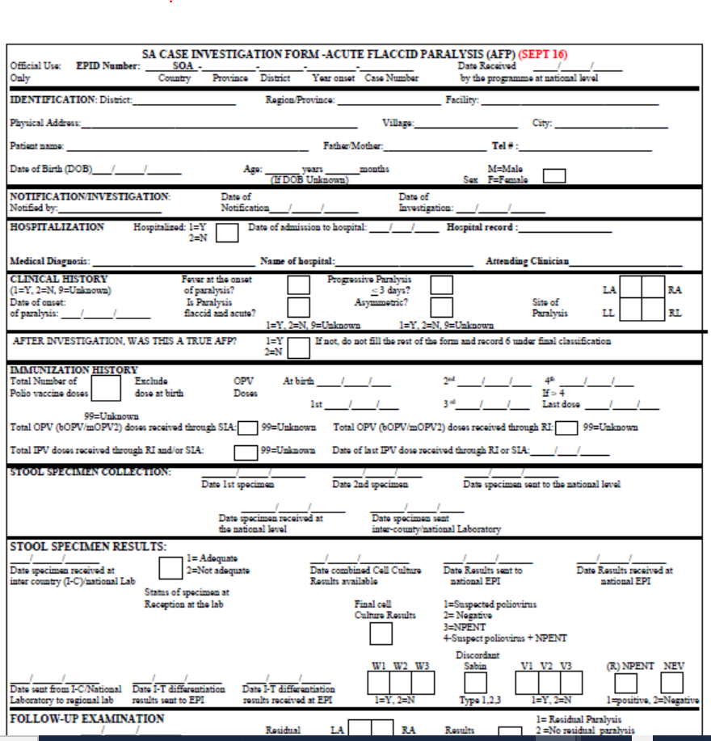
How is AFP Surveillance conducted?

Slide 15
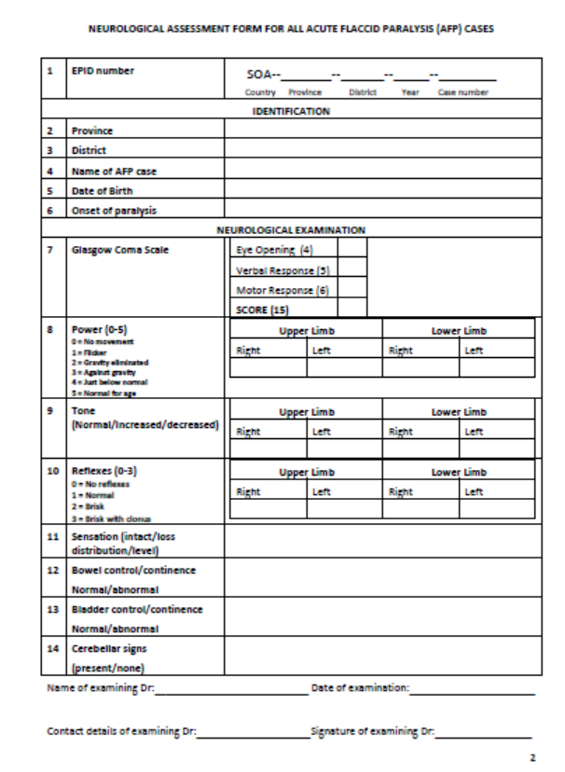
How is AFP Surveillance conducted?

Slide 16
Measles

Slide 17
Overview
Prior to 1963, 135 million cases and 7–8 million deaths were assumed to occur each year globally from measles.
The live attenuated measles vaccine was introduced in 1963.
In 2000, measles-related deaths accounted for 1–5% of under-five deaths worldwide.
Accelerated immunization activities during the year 2000-2018 had a major impact on global measles deaths having decreased by 73% from an estimated 536 000 in 2000* to 142 000 in 2018.

Slide 18
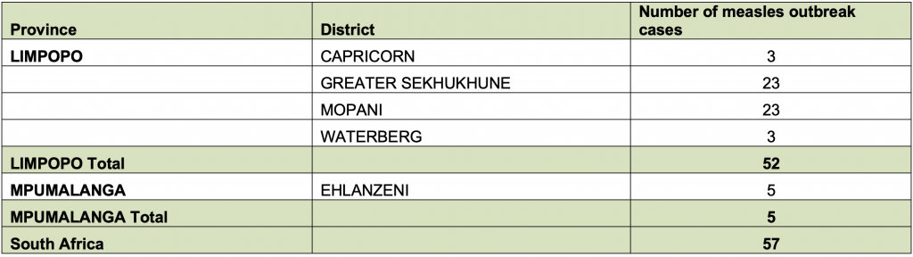
Overview – South Africa
01 September - 16 November 2022, 57 measles outbreak cases were reported in Limpopo & Mpumalanga province.
Sporadic laboratory-confirmed measles cases were reported in Northern Cape, Free State, Gauteng, Free State, and the Western Cape Provinces.
Table 1, Distribution of measles cases among districts, 17 Nov 2022 - NICD

Slide 19
Overview – South Africa
Greater Sekhukhune district – 6 months to 24 years
Mopani district - 2 to 42 years
Ehlanzeni district in Mpumalanga province - 18 months and 10 years
Incidence is high in age groups 13 months-4 years and 5-9 years
No deaths or other complications reported.
Vaccination of laboratory confirmed measles case contacts is necessary, as per the National Measles Surveillance Guidelines.
To prevent the spread of the measles virus in other provinces.

Slide 20
Measles - virus
Enveloped ssRNA virus
Only one serotype therefore prevented by single monovalent vaccine
Genotype data allows us to track virus movement

Slide 21
Measles - Transmission
Mode of transmission
Airborne
Droplet spread
Contact nasal/throat secretions
Incubation period
7-18 days (mean 10d) exp-onset fever
Generally 14 days to rash
Infectious Period
4 days before and 3-4 days after onset of rash

Slide 22
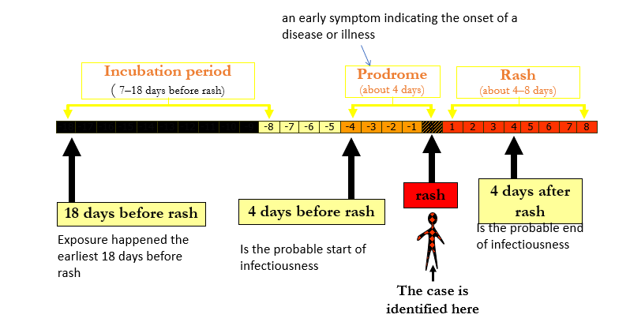
Figure 1, Measles clinical course – Julia Leballo

Slide 23
Measles – Clinical Features
Signs & symptoms
  high fever
  Cough
  running nose
  conjunctivitis
  Rash - starts at the head and spreads to the rest of the body.
  Koplik spots (white spots) - in mouth, relatively hard to identify.
With a weak immune system due to HIV, cancer, malnutrition (insufficient vitamin A) or other diseases - often do not develop a rash and at risk of severe measles.
Complications
  Pneumonia
  Blindness
  Severe diarrhoea
  Encephalitis
  Death

Slide 24
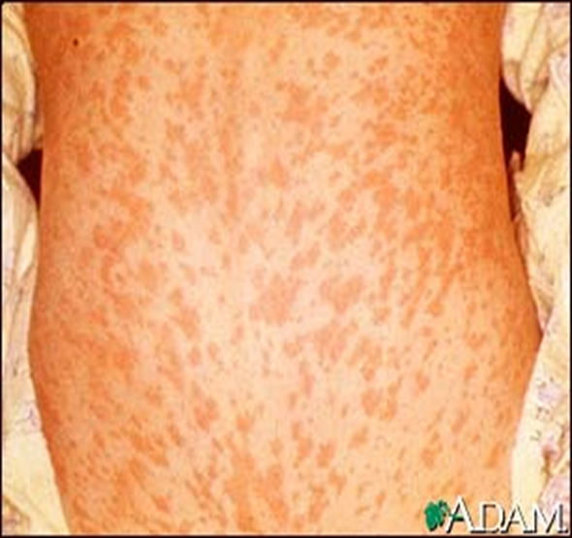
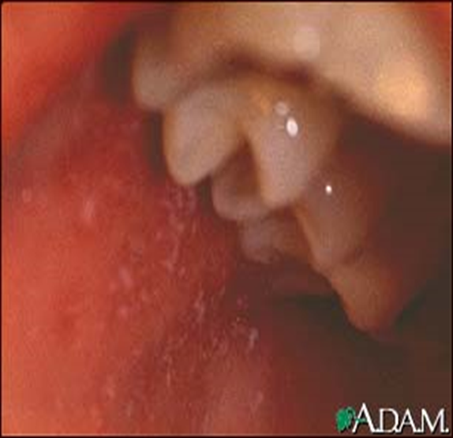

Slide 25
Measles – Case definition
Suspected Measles Case (SMC):
Any person with:
  Fever AND
  Maculopapular rash (non-vesicular) AND
  (any one of the 3 Cs) cough, coryza (runny nose) or conjunctivitis (red eyes) OR
  Any person in whom a clinician suspects measles infection
Confirmed Measles Case (CMC):
  A suspected case with laboratory confirmation (positive IgM antibody) or epidemiological link to confirmed cases in a measles outbreak

Slide 26
Measles - management
Vitamin A – 200 000U x 2 doses (>12 months)
Antibiotics
  All measles cases - No
  Only admissions - Usually
  Measles-related pneumonia - Yes
Oxygen
Fluids
Good nutrition

Slide 27
Measles Surveillance - Surveillance performance indicators
Field performance indicators
Lab performance indicators
  2 cases per 100 000 population
  E.g., if population = 3 million therefore total cases to be surveyed per year = 60
  At least 80% of suspected cases to be investigated with blood specimen
  80% of districts to report & investigate at least 1 case
  Monthly e-mailing of database to WHO
80% of tests results within 7 days
Monthly e-mailing of database to WHO

Slide 28
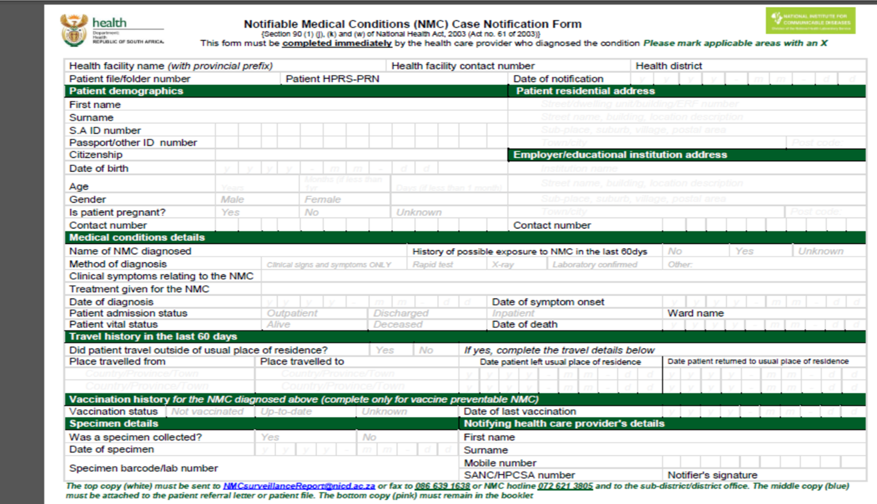

Slide 29
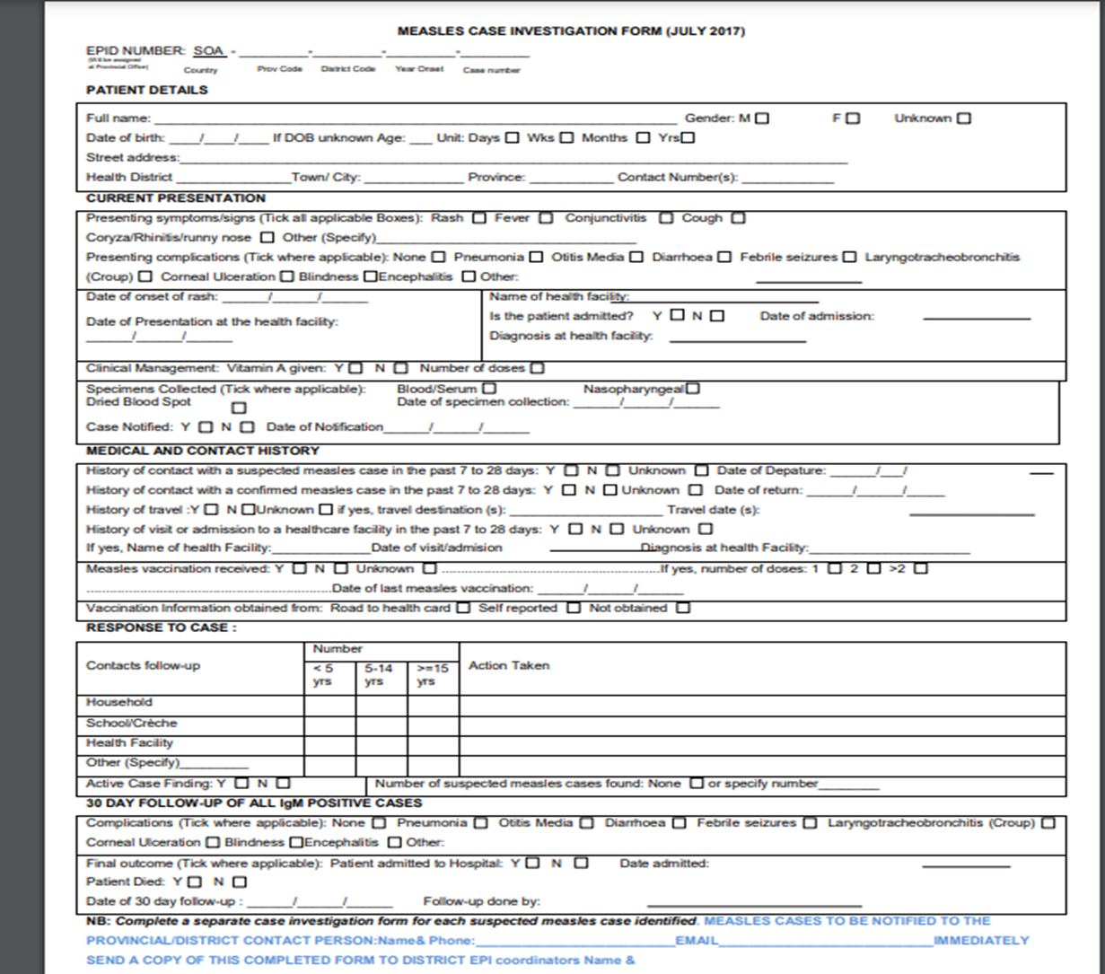

Slide 30
Measles elimination strategy
Achieve and sustain very high coverage (≥ 95%) with two doses of measles and at least one dose of rubella vaccine through high-quality routine immunization services.
Provide measles vaccination opportunities, including supplementary immunization activities (SIAs), to all population groups at risk for and susceptible to measles.
Improve quality of measles surveillance as well as epidemiological and virological investigation of measles outbreak.
Monitor measles vaccine coverage
Improve case management, including Vit A supplementation and treatment of complications

Slide 31
Ngiyabonga

